Slide 1
Hotwired Event Streams
Roy Williams
IVOA Victoria May 2010

Slide 2
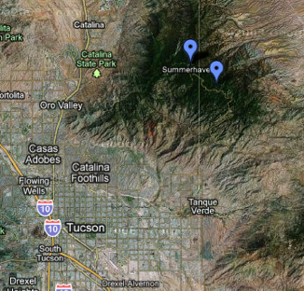
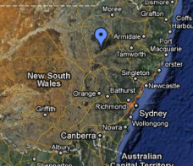
Three CRTS streams Catalina Realtime Transient Survey
Dozens of events per night except full moon
CRTS Circulars a few hours later with classification

Slide 3
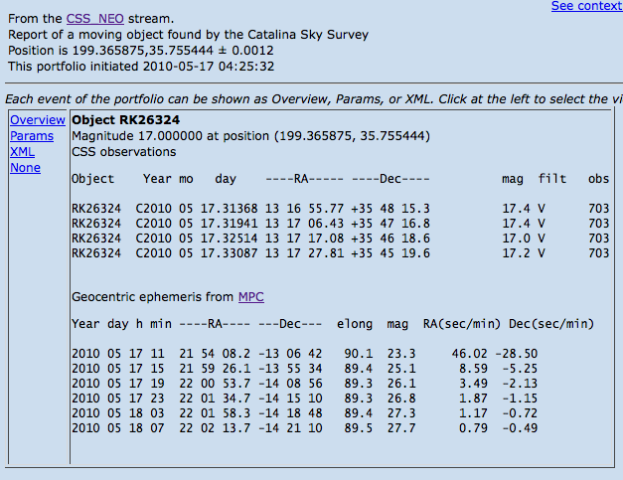
Killer Asteroids from CSS
Each is a multiline/CDATA string. <Param> element needs <Value> element as alternate to the attribute!
observed
predicted

Slide 4
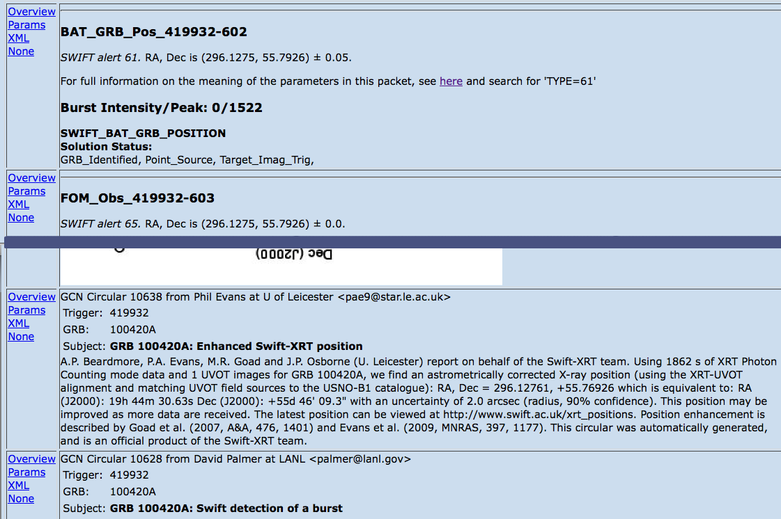
SWIFT Circulars
notices
circulars
Scraping emails → VOEvent

Slide 5
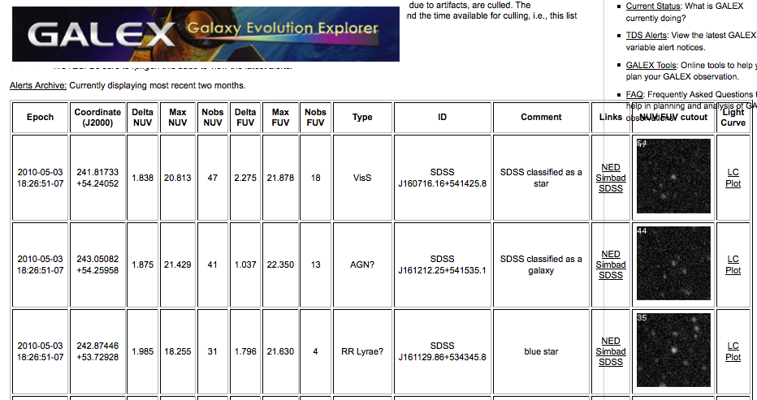
HTML scraping built now

Slide 6
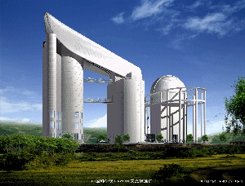
LAMOST China Supernova factory

Slide 7
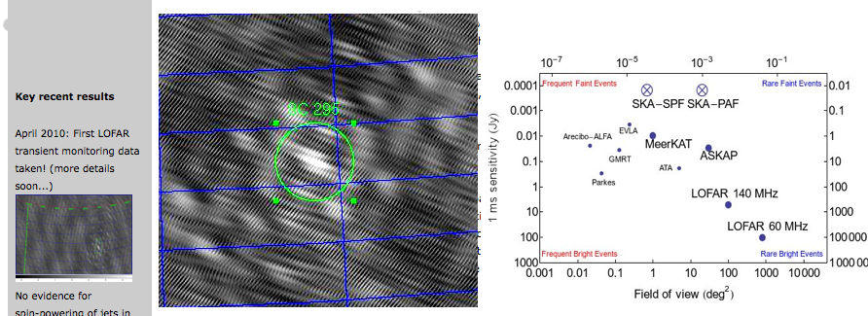
LOFAR transients
R. Fender
Event wants table of flux vs frequency band
→ Need table format in VOEvent2!

Slide 8
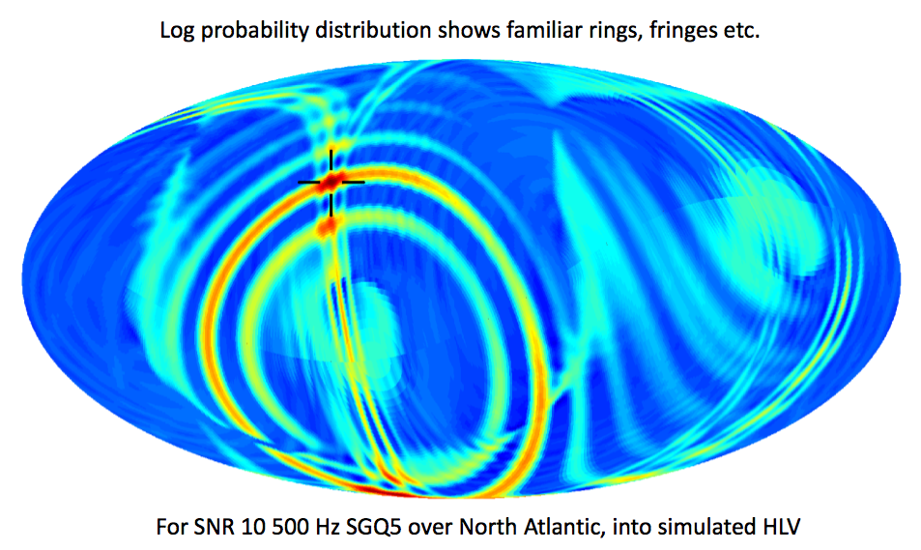
LIGO event localization
Searle, Sutton, Tinto, arXiv:0809.2809v1
Event defined as table of tiles 0.5x0.5 degree, with probability.
→ VOEvent2 needs <Table> element

Slide 9
LSST firehose?
100,000
designated community
10,000
number of events per night
1,000
designated community
100
10
designated community
1
0.5m
1m
2m
8m
required follow-up telescope

Slide 10
VOEvent Transport in the pre-dawn of LSST
Roy Williams
IVOA Victoria May 2010

Slide 11
VOEventNet
Near real time messaging
Distributed
Tier1 and Tier2 nodes
= server and end-point
= mailman and customer

Slide 12
Global partners
SWIFT
Fermi
AllenTA LOFAR Galex pi of the Sky
GCN
dc3.com customers
MOA
eStar Exeter
VERITAS
Caltech
Palomar P60
LCOGT
California
skyalert.org
LSST
NOAO
Tucson
OGLE III
Poland
Pairitel
lsst-tes.tuc.noao.edu
CSS_NEO
UAriz
Event Author
Publisher/Relay
Repository
Followup Subscriber
CTIO/KPNO
DES
Catalina RTS
UAriz

Slide 13
Tier1 and Tier2 Event Nodes Evolving in IVOA
Tier1
Brokering
Registry:
Tier2
Stream definitions
Event Servers
Authoring
Distribution
Jabber/XMPP
or raw socket
Tier1:
Immediate Forwarding, Reliable?, Topology?
Tier2:
Subscription, Repository, Query, Portfolio, Registry, Machine Learning, Substreams etc etc

Slide 14
Technologies
Technologies
Java Messaging service
XMPP/Jabber
TCP vanilla
HTTP poll

Slide 15
Talking points:
Fast delivery
meaning ... ms, s, min, hour, day ....?
Selection
nobody wants the whole firehose
Reliability
every Tier2 must get all events?
Private events
only for my colleagues
Compliance
who checks and what happens
Repository
IVORN → event, completeness, IVOA role
Integrity
digital signatures
Technologies:
XMPP/Jabber
TCP vanilla
HTTP poll
Java Messaging service
what else?

Slide 16
Standards EventStream, VOEvent2, SLiCAP
Roy Williams
IVOA Victoria May 2010

Slide 17
Event Stream
Defines semantics/metadata of event parameters
Stream: “x is a radio flux”
prepared in advance by stream author
goes in VO registry
Event: “x = 2.34”
real time and automated
Question:
Is “sample event” sufficient to define stream?

Slide 18
Extending VOEvent for more complex data
http://www.ivoa.net/Documents/Notes/VOEventTables/
Roy Williams and Matthew J. Graham
<Table name="TMO Observational Summary">
<Description>Loosely based on ATEL 2289, observations of asteroids from Arecibo </Description>
<Field name="UT Date">
<Description>Observation Date</Description></Field>
<Field name="Phase" unit="deg" dataType="float"/>
<Field name="R_mag" ucd="phot.mag;em.opt.R" dataType="float"/>
<Field name="Observers"/>
<Data>
<TR><TD>Oct 10</TD> <TD>64.2</TD> <TD>15.37</TD> <TD>Barajas</TD></TR>
<TR><TD>Oct 11</TD> <TD>64.6</TD> <TD>15.28</TD> <TD>Foster</TD></TR>
<TR><TD>Oct 17</TD> <TD>67.7</TD> <TD>14.79</TD> <TD>Somers, Hicks</TD></TR>
<TR><TD>Oct 22</TD> <TD>72.2</TD> <TD>14.10</TD> <TD>McAuley, Shitanishi</TD></TR>
</Data>
</Table>
<Reference
uri="http://.../data/h.fits"
type="http://.../data-models/#h-filter-image/>

Slide 19
String-valued Params
Attribute
<Param name=“fruit” value=“apple”/>
Cannot represent all strings
Element needed
<Param name=“fruit”><Value>apple</Value></Param>
Allows multiline strings, CDATA, Unicode, etc

Slide 20
Simple Light Curve Access Protocol SLiCAP
Interop of LC providers and consumers
federated LC from multiple providers
mining software using remote LC archive
In the S*AP model
request by position
response is table of matches
each with a URL for actual light curve
Representing light curve
STC in VOTable http://www.ivoa.net/Documents/latest/VOTableSTC.html
simpleTimeSeries http://dotastro.org/simpletimeseries/

