Slide 1
The NVO Data Discovery Portal
Tom McGlynn
NASA/GSFC

Slide 2
Purpose of the Portal
Get to science right away without worrying about protocols and such.
Quick and convenient
Integrate Web and CLI analysis

Slide 3
Issues
Complexity of the VO
Different kinds of questions users have
Our solution:
Make the portal a suite of interacting services rather than a single monolithic task.

Slide 4
What’s New
Subsume the portal into the NVO home page
Emphasize help functionality
Scrub for clarity and consistency
Establish automated regression tests
Released: February

Slide 5
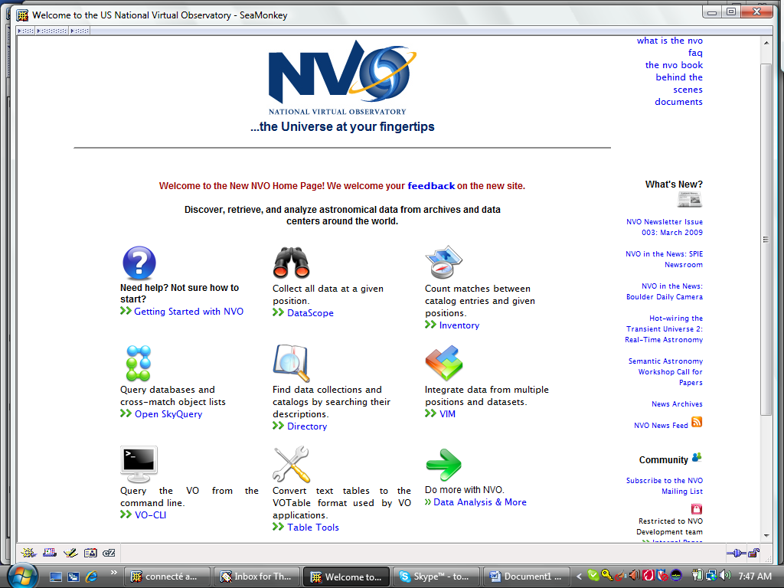
NVO Home page
Subsume the portal into the NVO Home page

Slide 6
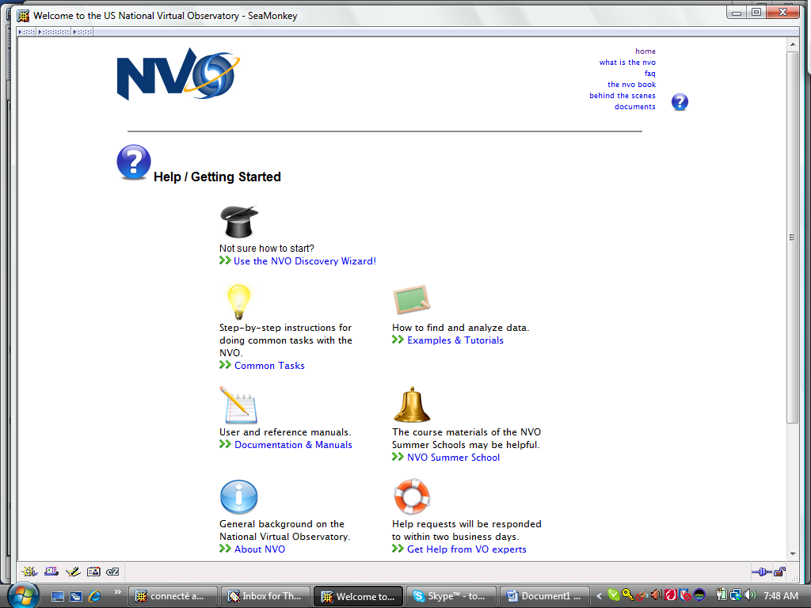
Service guides
Emphasize Help

Slide 7
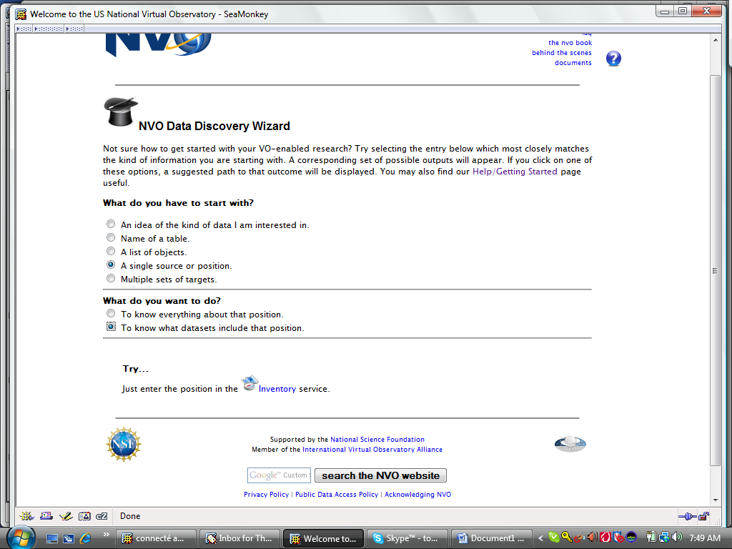
Interactive help

Slide 8
Clarity and consistency
NVO is many collaborating organizations
Common look and feel
  Title bars, descriptions
  Icons
Simpler vocabulary
  TLA elimination
  Registry -> Directory
External reviews

Slide 9
Regression testing
Hourly ‘It’s up’ tests in NVO monitor tool.
More sophisticated Selenium tests developed and run each day
  Will replace simpler tests in automated procedures
  Suggested at Baltimore IVOA

