Slide 1
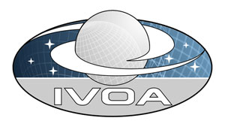
Mapping Data Models to VOTable
The specification
Published version
https://volute.googlecode.com/svn/trunk/projects/dm/vo-dml/doc/MappingDMtoVOTable-v1.0-20150427.pdf
Last working version at:
https://volute.googlecode.com/svn/trunk/projects/dm/vo-dml/doc/MappingDMtoVOTable-v1.0-201506xx.docx

Slide 2
Current Document Outline
Introduction
Use Cases
The need for a mapping language
Mapping with the <VODML> element
General information about this spec
Examples: Mapping VO-DML ⇨ VOTable
Patterns for annotating VOTable [Normative]
Notable absences
Serializing to other file formats
References
Appendix A: The VODML annotation element
Appendix B: Growing complexity: naïve, advanced and guru clients
Appendix C: Regular expressions for mapping
Appendix D: Frequently Asked Questions
Please read it!

Slide 3
Discussion items
Mapping = identifying instances in (ad hoc) serializations
Using VO-DML
Use of VOTable meta-data elements
No change apart from <VODML>
Use of GROUPs
Structure VODML element
Mapping expression syntax
Use of ivoa:quantity types
Use of vo-dml: vodmlrefs
vodml-ref prefix, explicitly declared or name ?
Use of identifiers
Mapping references
vo-dml:GROUPref, vo-dml:ORMReference, vo-dml:RemoteReference
Mapping to TAP_SCHEMA, FITS

Slide 4
1. Mapping = identifying instances in (ad hoc) serializations
The doc discusses a formalize way to map VO-DML models to tables.
It defines this as:
Identifying instances of model types inside tabular data structures
Using VO-DML means:
We have formal expressions for the data model elements and can use these in the mapping description.

Slide 5
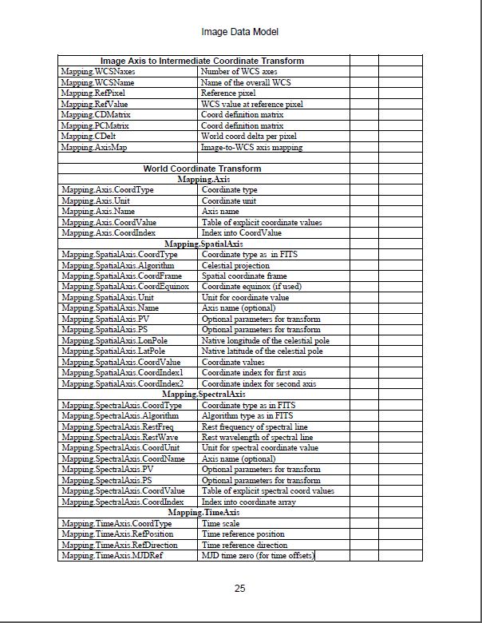
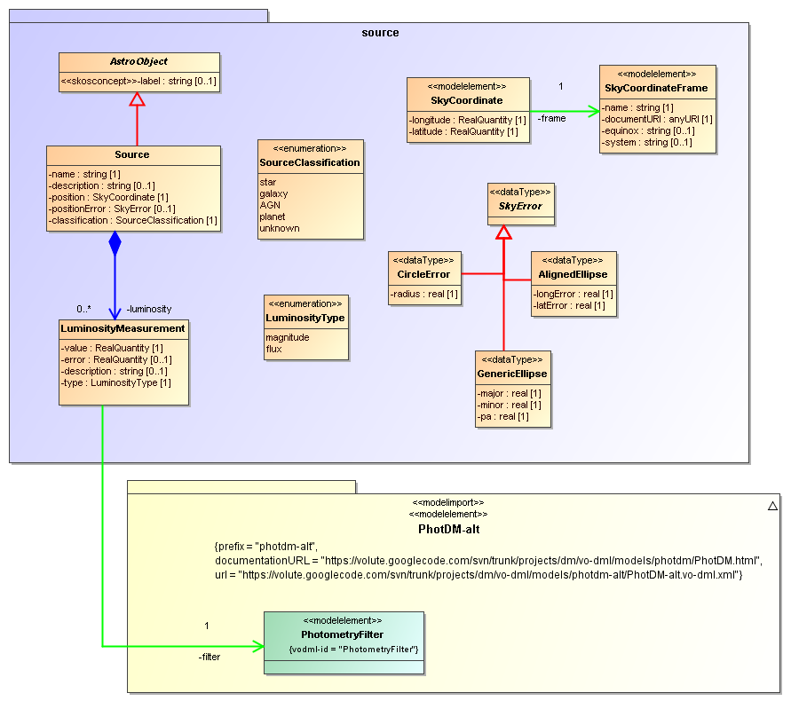
Reminder
Data Models, when properly reflecting the real world, are not lists
They are graphs.

Slide 6
Especially
For information integration the best modelling approach is to try to represent the world as it is.
⇨ Domain Model
For we have no idea how someone else has represented the world for their application
But if we assume they have based it on a conceptual model of the world (at least implicitly) there is a chance to map between them.

Slide 7
Pragmatism
We live in the same world, even though we want to do different things with(in) it.
Let’s model that world as directly as possible.
Main issue then is level of detail.

Slide 8
The world is complex, whether you like it or not

Slide 9
2. Using VO-DML
Standard, formal modelling language (aka meta-model)
Explicit modelling concepts promote understanding
E.g. object types vs value types
Restrictions facilitate making modelling choices
Standardization supports reuse of models by models
Machine readability supports validation, implementation
E.g. XSLT scripts
Allows standard (faithful) serialization
E.g. XML schema, HTML documentation, Java classes, TAP_SCHEMAs
See VO-URP

Slide 10
Standardizing mapping
Standardization by using meta-model mapping
VO-DML modelling concepts represented by VOTable metadata elements!
Mapping document at volute (for now)
Last announced version: https://volute.googlecode.com/svn/trunk/projects/dm/vo-dml/doc/MappingDMtoVOTable-v1.0-20150427.docx
Working copy: https://volute.googlecode.com/svn/trunk/projects/dm/vo-dml/doc/MappingDMtoVOTable-v1.0-201506xx.docx

Slide 11
Use of VOTable meta-data elements
No change required to VOTable schema apart from <VODML>
discussion on Banff
replace use of @utype by a new element
only on : GROUP, PARAM(ref), FIELDref
Use of GROUPs
data models group (more) primitive elements into (structured) types
That’s what GROUPs are for
Often elements themselves are structured:
GROUP hierarchies

Slide 12
4. <VODML> element structure
<xs:complexType name="VODMLAnnotation">
<xs:sequence>
<xs:element name="TYPE" type="VODMLReference“
minOccurs="0" maxOccurs="unbounded“/>
<xs:element name="ROLE" type="VODMLReference“
minOccurs="0“/>
<xs:element name="OPTIONMAPPING"
type="VODMLOptionMapping" minOccurs="0"
maxOccurs="unbounded“/>
</xs:sequence>
</xs:complexType>

Slide 13
VODML contents
Order: TYPE-ROLE or ROLE-TYPE?
TYPE multiplicity
0..1 : “casting” of ROLE to actual type
0..* : list ALL¹ types compatible with the ROLE, i.e. actual type and all super types. (for "naïve clients")
¹ Maybe only “first” super type in separate models.

Slide 14
OPTIONMAPPING
Enumeration or SKOSConcept define valid values for attribute
map to VOTabe’s VALUES/OPTION pattern
(Legacy) serialization may have chosen own values
Do we need to allow translation?
How if no OPTION defined on FIELD or PARAM?
Is OPTIONMAPPING on VODML best way to model?
disadvantage: repeat of OPTION values required
advantage: multiple annotation possible
alt: add VODML to OPTION itself, with only the vodml-ref to the literal

Slide 15
E.g. value ⇨ enum literal (from skyserver.sdss.org/PhotoObjAll.type)
<VODML>
<ROLE>src:Source.classification</ROLE>
<OPTIONMAPPING>
<VALUE>6</VALUE>
<LITERAL>src:source.SourceClassification.star</LITERAL> </OPTIONMAPPING>
<OPTIONMAPPING>
<VALUE>3</VALUE>
<LITERAL>src:source.SourceClassification.galaxy</LITERAL> </OPTIONMAPPING>
<OPTIONMAPPING>
<VALUE>0</VALUE>
<LITERAL>src:source.SourceClassification.unknown</LITERAL> </OPTIONMAPPING>
</VODML>

Slide 16
5: Mapping expression syntax
Chapter 7 uses somewhat abstract, but formal syntax to define mapping pattern
{GROUP G | G ⊂ RESOURCE & G ⊄ TABLE & G ⊄ GROUP[VODML] & G/VODML/TYPE ⇒ ObjectType & G/VODML/ROLE = NULL}
==
a GROUP (G) with a VODML/TYPE identifying an ObjectType and no VODML/ROLE, contained in a RESOURCE, not contained in a TABLE, not contained in a GROUP with a VODML element.
Formally define all patterns that a client should understand, that a provider should use to express meaning.
Aims to be comprehensive and rigorous, scope open for discussion

Slide 17
6. Use of ivoa: model https://volute.googlecode.com/svn/trunk/projects/dm/vo-dml/models/ivoa/IVOA.vo-dml.xml
Defines reusable primitive types
conceptual: ivoa:string, ivoa:integer, ivoa:real
not: float vs double, int vs long vs short
Defines reusable quantity types
ivoa:quantity.RealQuantity
with ucd, unit etc
can be mapped directly to FIELDref
ucd/unit implicitly mapped to FIELD’s attributes

Slide 18
Issues
sufficient number of predefined types?
too many?
do we need 'ucd' attribute in quantity types?
can we support other (SKOS) vocabularies

Slide 19
7: Use of vo-dml: serialization model https://volute.googlecode.com/svn/trunk/projects/dm/vo-dml/models/vo-dml/VO-DML.vo-dml.xml
Some serialization concepts must be available for annotations
concepts not required in model definition
<objectType>vo-dm:Model : defines how/which models are used in serialization
<dataType>vo-dml:Identifier : how to define explicit identifiers
<objectType>vo:dml:Reference: how to serialize references
<objectType>vo-dml:ObjectTypeInstance
implicit super type of all serialized ObjectType instances
defines roles useful for serializations
<attribute>vo-dml:ObjectTypeInstance.ID [vo-dml:Identifier]
<reference>vo-dml:ObjectTypeInstance.container [vo-dml:ObjectTypeInstance]

Slide 20
Issues
Do we want this model?
how formal do we want to be
model introduced to preserve invariant that each vodml-ref points to a concept in a model
Change name?
vo-dml-s (for serialization)
???

Slide 21
8: vodml-ref prefix, explicitly declared or Model.name ?
Long discussion came to conclusion not to allow flexible prefixes
use fixed name of Model
Advantage:
simpler for clients, can always look for same prefix
Disadvantage
need fixed list of names
independently created custom models may clash

Slide 22
9. Use of identifiers
VO-DML does not define explicit identifier role
Each objectType instance is implicitly assume to have an ID
No statement on structure
Objects can be identified in many different ways.
Primary key column(s) in table
xsd:ID or xsd:key in XML serialization
GROUP/@ID element in VOTable
ivo/identifier
URI
...
vo-dml:Identifier DataType
vo-dml:Identifier.field [0..*]
May be mapped to single column

Slide 23
10. Mapping Reference-s
Different types:
vo-dml:GROUPref : refer to singleton-GROUP
vo-dml:ORMReference : Object-relational mapping pattern
vo-dml:RemoteReference : reference to object in remote document
E.g. standard coordinate frames of photometry filters stored in some registry(?)
Acceptable remote serializations?

Slide 24
11. Mapping to TAP_SCHEMA, FITS
Wrap with VOTable
Need standardize way of expressing wrapped data structures
E.g. (from “VO-DML Mapper”)
TBD

Slide 25
Implementations, code, tools

Slide 26
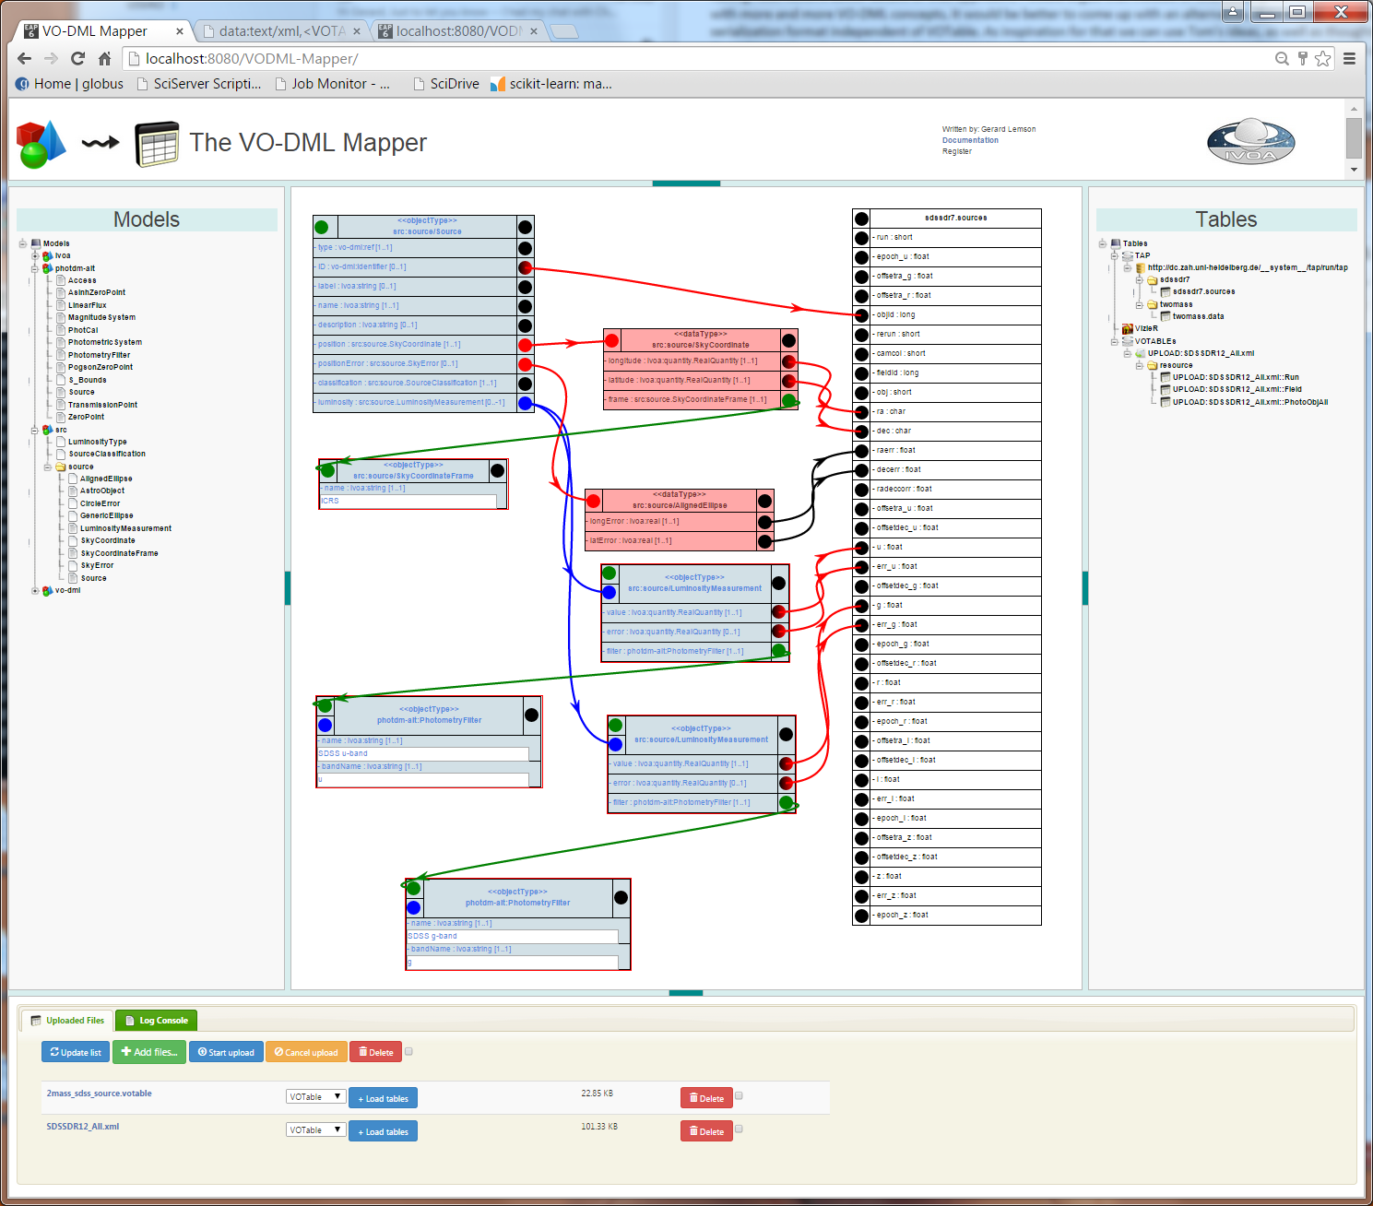

Slide 27
Guru clients
VOTable validator
Check
VOTable loader
generate in-memory instances of Java classes generated from VO-DML using XSLT
VOTable interpreter
Writes instances to XML document following VO-DML-I schema
Using Java classes generated from VO-DML, not necessary
All load VO-DML docs dynamically
Algorithms will be written up

Slide 28
that’s it

