Slide 1
GAVO
http://www.g-vo.org
Virtual Observatory magic in Germany since 2003
International Virtual Observatory Alliance
Credit: X-ray: NASA/CXC/CfA/R. Tullmann et al.; Optical: NASA/AURA/STScI

Slide 2
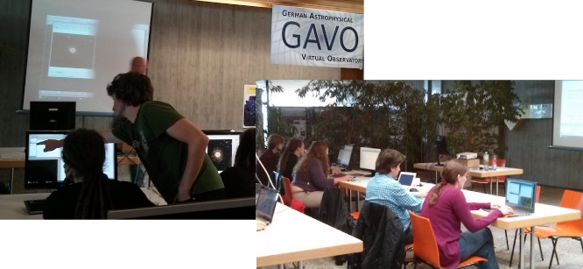
GAVO Data Services
Datacenters in Heidelberg and Potsdam:
http://dc.g-vo.org/, http://www.aip.de/
VO Software Development and Maintenance
DaCHS, SPLAT-VO, pyVO…
Developing VO Skills
Book your VO Day here!
Check out VO tutorials at http://dc.g-vo.org/VOTT
Data Publishing
we bring your data to the VO - or help you to do it yourself
Contact: gavo@ari.uni-heidelberg.de
International Virtual Observatory Alliance
Credit: X-ray: NASA/CXC/CfA/R. Tullmann et al.; Optical: NASA/AURA/STScI

