Slide 1


VO tools for development
VO tools are a way for previously disadvantaged universities in South Africa to participate in the stream of investment in Astronomy in the country with potential expansion across the African continent.
Partnership between SA³, OAD and UniZulu.
International Virtual Observatory Alliance

Slide 2
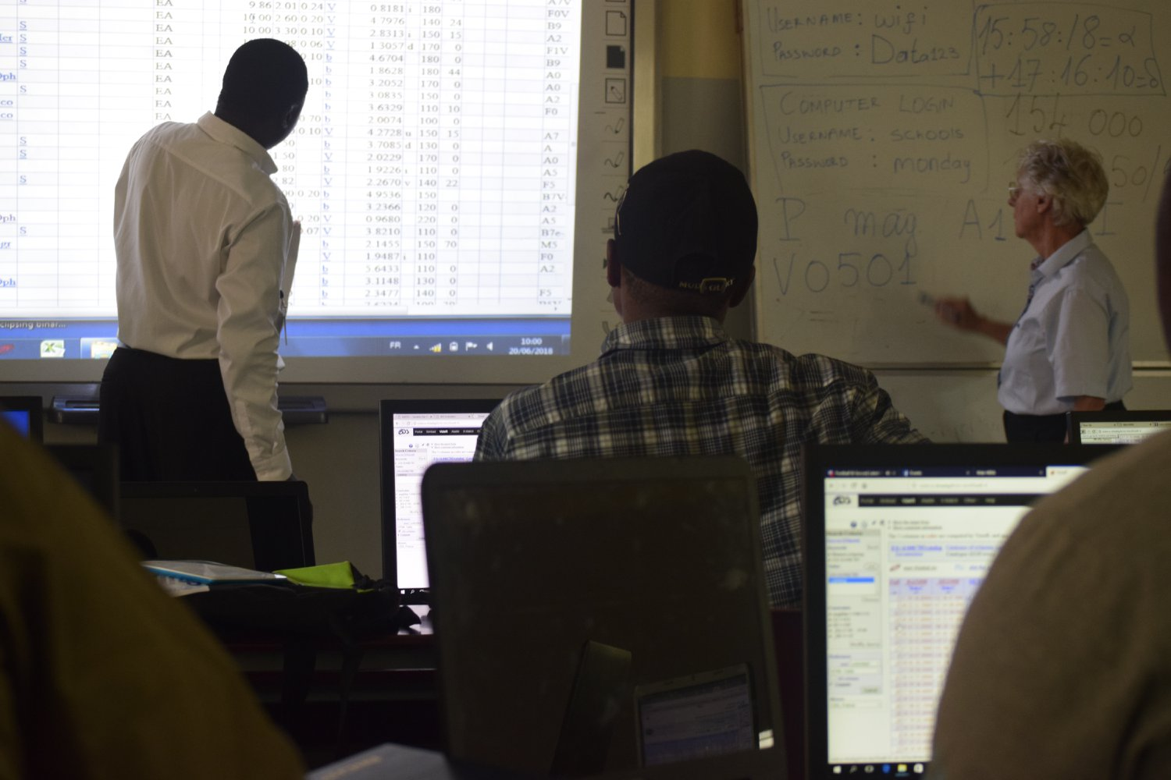
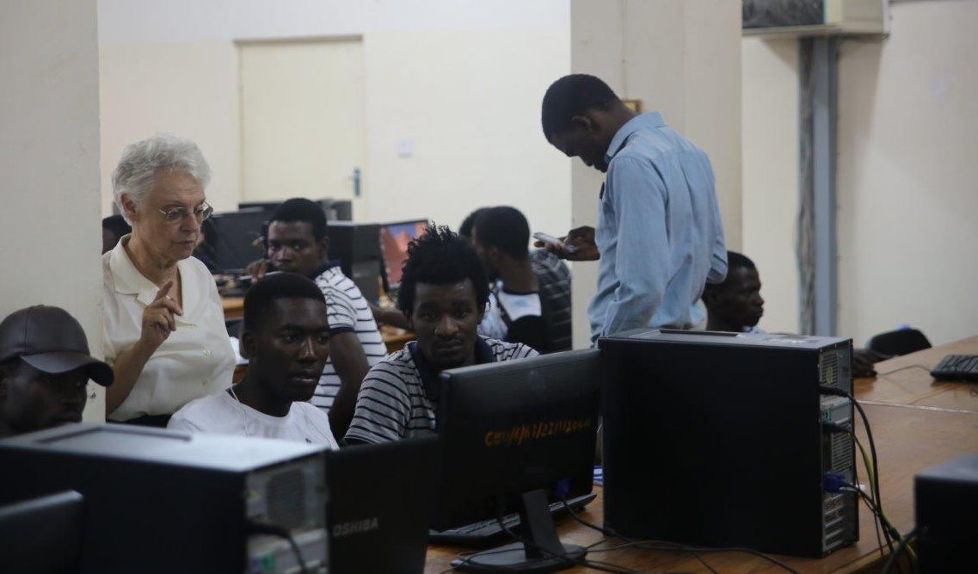
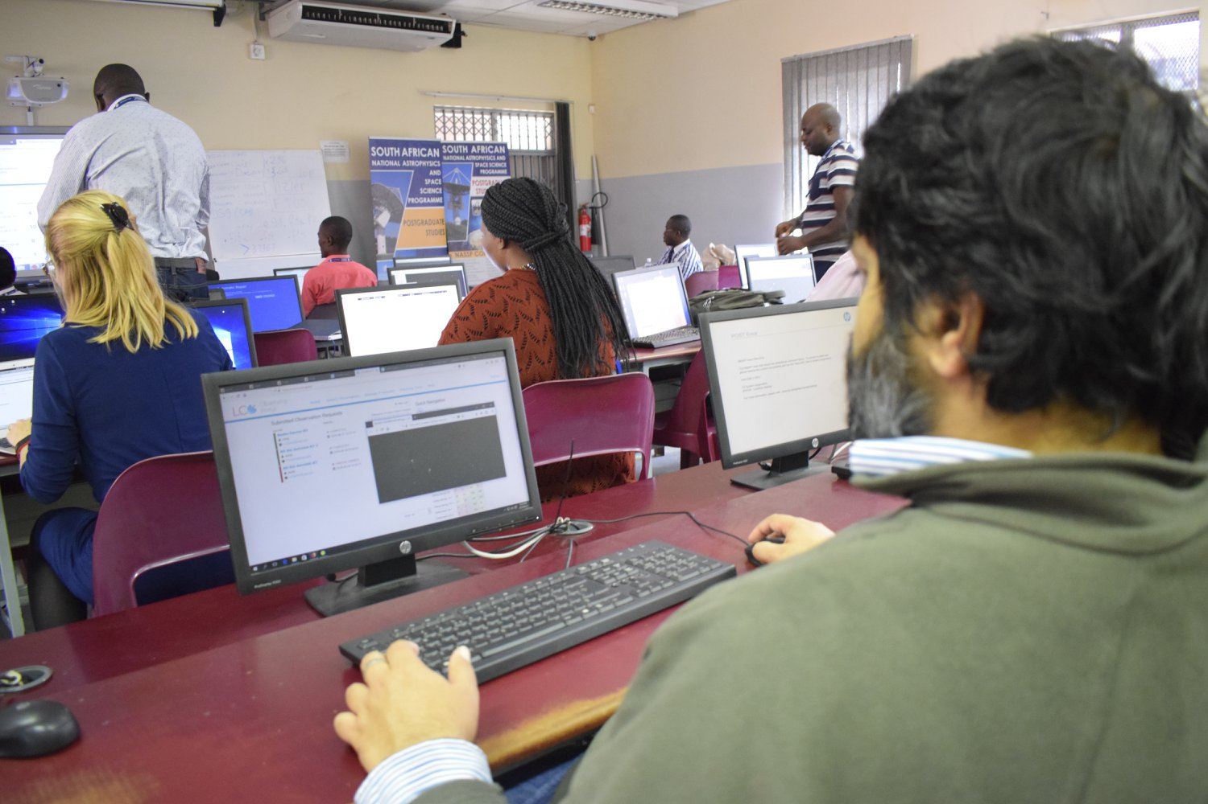
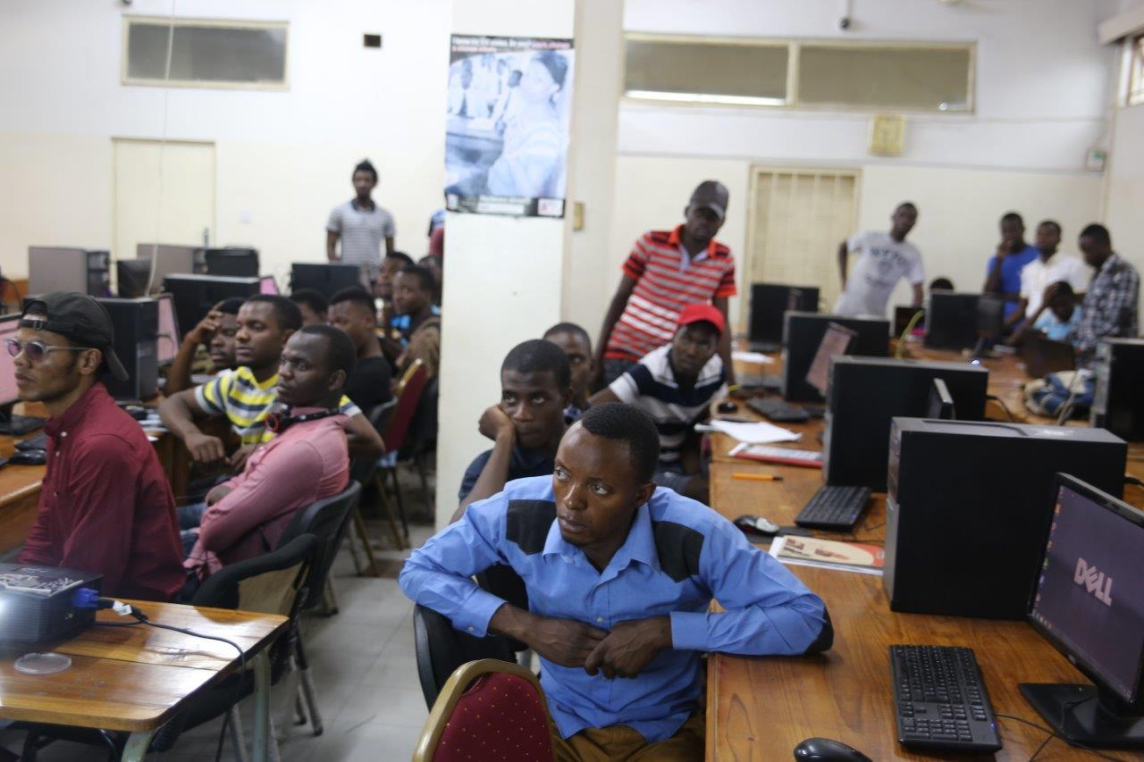
In the absence of costly infrastructure VO tools provide access to astronomy teaching and research
Astrolab @ Zululand University, South Africa - 2018
Astrolab @ Copperbelt University, Zambia - 2016
International Virtual Observatory Alliance

