Slide 1


European Virtual Observatory
Euro-VO
EURO-VO supports the utilization of VO tools and services by the scientific community, technology take-up and VO compliant resource provision, and building of the technical infrastructure.
International Virtual Observatory Alliance
Image credit: CDS

Slide 2
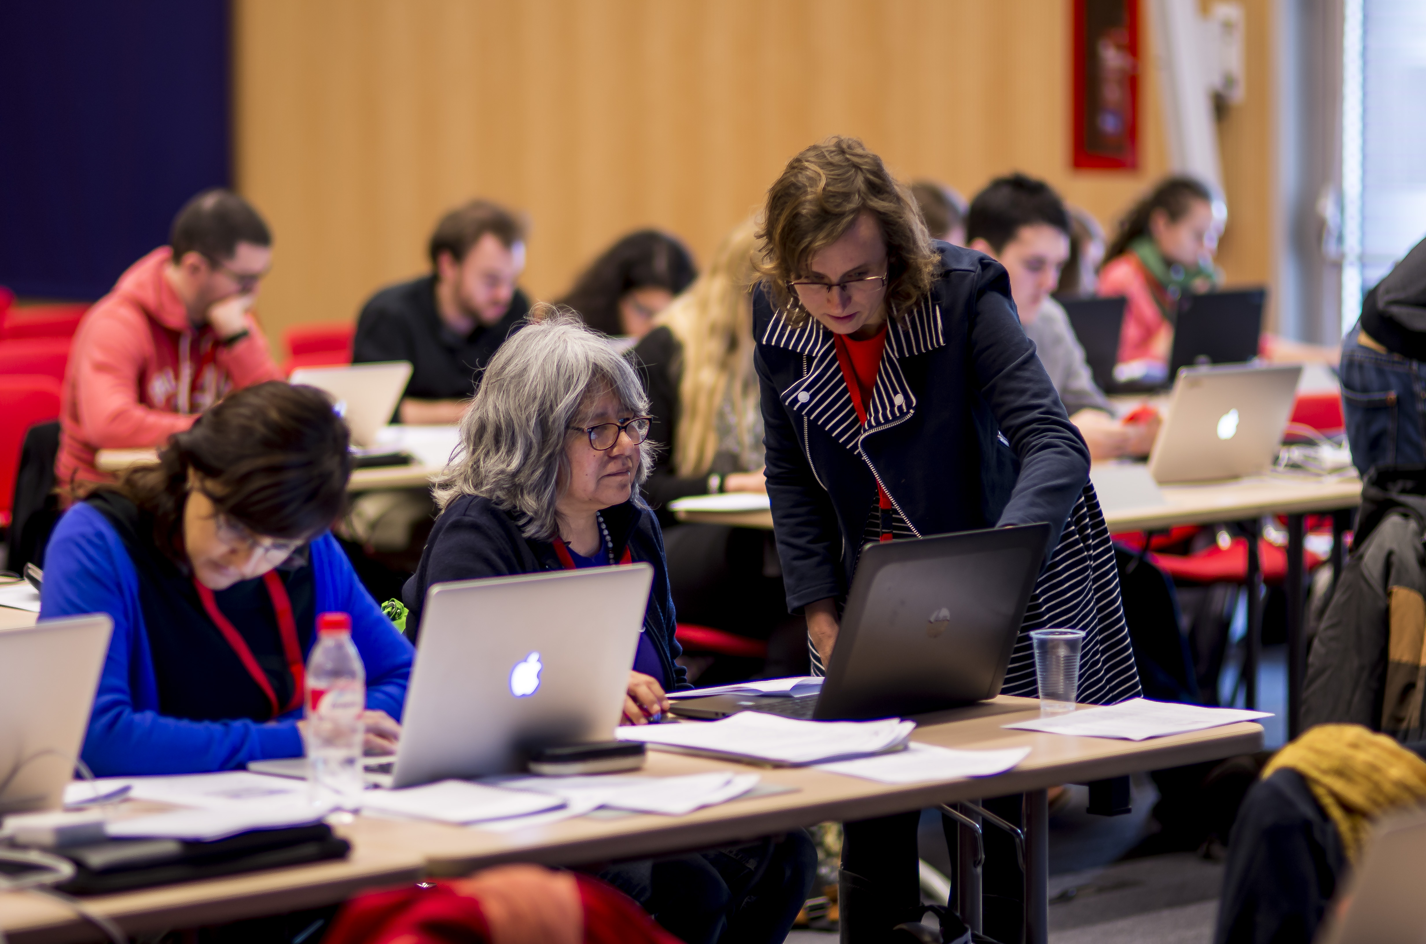
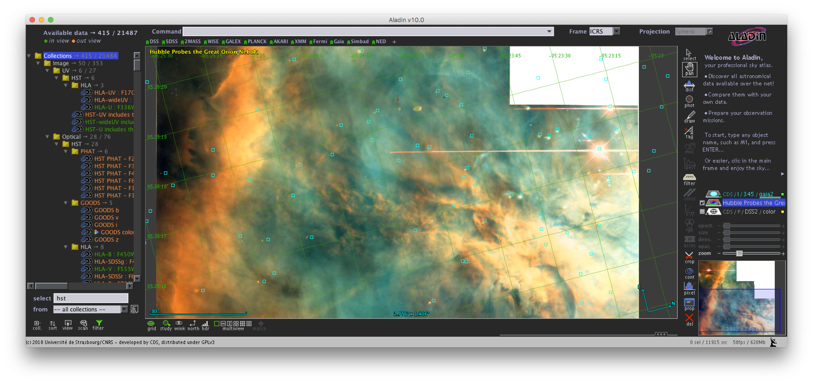
Virtual Observatory Schools and tutorials
Learn how to use VO tools for your own science!
Aladin, TOPCAT, VOSA, ADQL queries, 100s of VO services and much more.
Euro-VO Supports Data Providers:
Technical forums and coordination of requirement gathering and support of implementation
Support of technical work to build the VO:
Participation in IVOA to make the standards, and
building VO compliant tools for science
Supported via European projects:
Euro-VO has been supported by EC funded projects, the current one being the H2020 ASTERICS Cluster (WP4)
Data Provider Forums and Training Events
http://euro-vo.org
International Virtual Observatory Alliance
Image credit: CDS

