Slide 1
European Space Agency
ESAC Science Data Centre (ESDC)
Presenting, Promoting and Preserving Reliable Space Science Data
ESA, through the ESDC, has been a member of the IVOA since its creation and develops all its space science archives and services with the virtual observatory in mind.
International Virtual Observatory Alliance
Credit: ESA, Gaia, DPAC

Slide 2
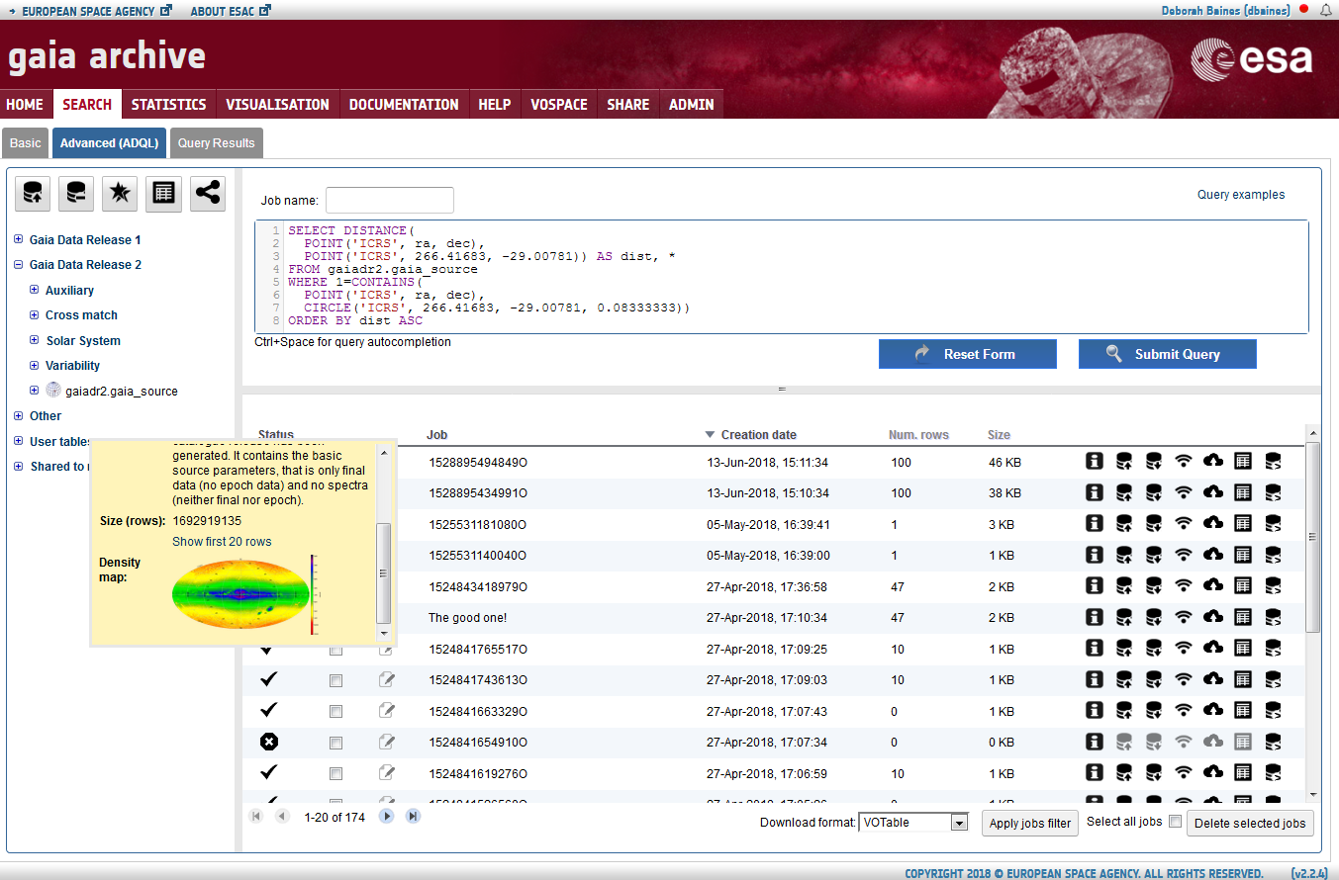
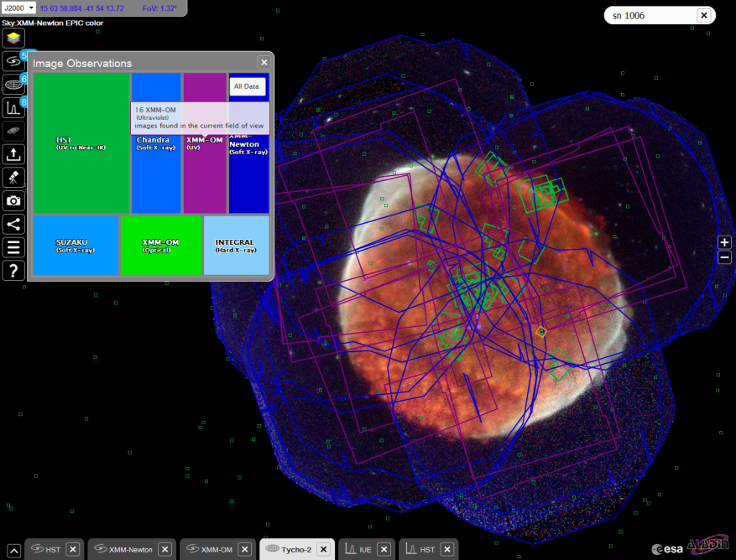
ESA Gaia Archive
Big VO success behind the scenes. Gaia Data Release 2: ~5000 users in 1st week performing advanced ADQL queries!
VO-built in: ADQL, TAP, UWS, DataLink, VOSpace, SAMP
http://archives.esac.esa.int/gaia
ESASky
Science-driven portal on top of the astronomy space science archives providing easy access to high-level data.
VO-built in: HiPS, SAMP, TAP, ObsCoreDM, MOC, VOTable
ESA TAP servers
ivo://esavo/
Access our archives + ESASky programmatically, e.g. using Topcat or astroquery:
http://astroquery.readthedocs.io/en/latest/utils/tap.html
http://sky.esa.int
International Virtual Observatory Alliance
Credit: ESA, Gaia, DPAC

