Slide 1
Teaching Resources of Virtual Observatory
Chenzhou Cui
Chinese Virtual Observatory
National Astronomical Observatories, Chinese Academy of Sciences

Slide 2
Contents
Virtual Observatory (VO) and IVOA
Resources for VO
IVOA website and wiki pages
Curriculums and Tutorials
Schools, Meetings and Workshops
Resources for Astroinformatics
A Special Epilogue

Slide 3
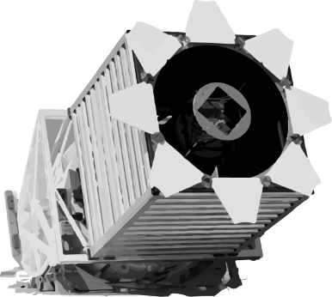
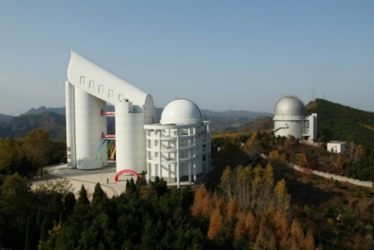
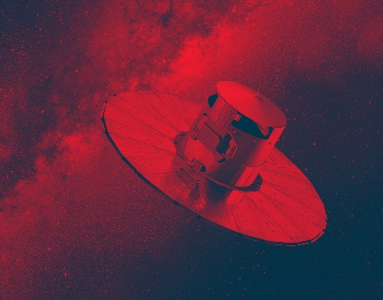
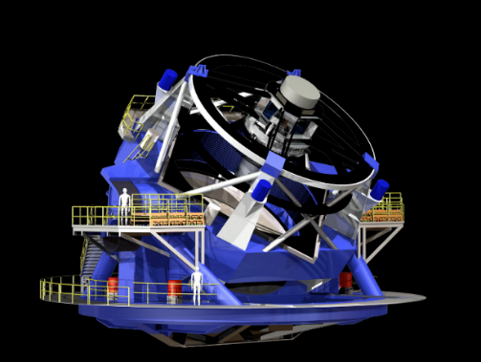
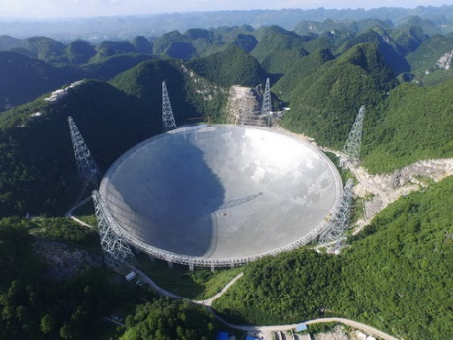
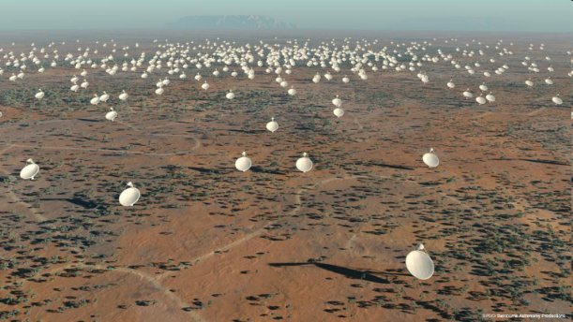
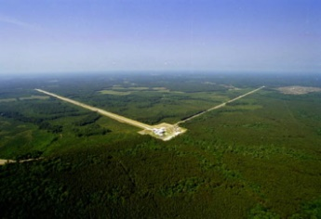
Astronomy: a Data-driven Science
TBs era
2dFGRS
SDSS
LAMOST
Gaia
PBs to EBs era
FAST/FASTA
SKA
Vera Rubin Observatory LSST
Euclid
…
Astronomy is entering an era of big data where the data sets are too large to download and analyze using users’ own facilities.

Slide 4
The Idea of Virtual Observatory
Vision of the VO:
The Web is transparent. The goal of the Virtual Observatory is to achieve the same feeling for astronomical data - that it is all available to explore in a single transparent system.
Astronomical datasets, tools, services should work seamlessly together.
The VO allows astronomers to interrogate multiple data centers in a seamless and transparent way, provides new powerful analysis and visualization tools within that system, and gives data centers a standard framework for publishing and delivering services using their data.
Like the World Wide Web, the VO is not a fixed system, but rather a way of doing things.
Virtual Observatory (VO) is a data-intensively online astronomical research and education environment, taking advantages of advanced information technologies to achieve seamless, global access to astronomical information.
-- my words

Slide 5
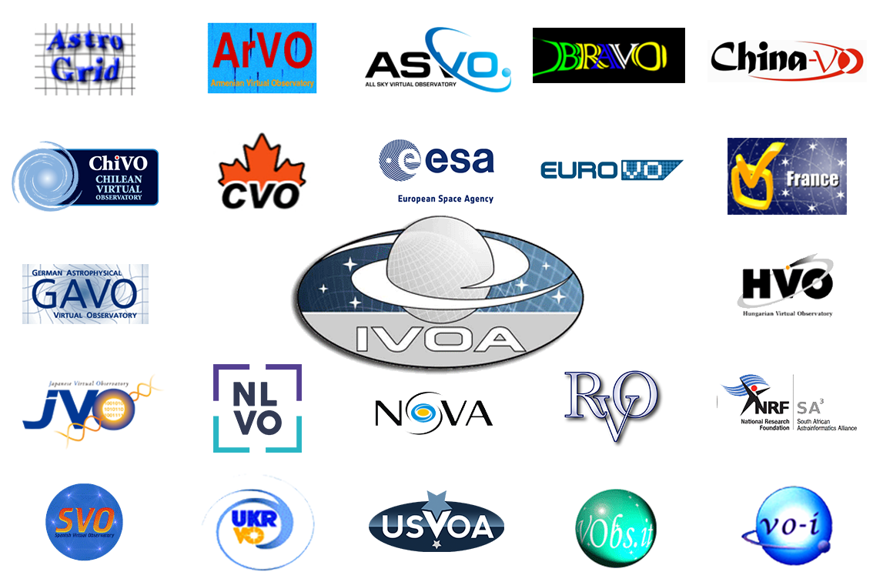
International Virtual Observatory Alliance
An organisation that debates and agrees the technical standards that are needed to make the VO possible, A focal point for VO aspirations, a framework for discussing and sharing VO ideas and technology.
Created in 2002
22 member VO projects
6 Working Groups, 8 Interest Groups
2 Interoperability meetings per year
May
Oct/Nov with ADASS
~ 46 interoperability standards

Slide 6
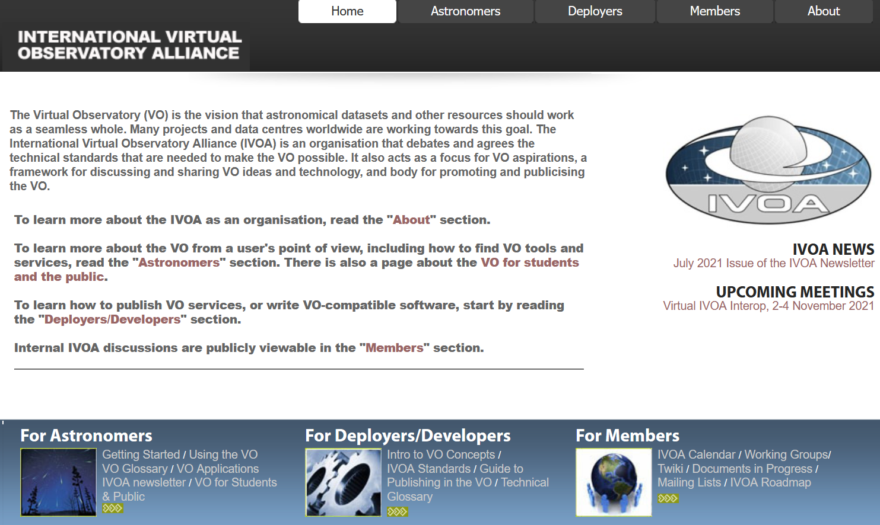
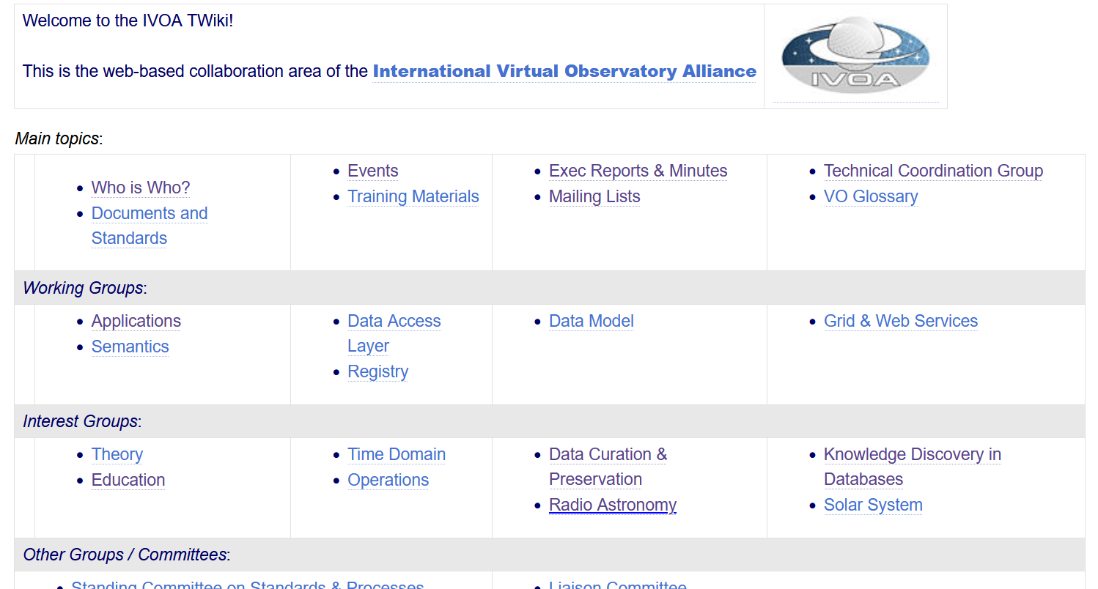
IVOA Website and Wiki Pages
https://www.ivoa.net/

Slide 7
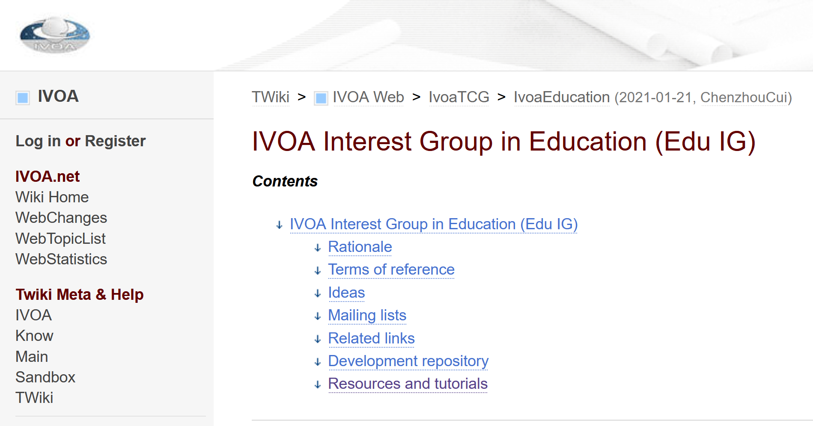
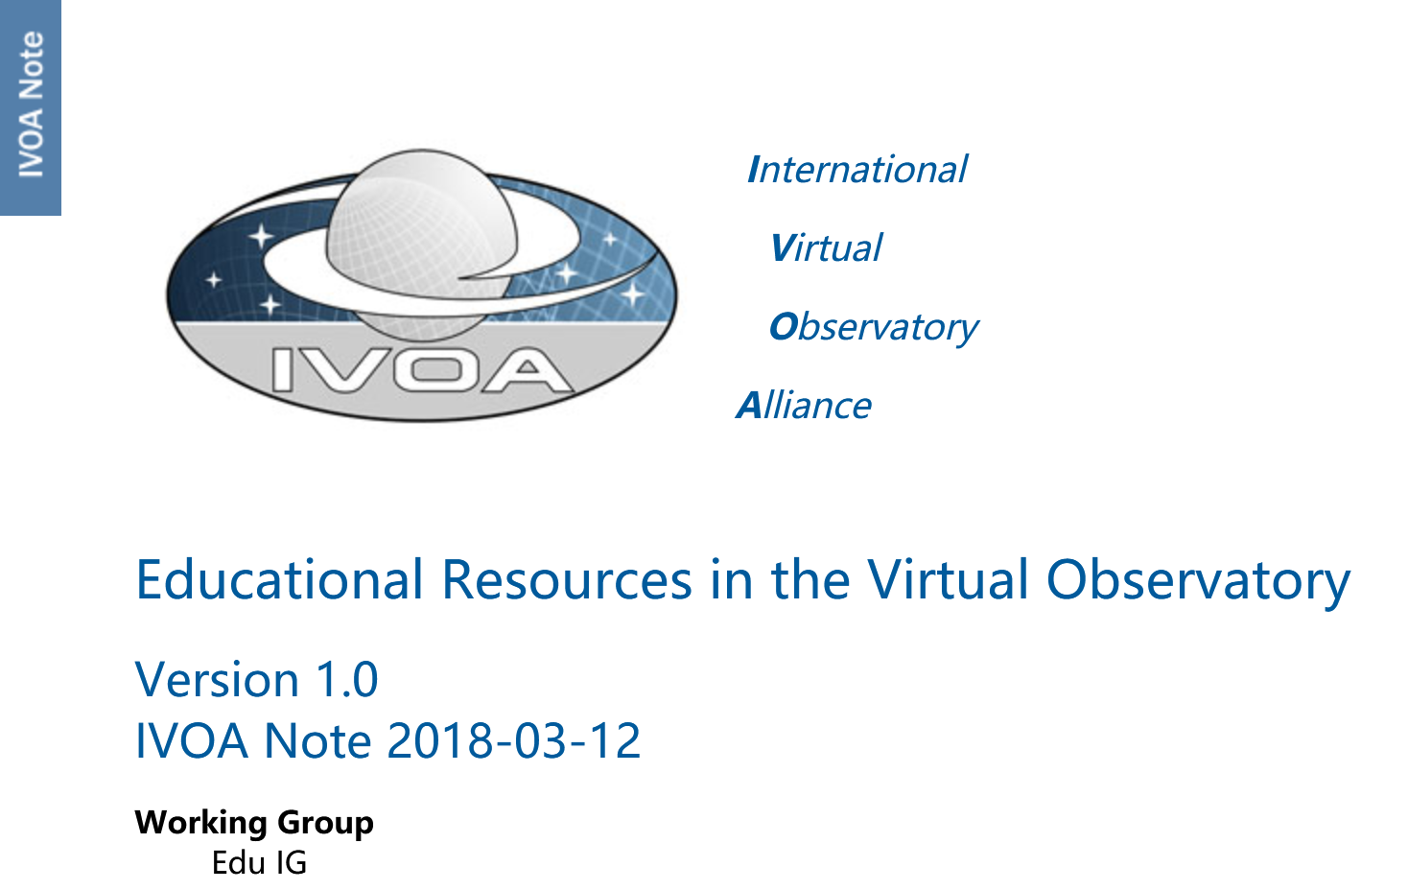
IVOA Education Interest Group
Contents
1 Introduction 2 Registering Texts 2.1 Use Cases 2.2 A Document Registry Extension 2.3 DocRegExt in RegTAP 2.4 An Example DocRegExt Record 2.5 A versioned repository for tutorials 3 A Curated Registry for Education 3.1 Educational vs. Professional Resources 3.2 ContentLevel granularity issue 3.3 Curating the Edu Registry A ContentLevel values summary
https://wiki.ivoa.net/twiki/bin/view/IVOA/IvoaEducation
Your contributions are welcome!

Slide 8
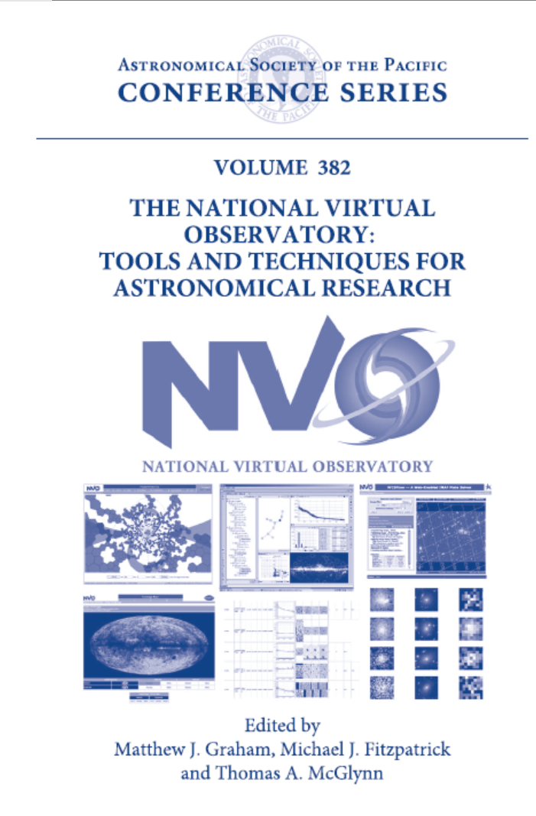
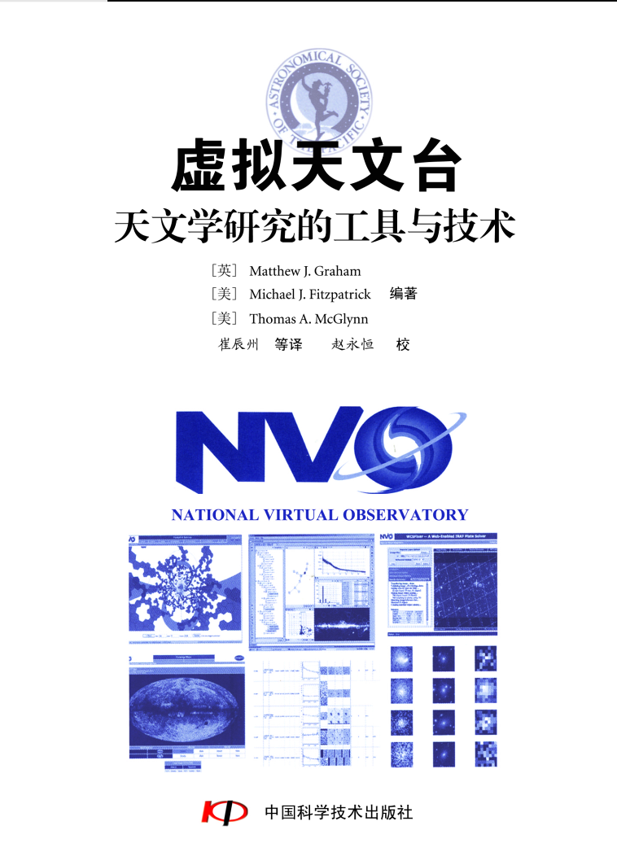
59 chapters, 3 appendixes, published by ASP in 2007
Prologue: The Virtual Observatory—A New Environment for Astronomical Research
Section 1. An Introduction to VO Tools
Section 2. Science with the Virtual Observatory
Section 3. Technologies and Protocols
Section 4. Discovering and Registering Resources in the VO
Section 5. Accessing Data in the VO
Section 6. Publishing Data in the VO
Section 7. Foundation Technologies
In 2004, 2005 and 2006, the US National Virtual Observatory development project presented Summer Schools in Aspen, Colorado. This volume is a collection of the Summer School lectures and tutorials. These materials are still relevant.
Published in Chinese in 2010
http://www.aspbooks.org/a/volumes/table_of_contents/?book_id=420

Slide 9
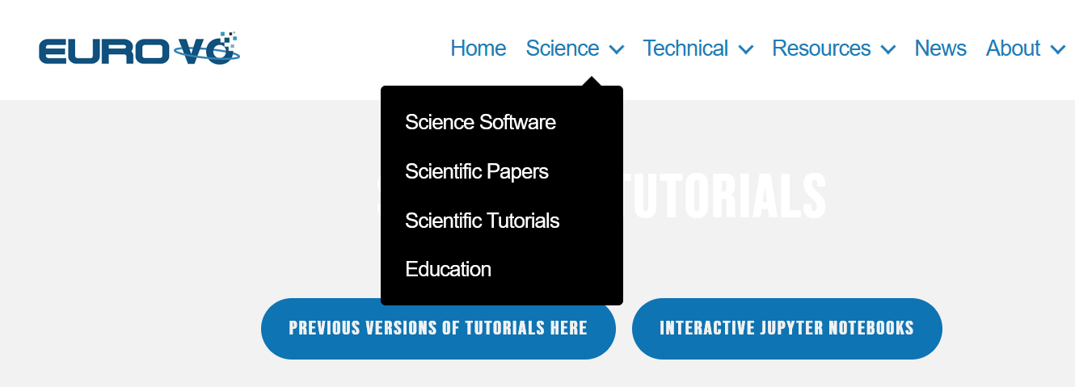
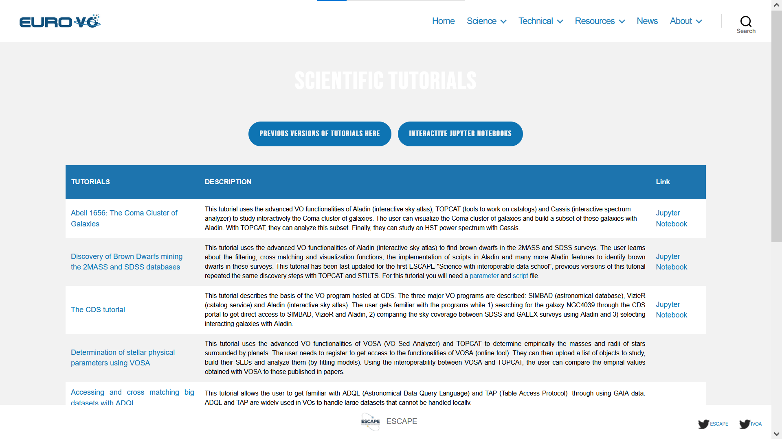
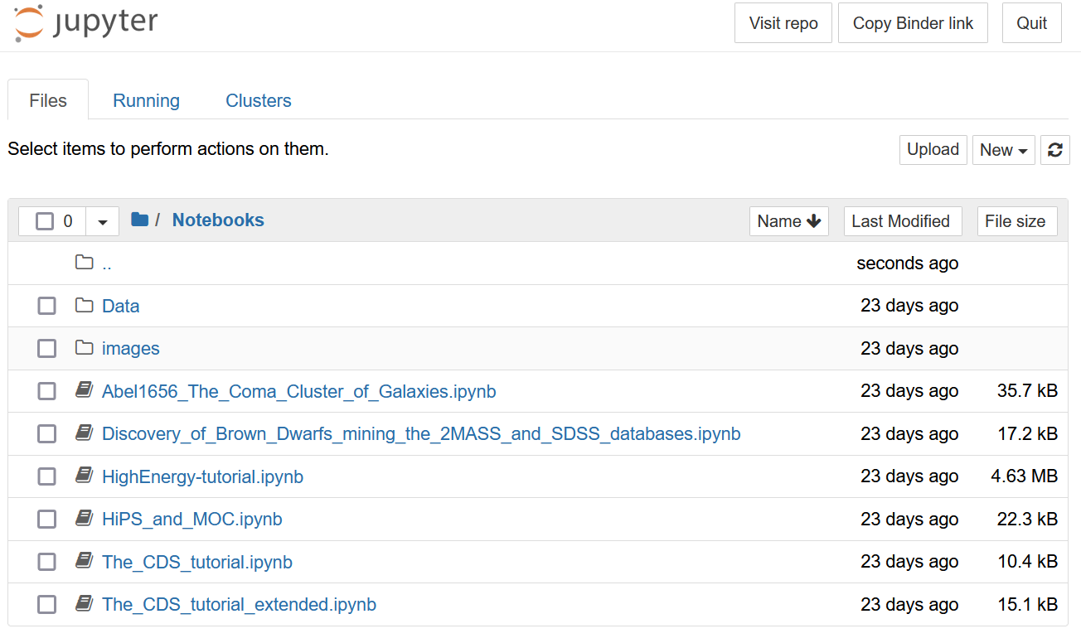
https://www.euro-vo.org/scientific-tutorials/

Slide 10
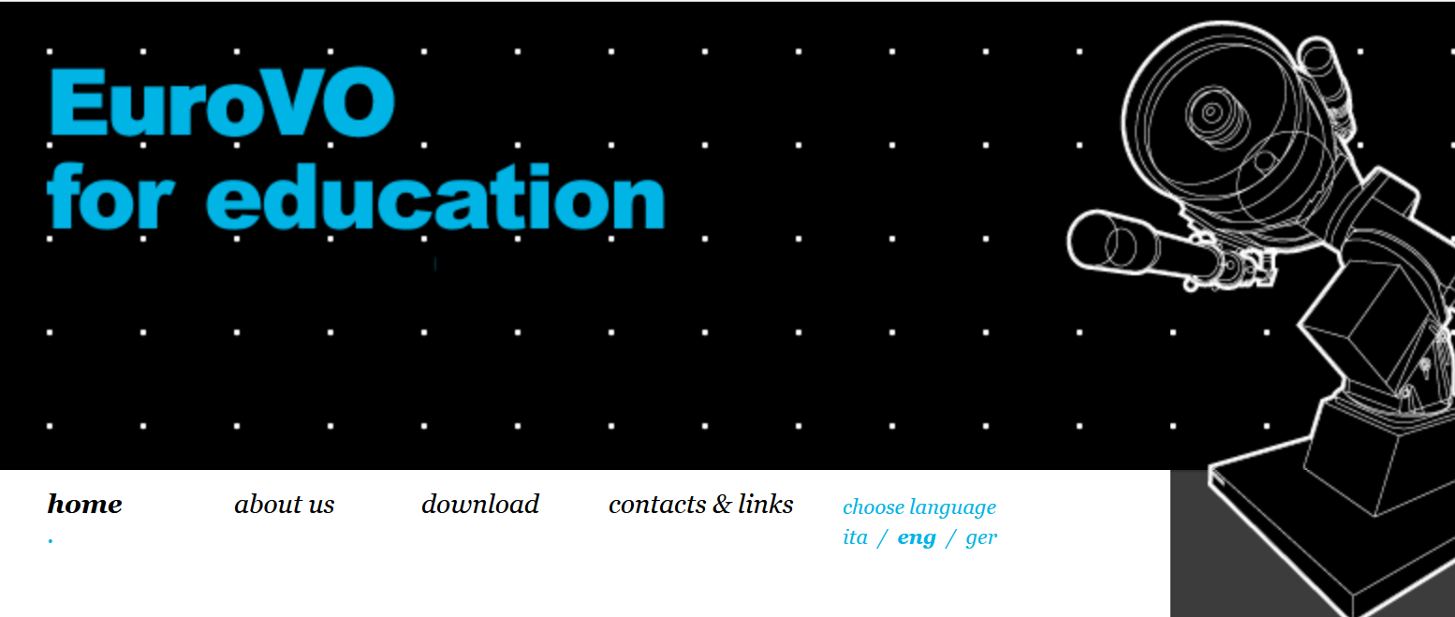
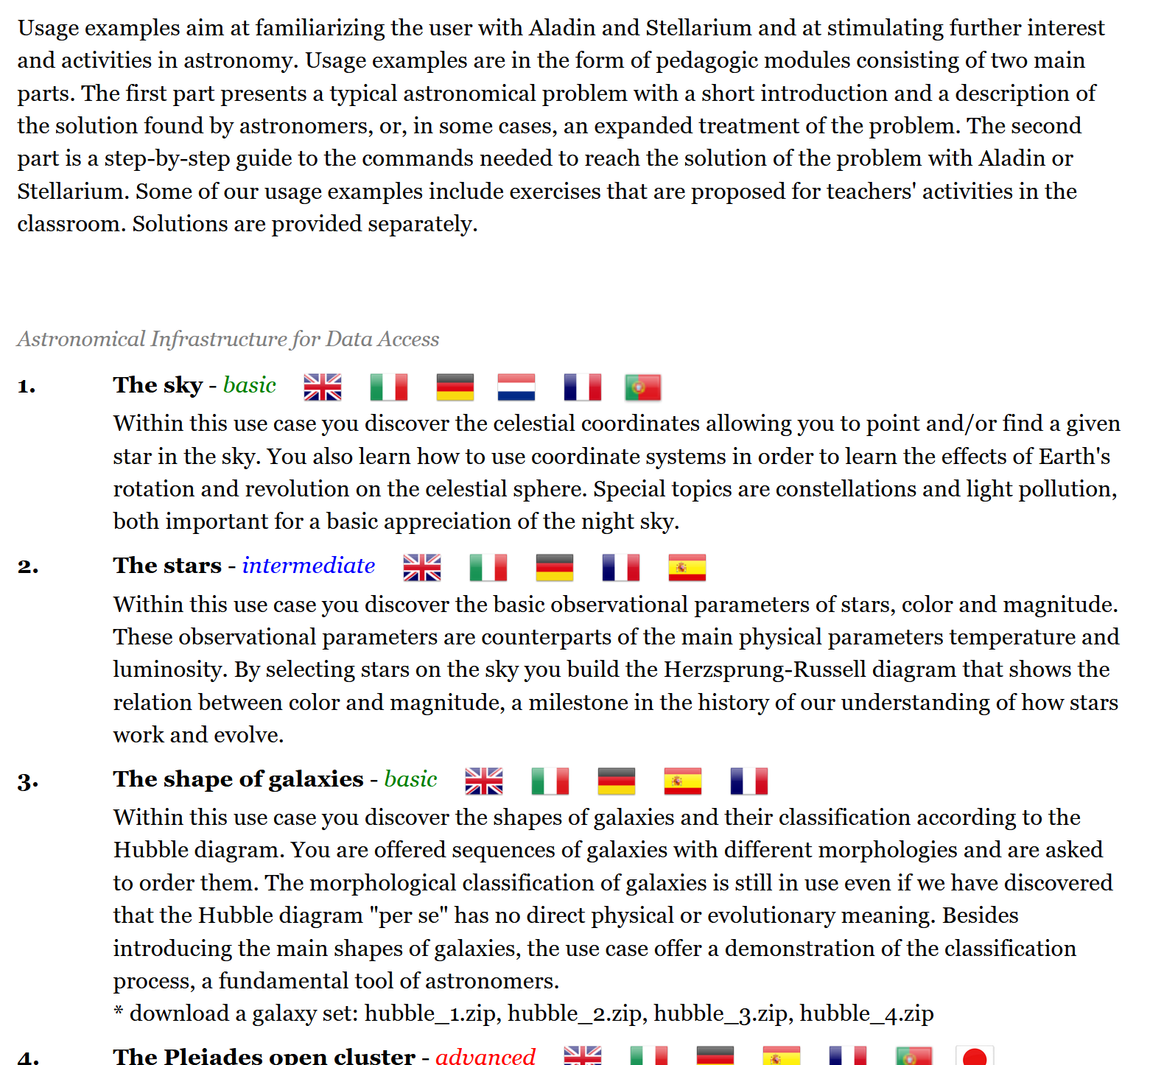
EuroVO for education is a project developed within the framework of the EuroVO with the aim of diffusing EuroVO data and software to the public, in particular students, teachers and astronomy enthusiasts.
Usage examples are in the form of pedagogic modules consisting of two main parts. The first part presents a typical astronomical problem with a short introduction and a description of the solution found by astronomers, or, in some cases, an expanded treatment of the problem. The second part is a step-by-step guide to the commands needed to reach the solution of the problem with Aladin or Stellarium.
The EuroVO resources are now maintained and upgraded/updated by VObs.it at INAF-OA Trieste.
http://vo-for-education.oats.inaf.it

Slide 11
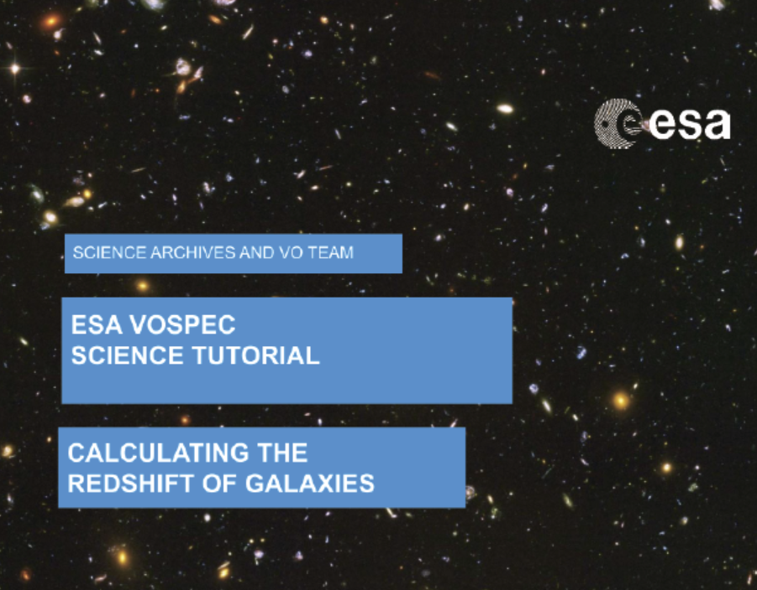
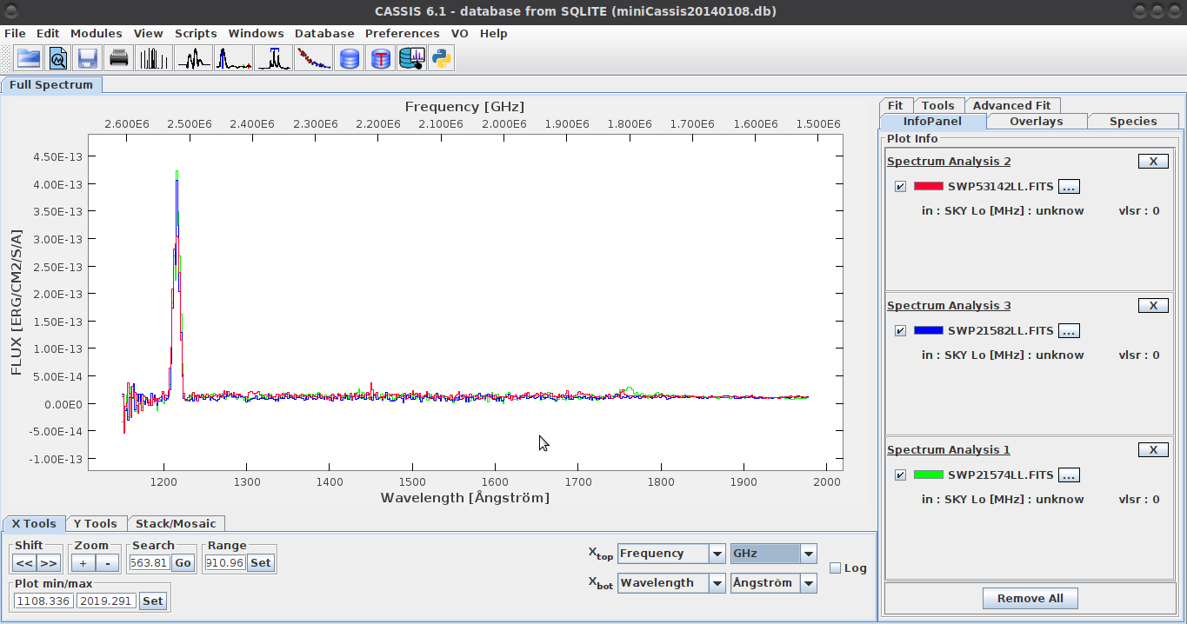
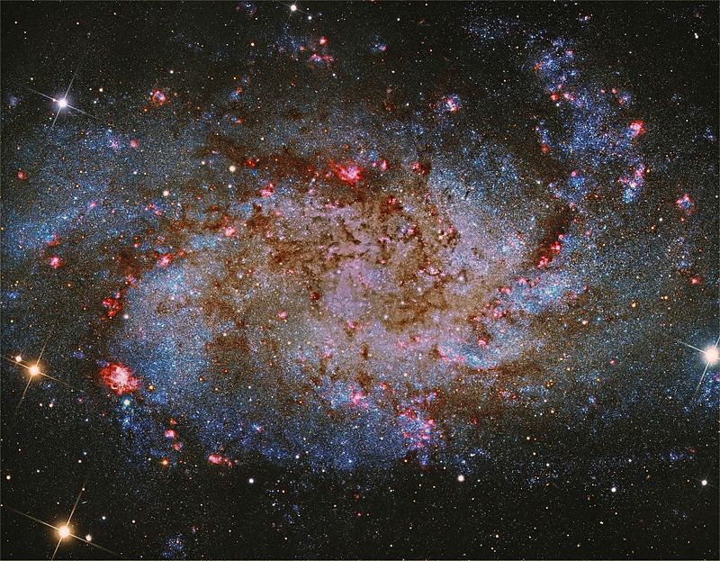
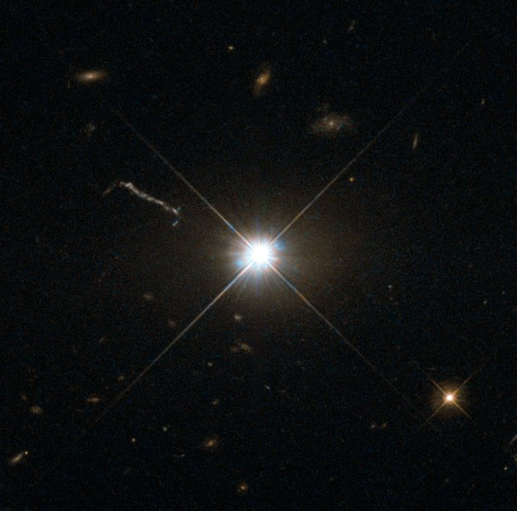
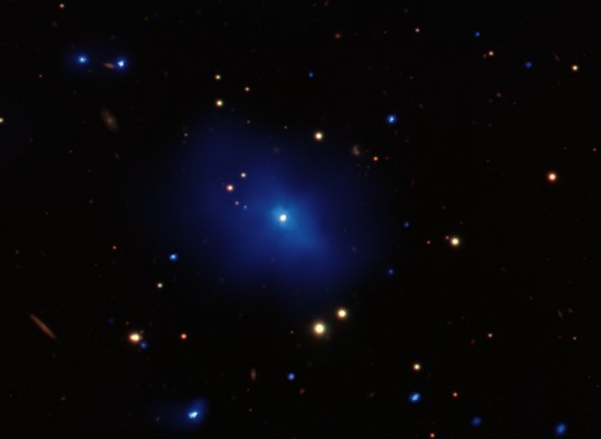
Tutorial: "Calculating the Redshift of Galaxies"
Derian Jesús Dorado-Daza has been working with translation (to Spanish) and updating some tutorials for VO Education. He used CASSIS for updating the tutorial "Calculating the Redshift of Galaxies“
Teaching/Learning Goal: “The overall goal of this tutorial is to compare the spectra of different galaxies, calculate their redshifts and hence search for evidence of the expansion of the Universe.”
Tools and Services from VO:
CASSIS: This tool allows the query, download and analysis of spectra from different databases and services, using protocols and communication standards established in the framework of the Virtual Observatory.
NIST Atomic Spectra Database Service: Database for radiative transitions and energy levels in atoms and atomic ions, for the most of the known chemical elements.
NASA/IPAC Extragalactic Database (NED): Database of multiwavelength data for extragalactic objects, providing a systematic, ongoing fusion of information integrated from hundreds of large sky surveys and tens of thousands of research publications
Topcat: Widely known tool for analysis, manipulation and visualization of astronomical source catalogues and other tables.
Acknowledgments:
Tutorial created by Phil Furneaux (Lancaster University) and Deborah Baines (Science Archives Team scientist - ESA).
The tutorial is based on analysis carried out with the CASSIS software (http://cassis.irap.omp.eu; Vastel et al. 2015 http://adsabs.harvard.edu/abs/2015sf2a.conf..313V). CASSIS has been developed by IRAP-UPS/CNRS .
This tutorial can be found online at: http://vo-for-education.oats.inaf.it/
Courtesy of Derian Jesus Dorado-Daza, derianjesus@gmail.com

Slide 12
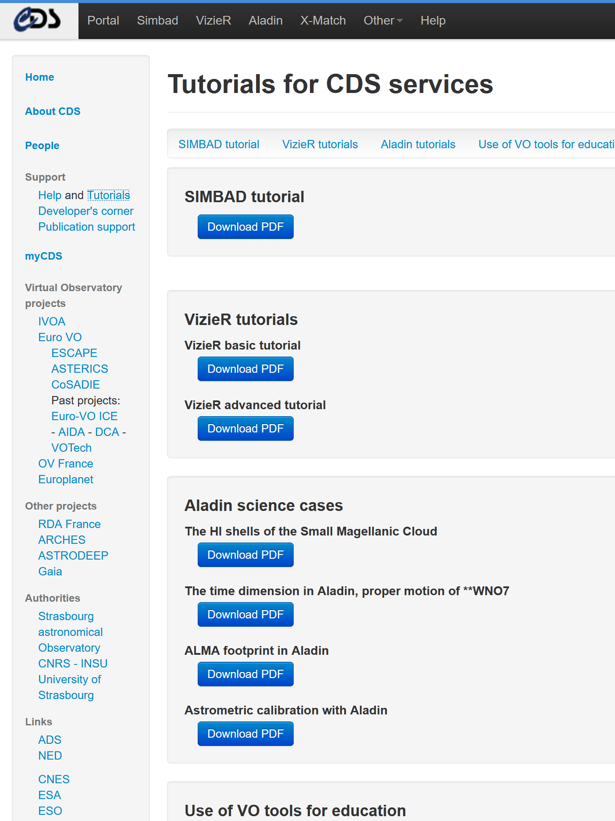
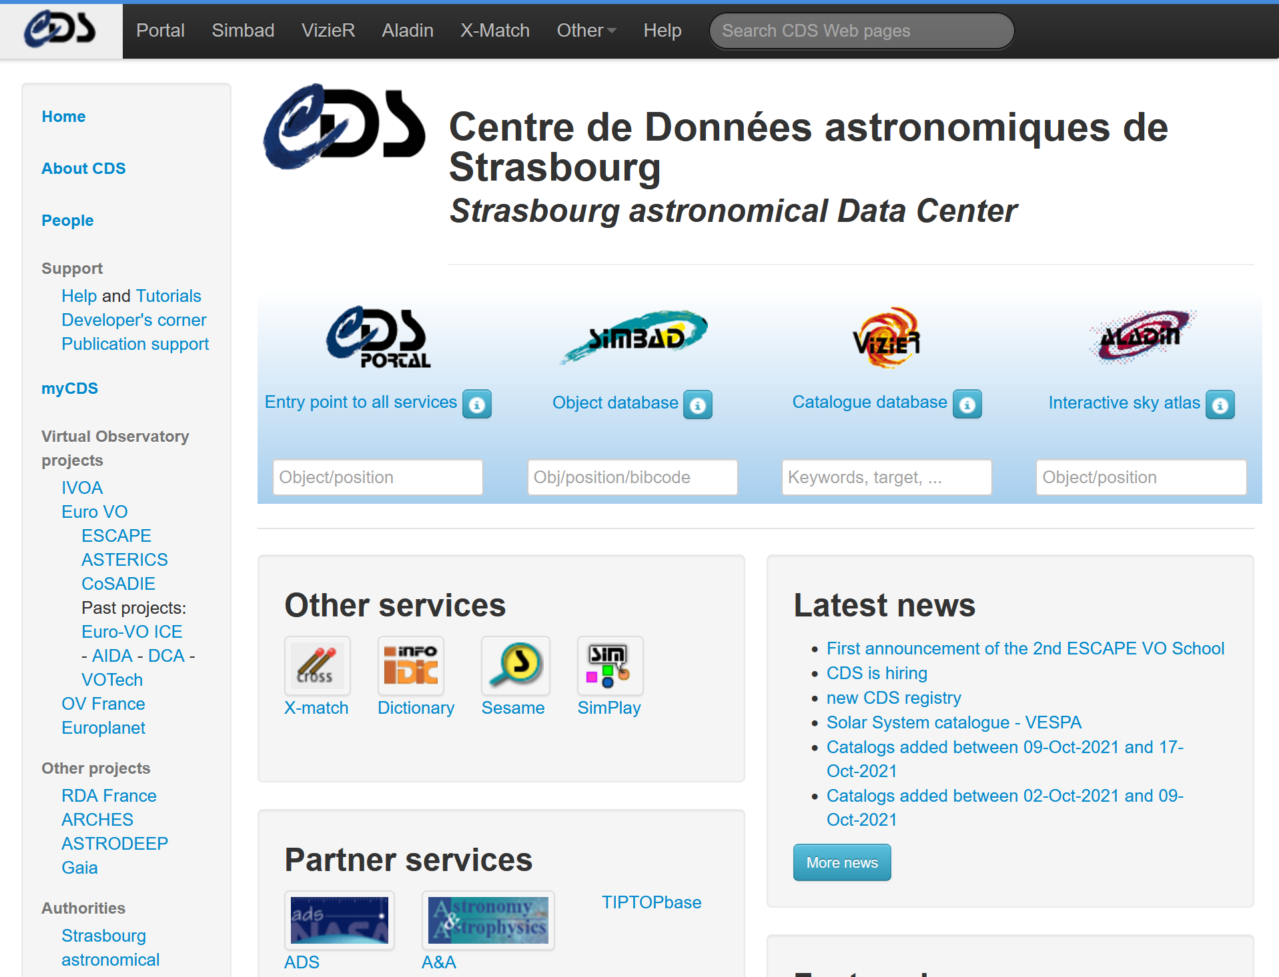
http://cdsweb.u-strasbg.fr/tutorials/

Slide 13
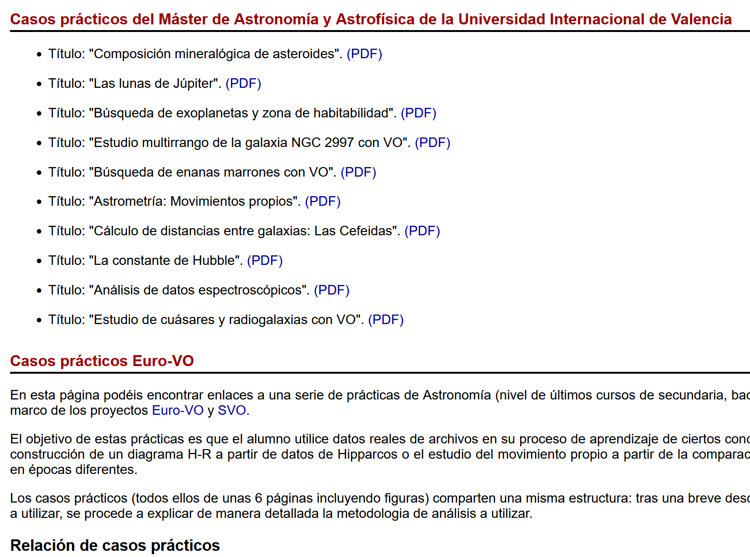
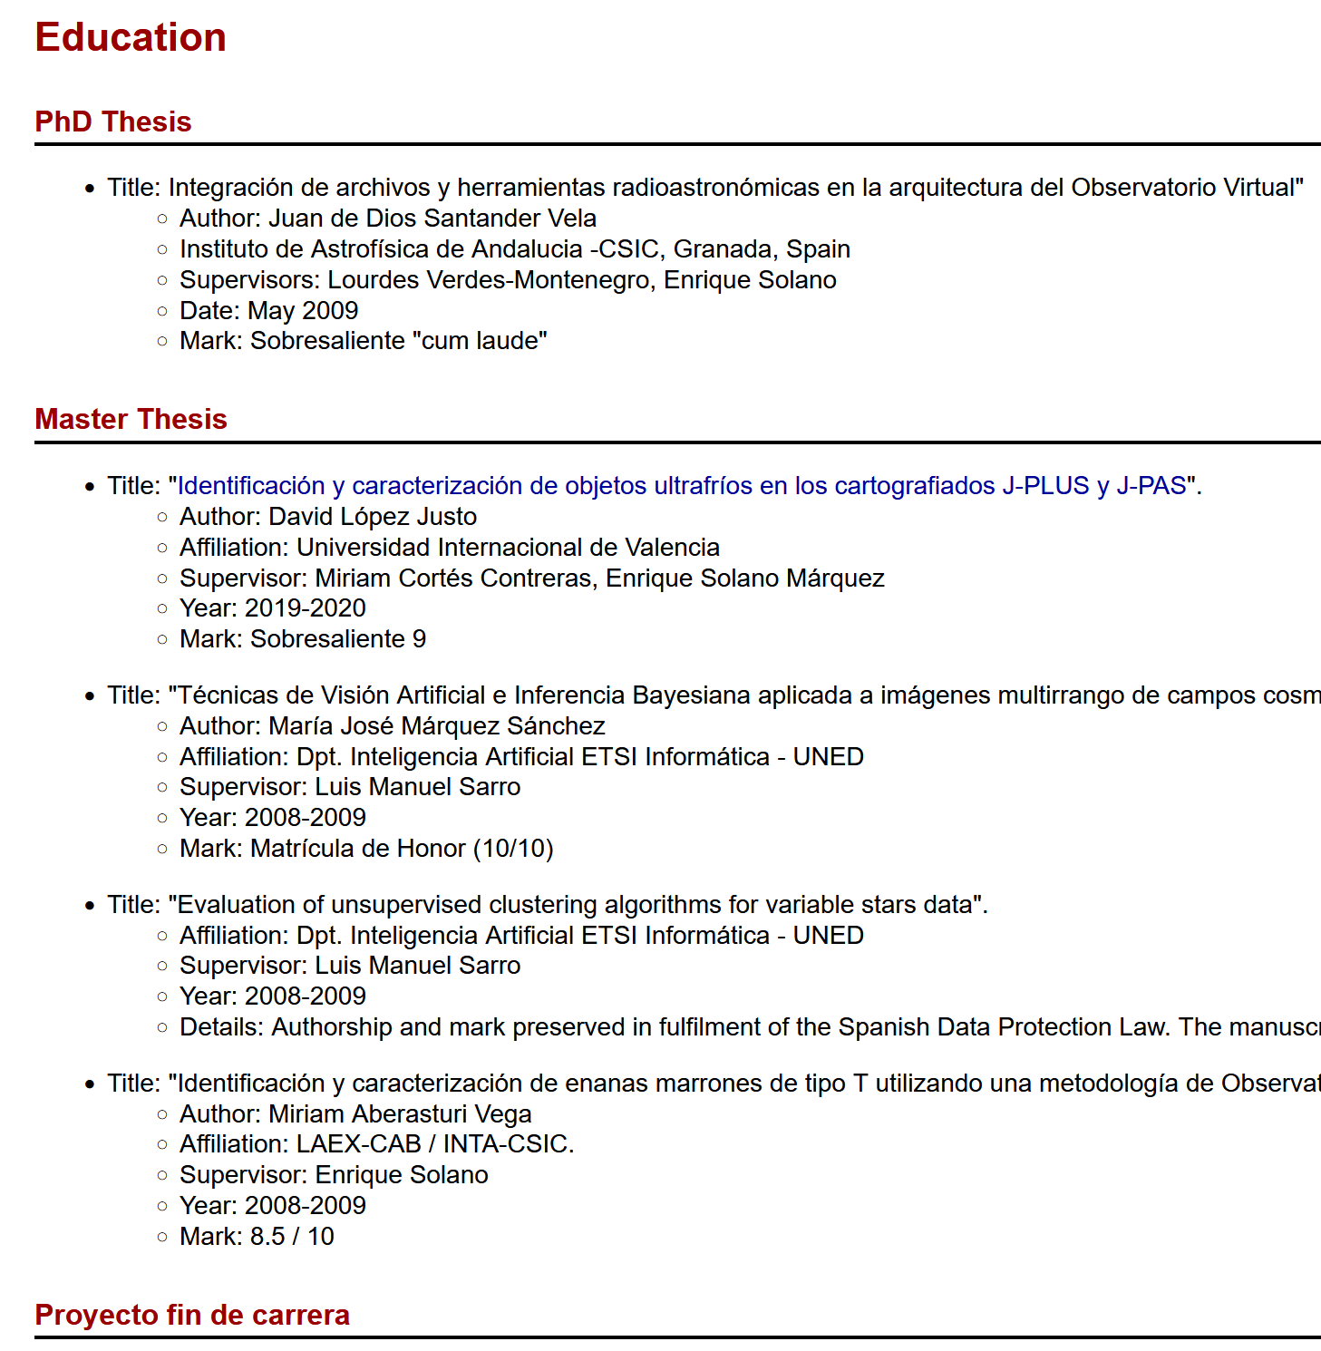
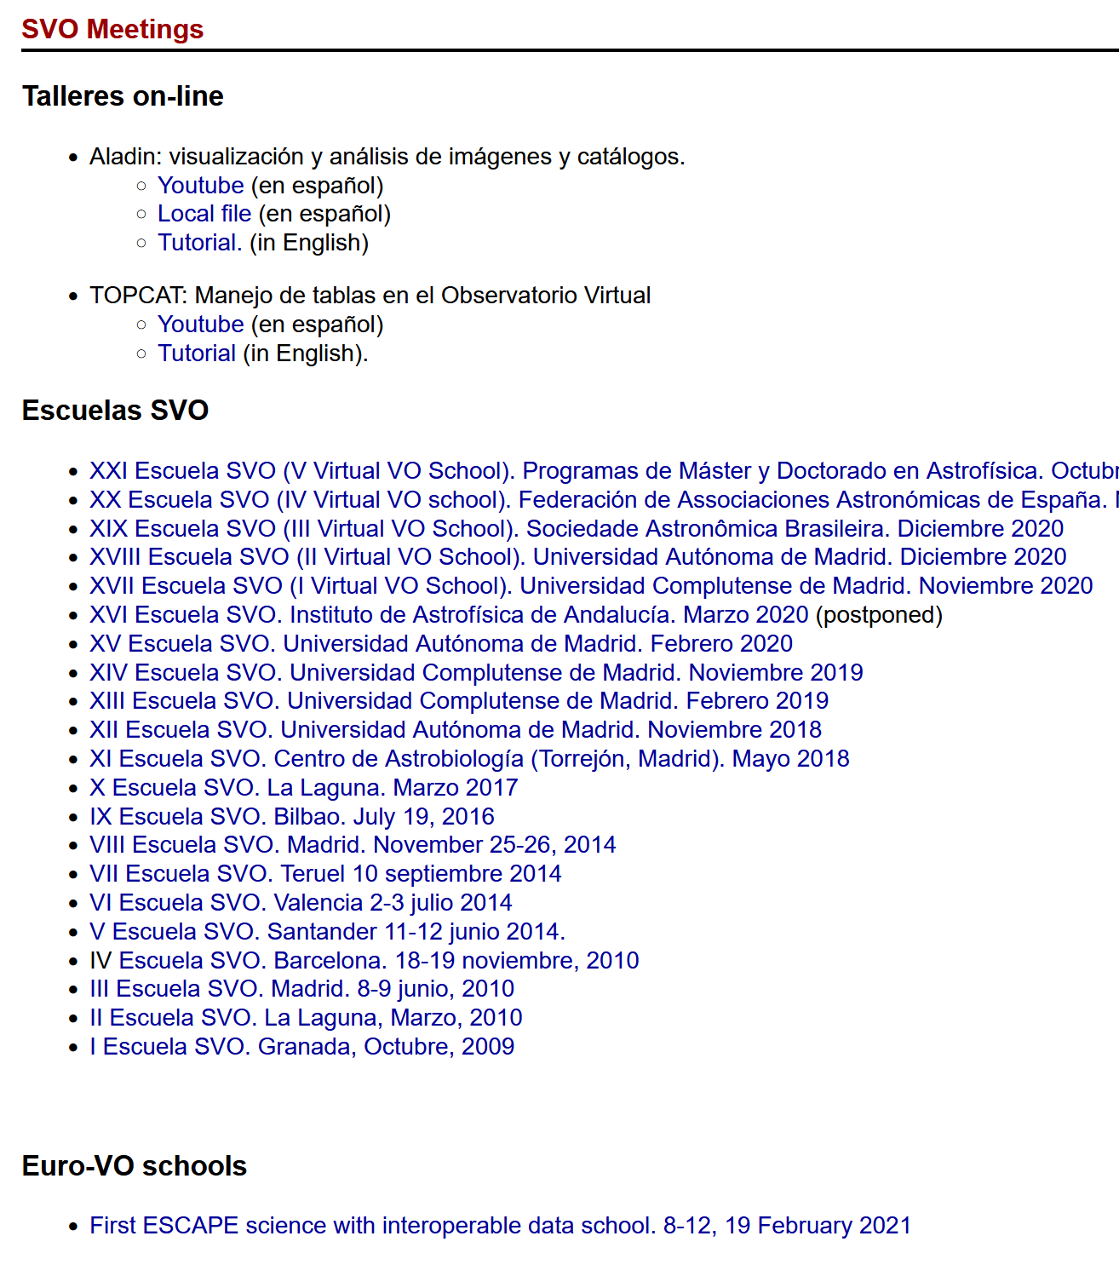
SVO
https://svo.cab.inta-csic.es/main/index.php

Slide 14
Euro-VO Schools
The European Virtual Observatory (Euro-VO) initiative organizes regular VO schools since 2008.
https://pretalx.adass2021.ac.za/adass-xxxi-2021/talk/RN3CMZ/

Slide 15
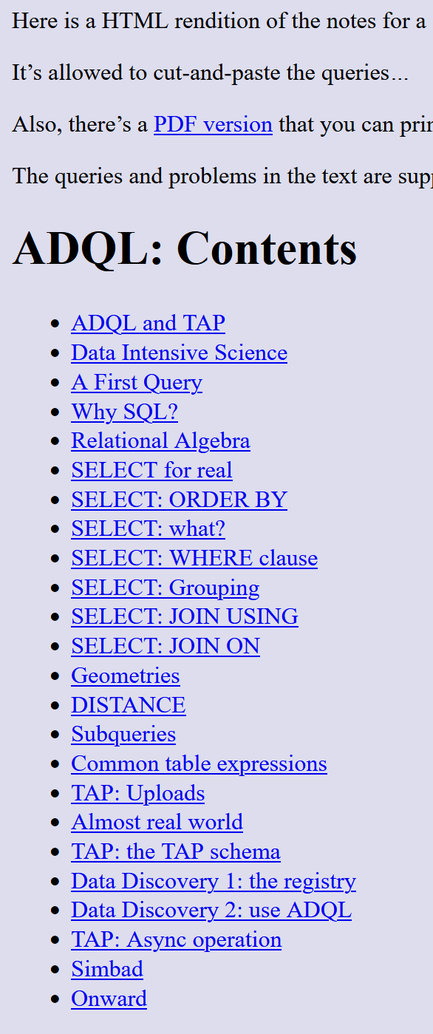
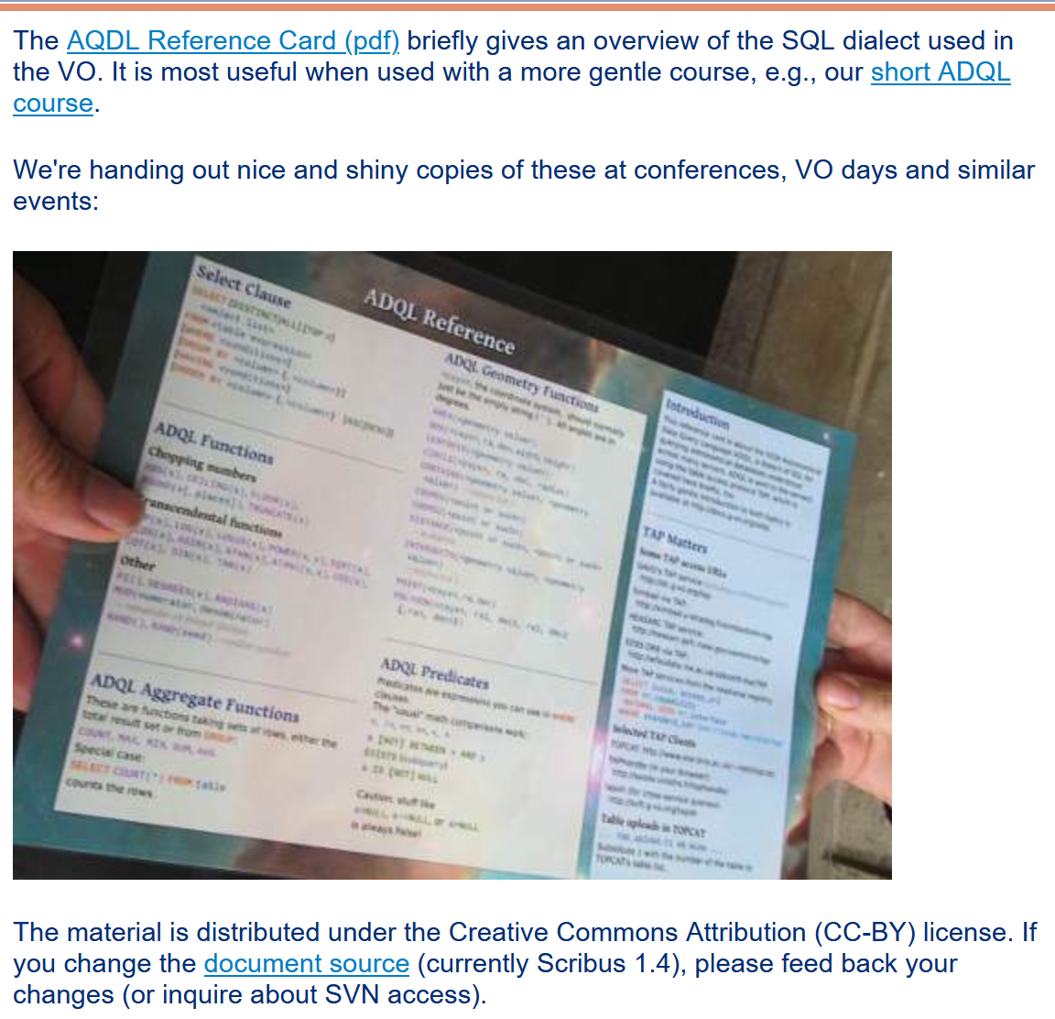
Hand-Outs/Tutorials:
Astronomical Data Query Language (ADQL) Reference Card
ADQL Hands-on Course
GAVO Tutorials
https://www.g-vo.org/pmwiki/About/Services

Slide 16
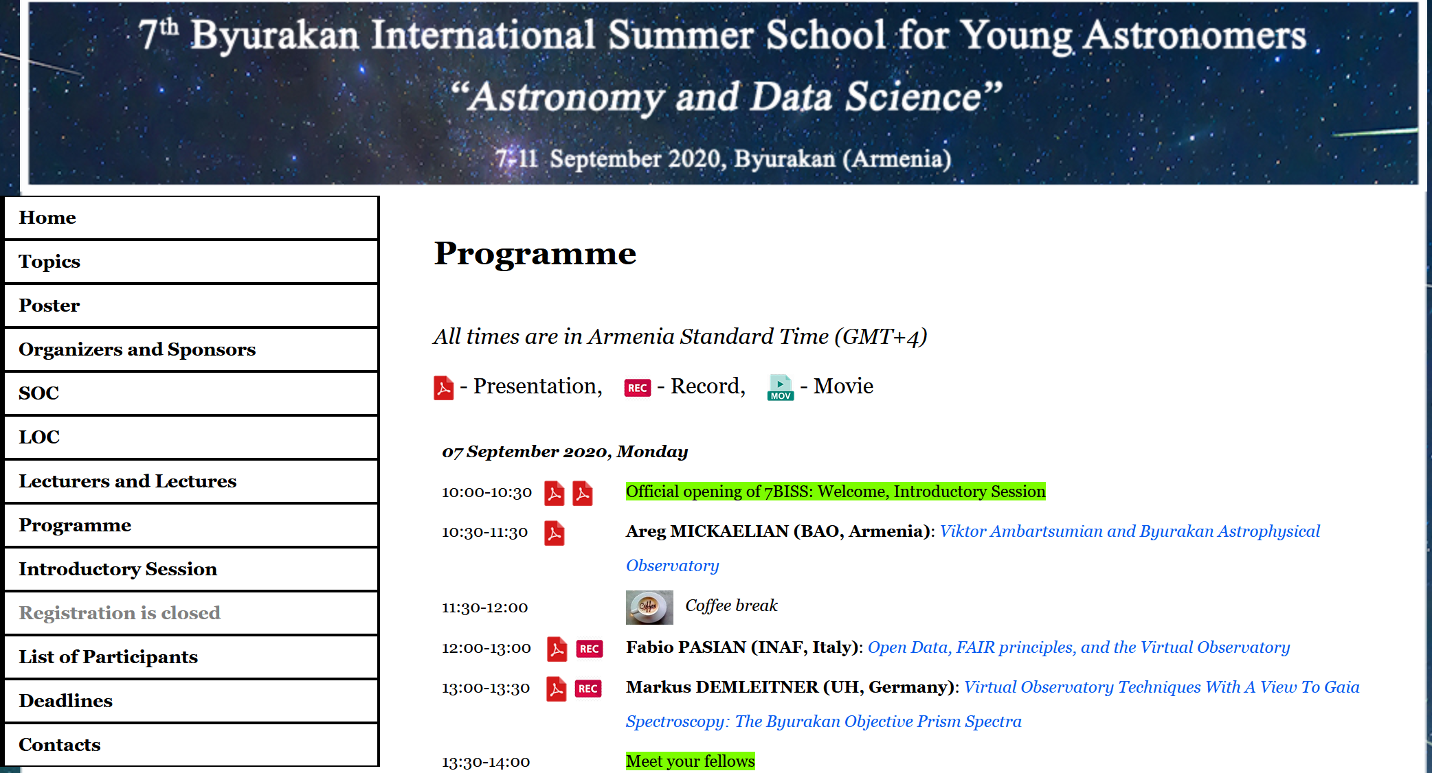
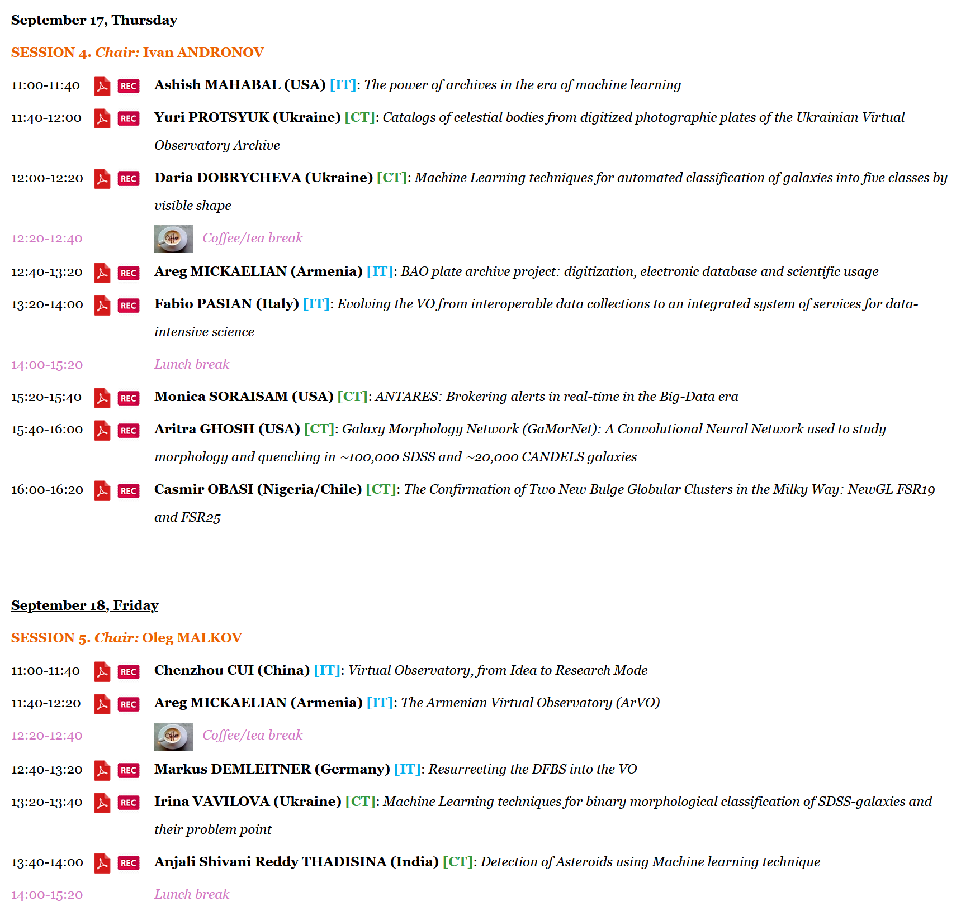
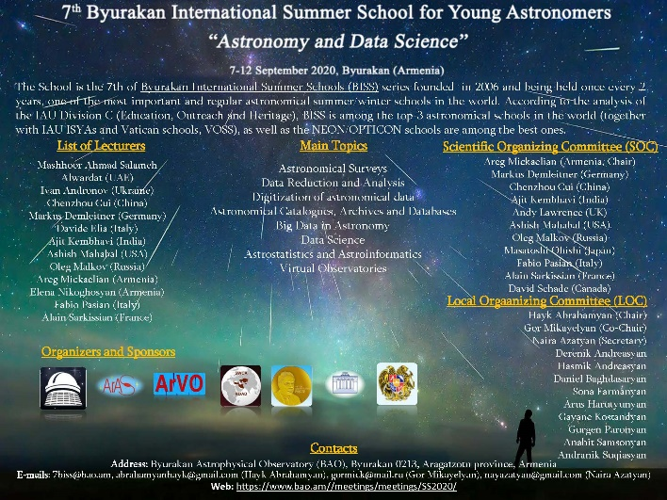
ArVO – Armenian Virtual Observatory
Meetings and Events:
7th Byurakan International Summer School (7BISS),
07-11.09.2020, Byurakan, Armenia
Astronomical Surveys and Big Data 2 (ASBD-2),
14-18.09.2020, Byurakan, Armenia
https://www.bao.am/meetings/meetings/SS2020/index.html
https://www.bao.am/meetings/meetings/ASBD2/index.html

Slide 17
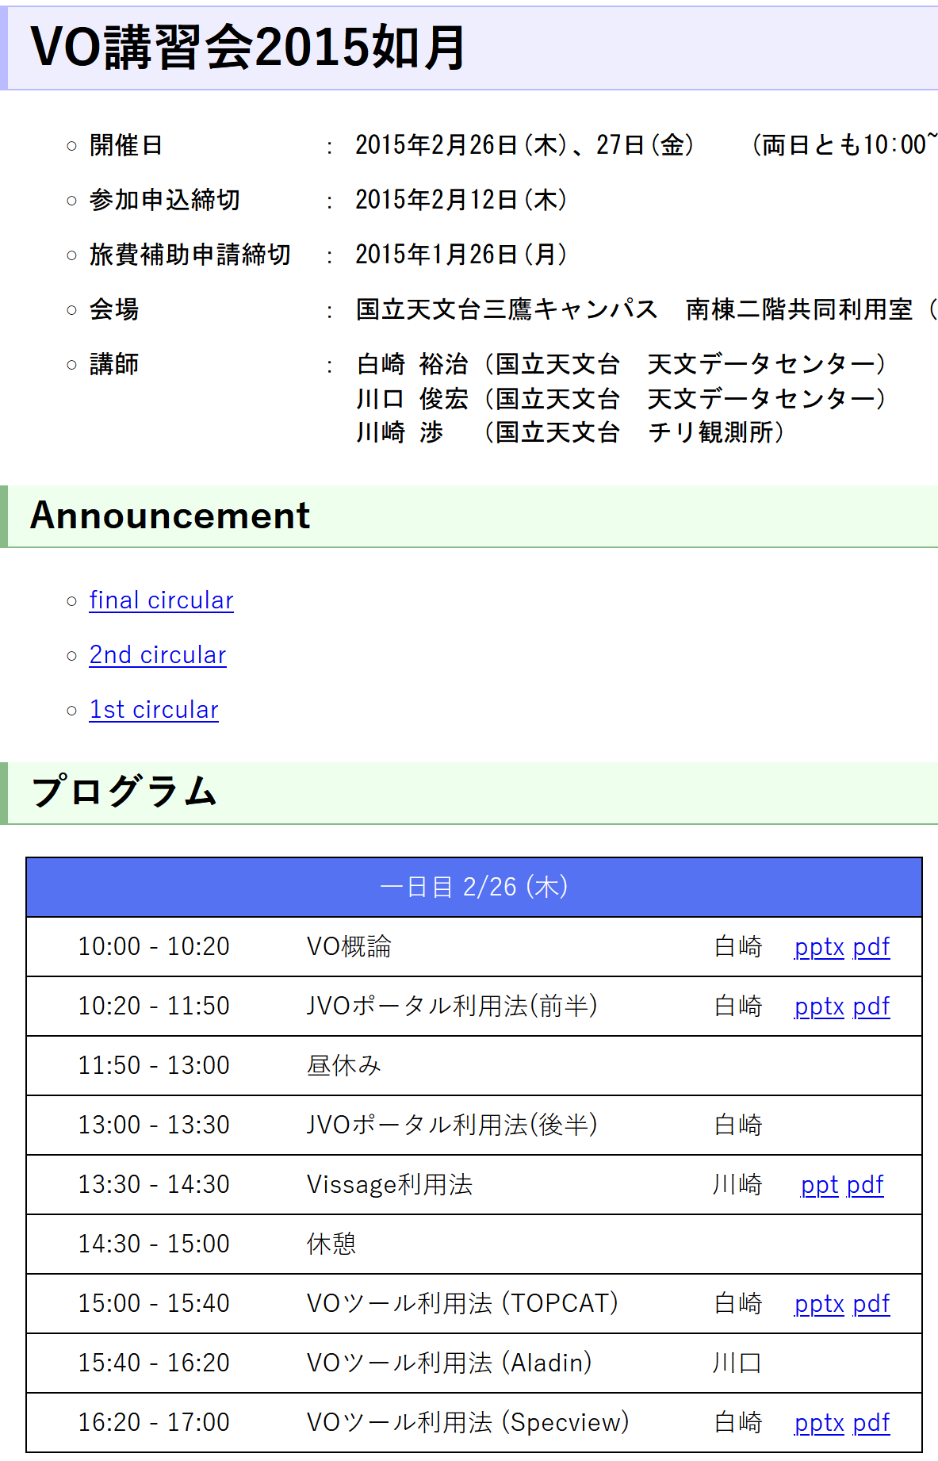
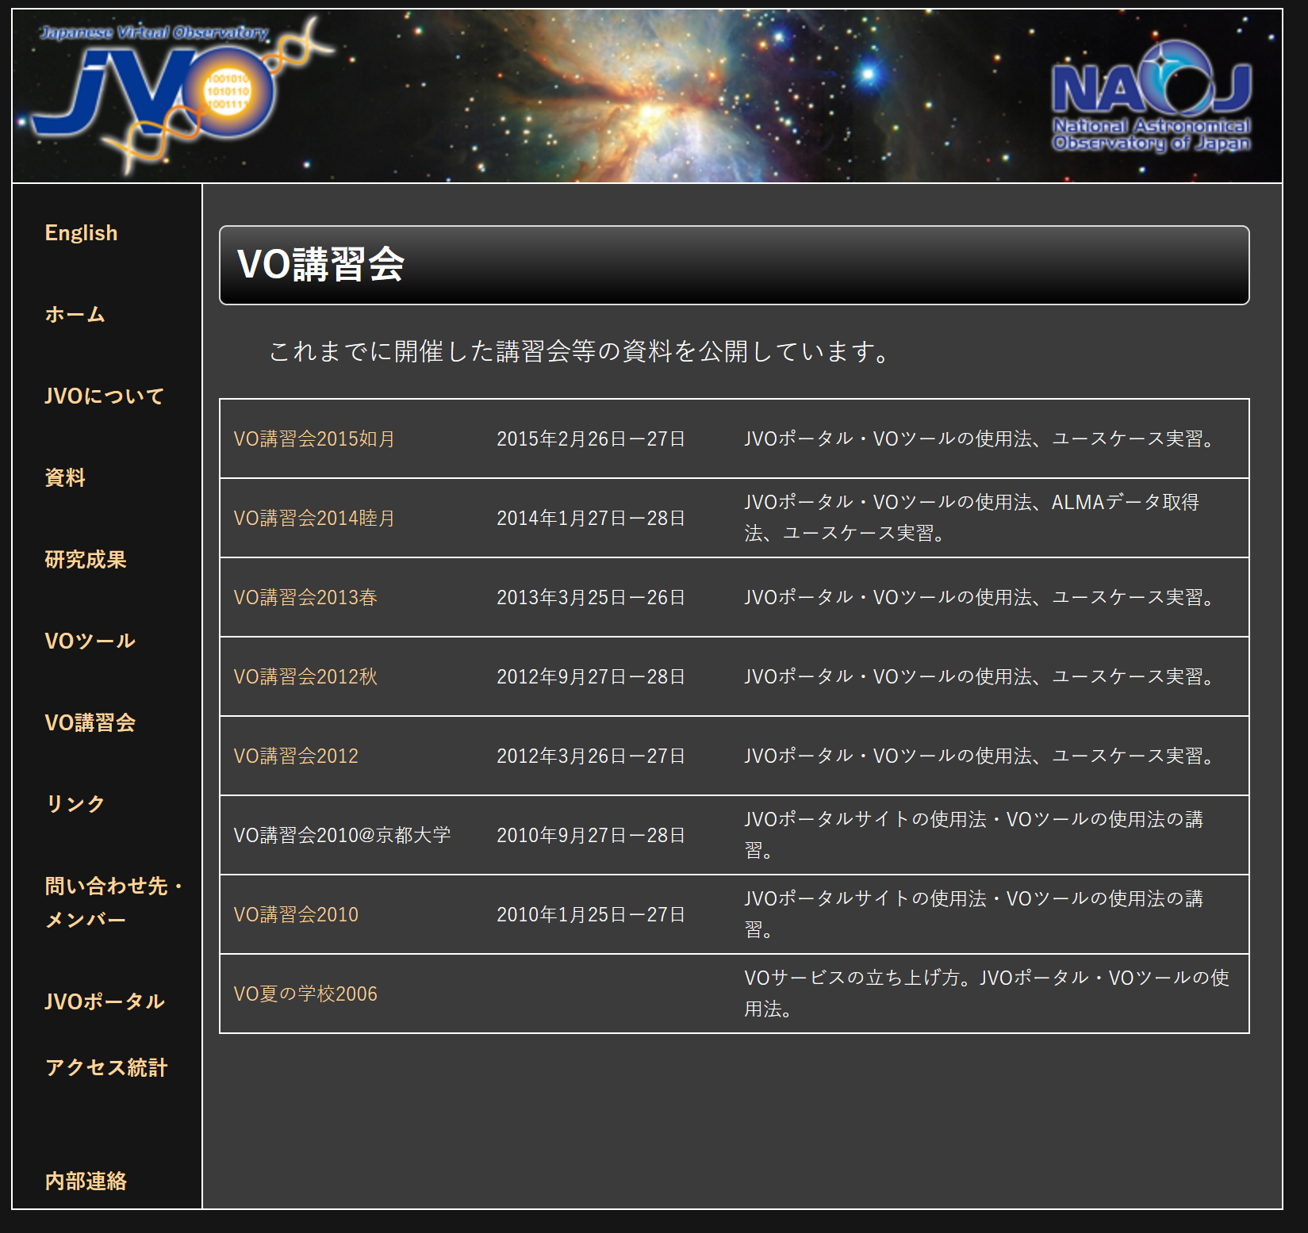
http://jvo.nao.ac.jp/voschool.html

Slide 18
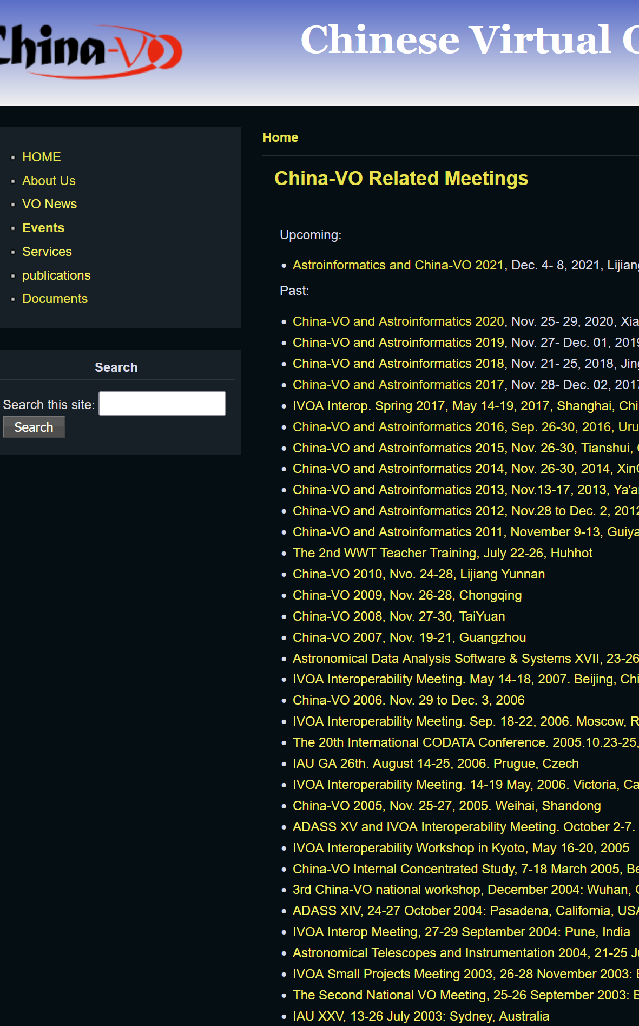
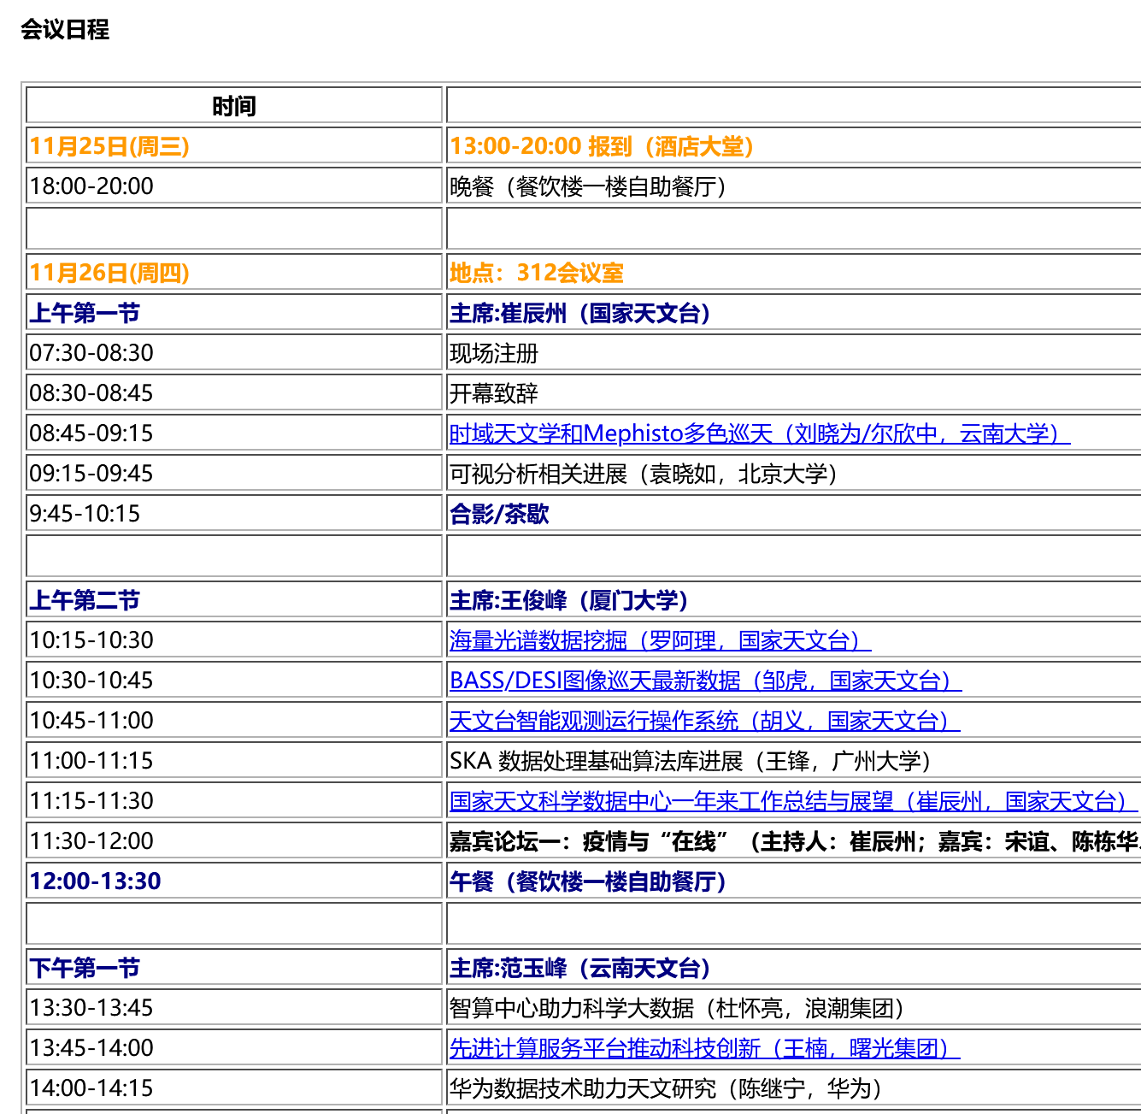
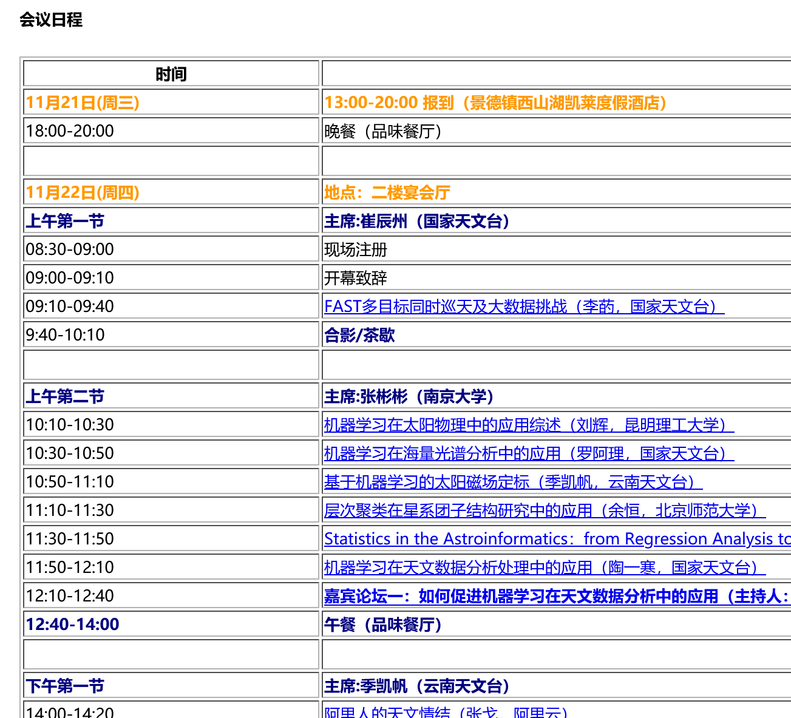
China-VO Annual Meetings
http://www.china-vo.org/events.html

Slide 19
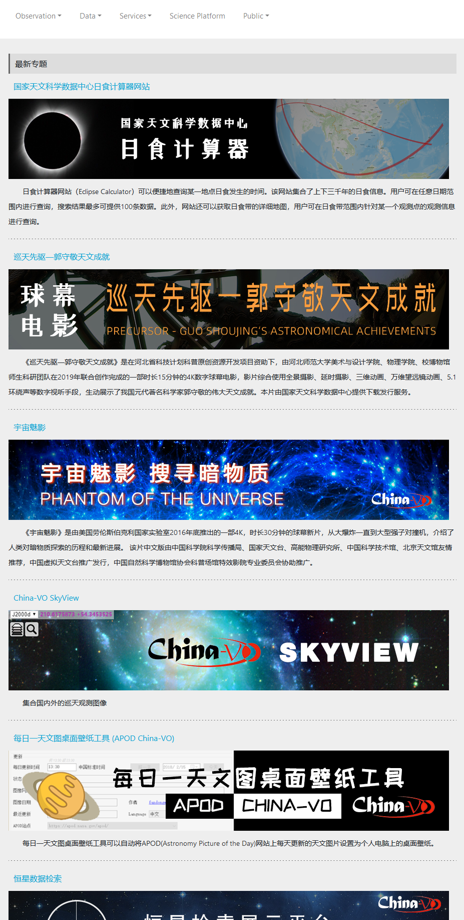
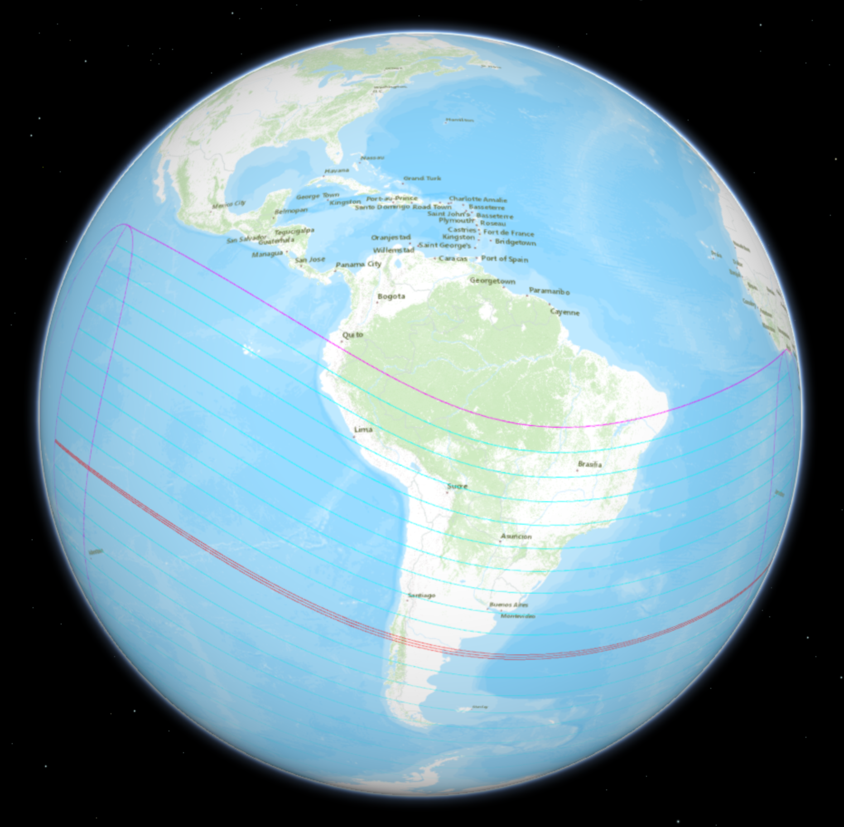
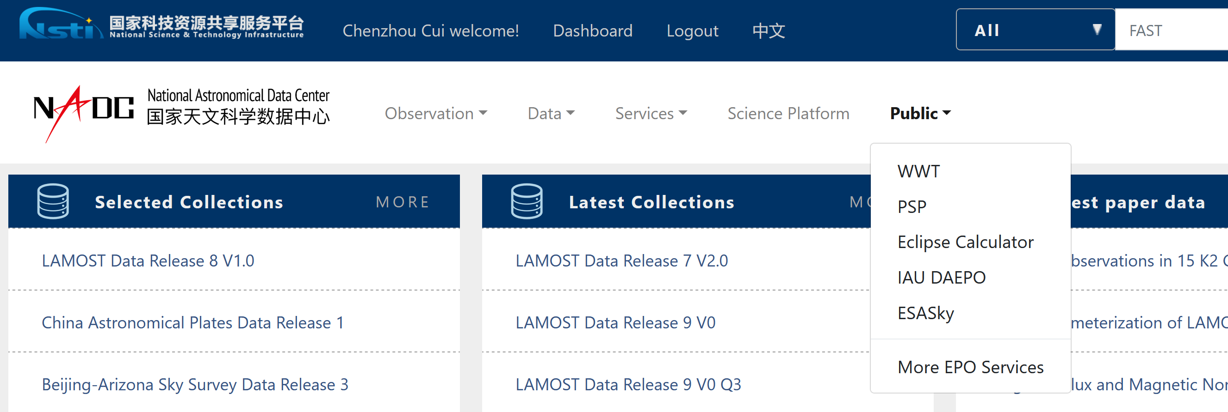
China-VO EPO Resources
https://nadc.china-vo.org/?&locale=en

Slide 20
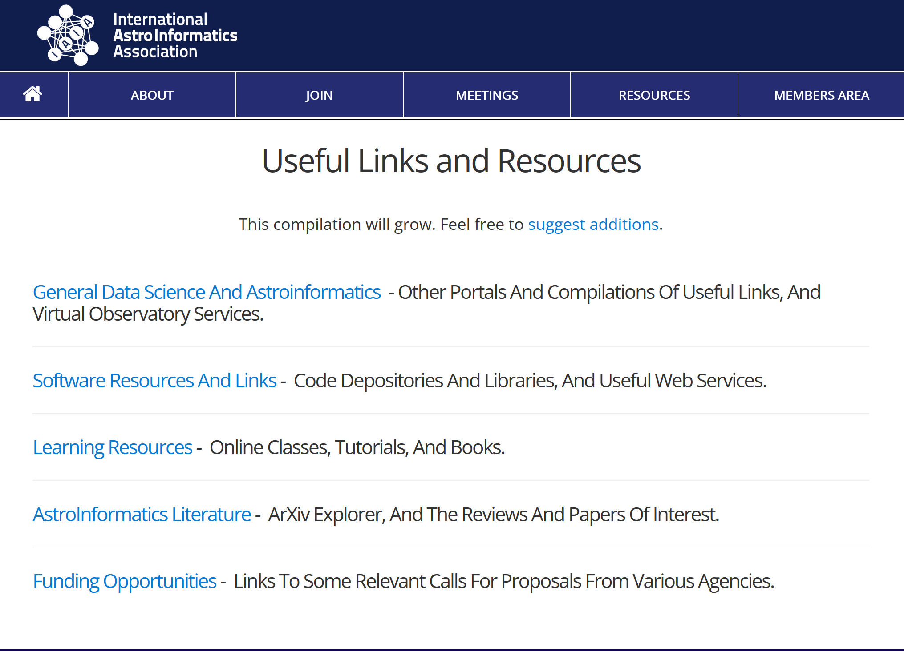
Resources for Astroinformatics
On-line courses
You are here: Home / Resources / On-line courses
A vast array of courses in statistics and computational methods are available online. Some have fixed schedules and charge tuition, others are flexible and free. We list a selection of these courses here. Listing does not imply any assurance or approval by ASAIP.
The Astrostatistics and Astroinformatics Portal (https://asaip.psu.edu) is a new Web site serving the cross-disciplinary communities of astronomers, statisticians and computer scientists.
http://astroinformatics.info/resources
https://asaip.psu.edu/resources/on-line-courses/

Slide 21
https://sites.astro.caltech.edu/ay119/
https://sites.astro.caltech.edu/~george/ay119/

Slide 22
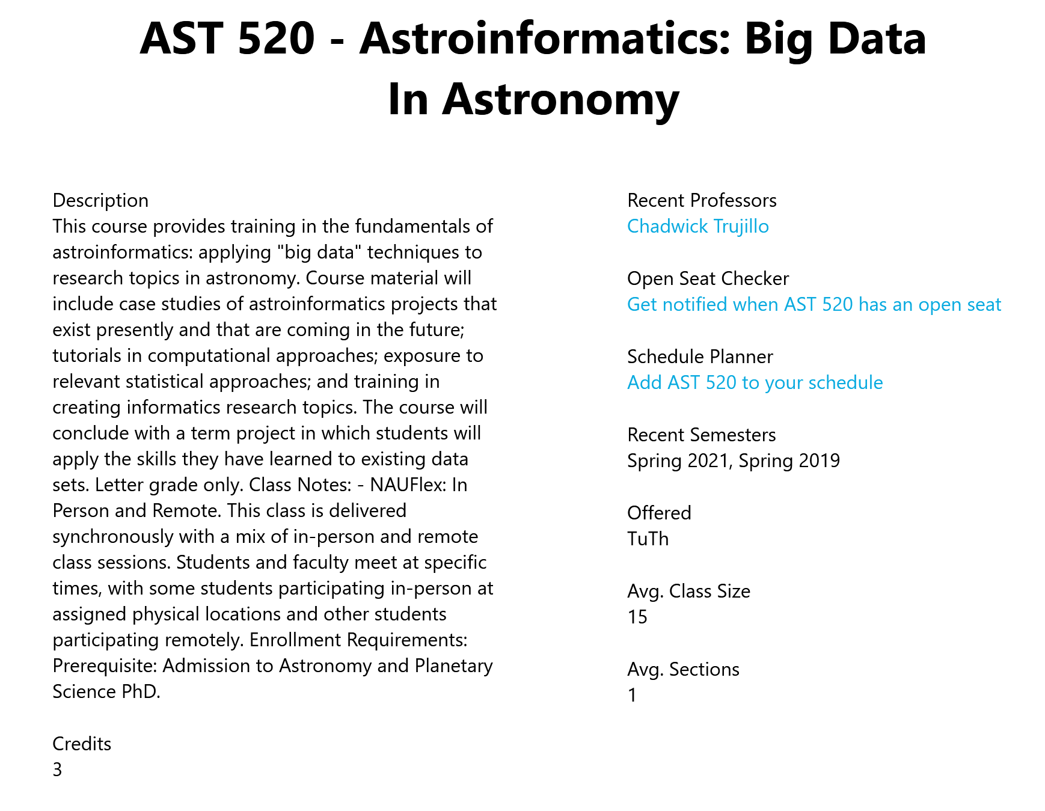
Astronomy Term : Summer 2021 Catalog Year : 2020-2021 AST 520 - Astroinformatics: Big Data In Astronomy Description: This course provides training in the fundamentals of astroinformatics: applying "big data" techniques to research topics in astronomy. Course material will include case studies of astroinformatics projects that exist presently and that are coming in the future; tutorials in computational approaches; exposure to relevant statistical approaches; and training in creating informatics research topics. The course will conclude with a term project in which students will apply the skills they have learned to existing data sets. Letter grade only. Units: 3 Prerequisite: Admission to Astronomy and Planetary Science PhD
http://catalog.nau.edu/Courses/course?courseId=011813&term=1214

Slide 23
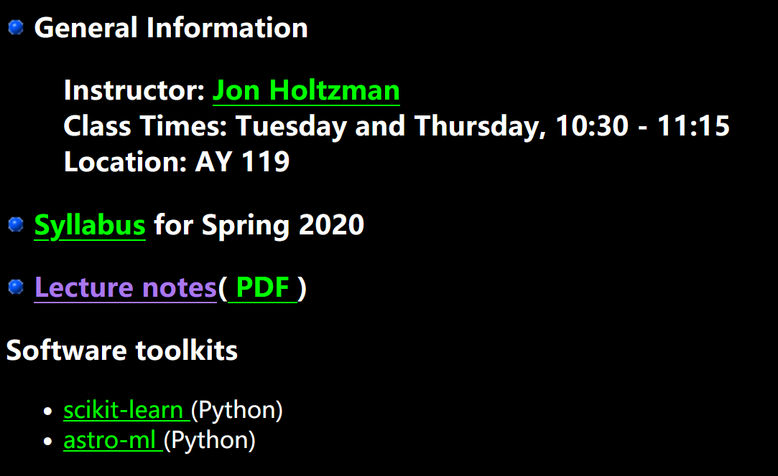
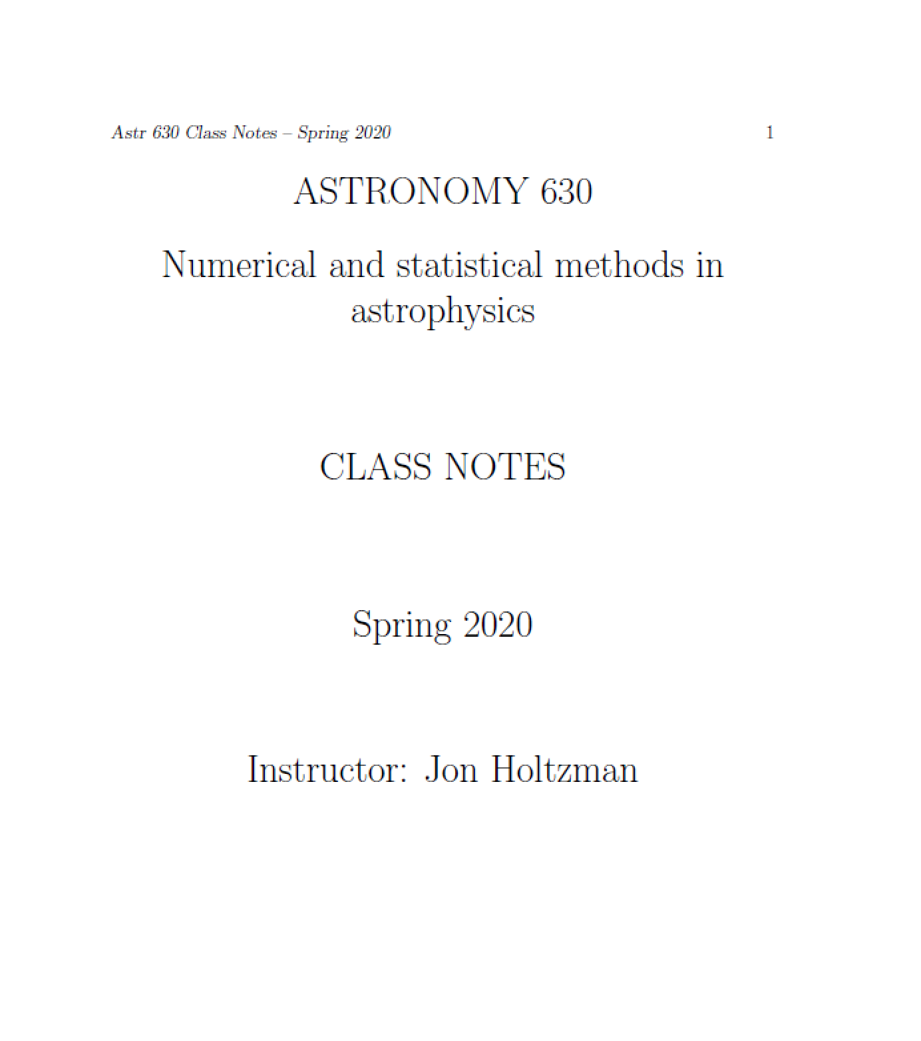
Astronomy 630: Astrostatistics
http://astronomy.nmsu.edu/holtz/a630/index.html

Slide 24
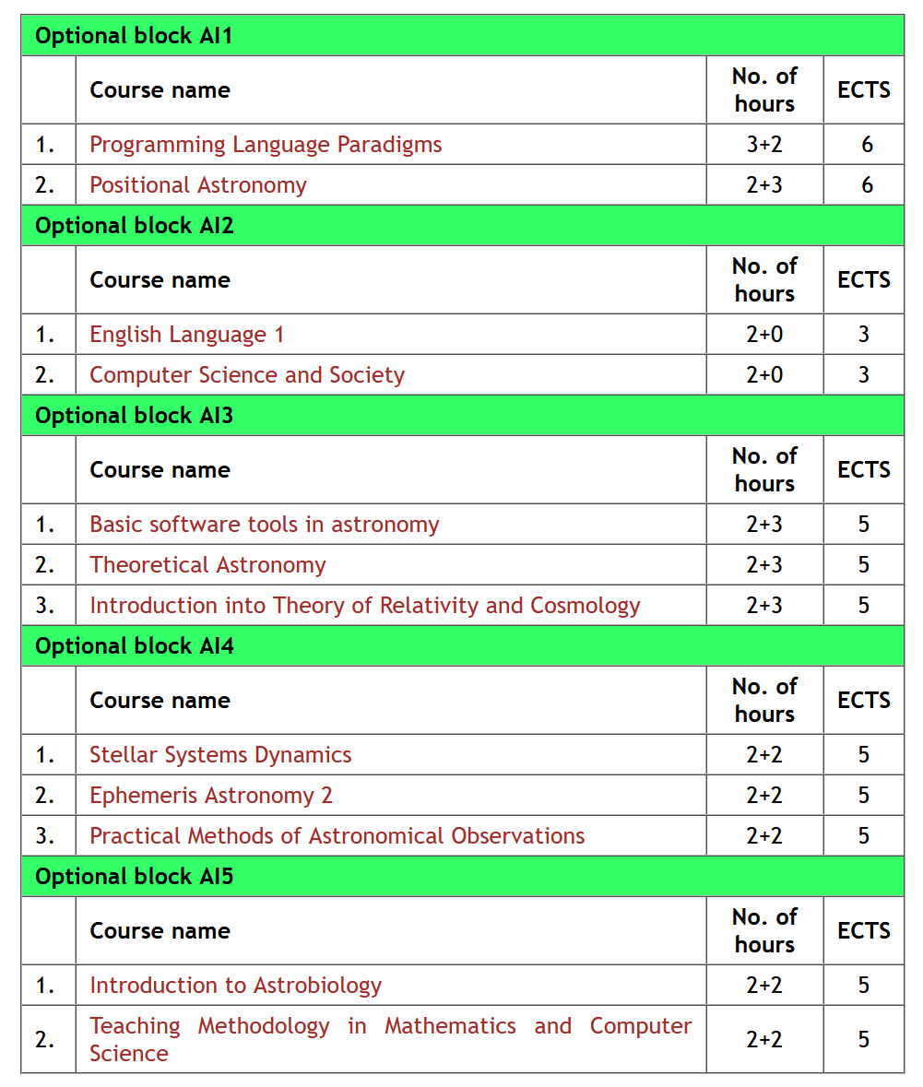
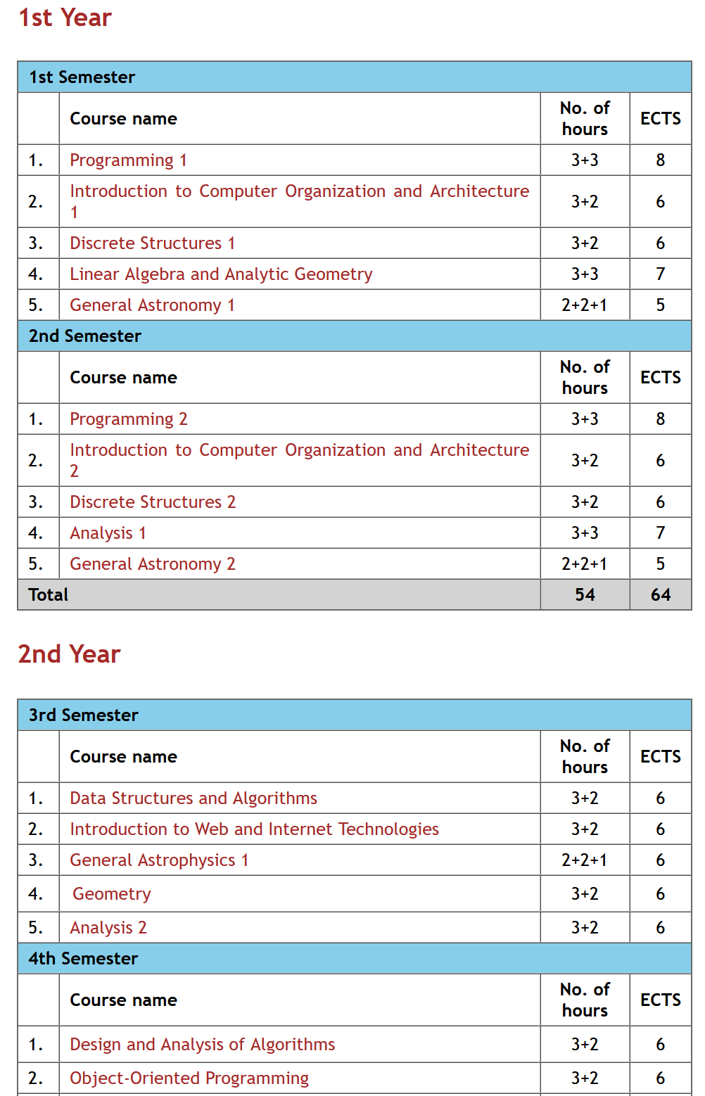
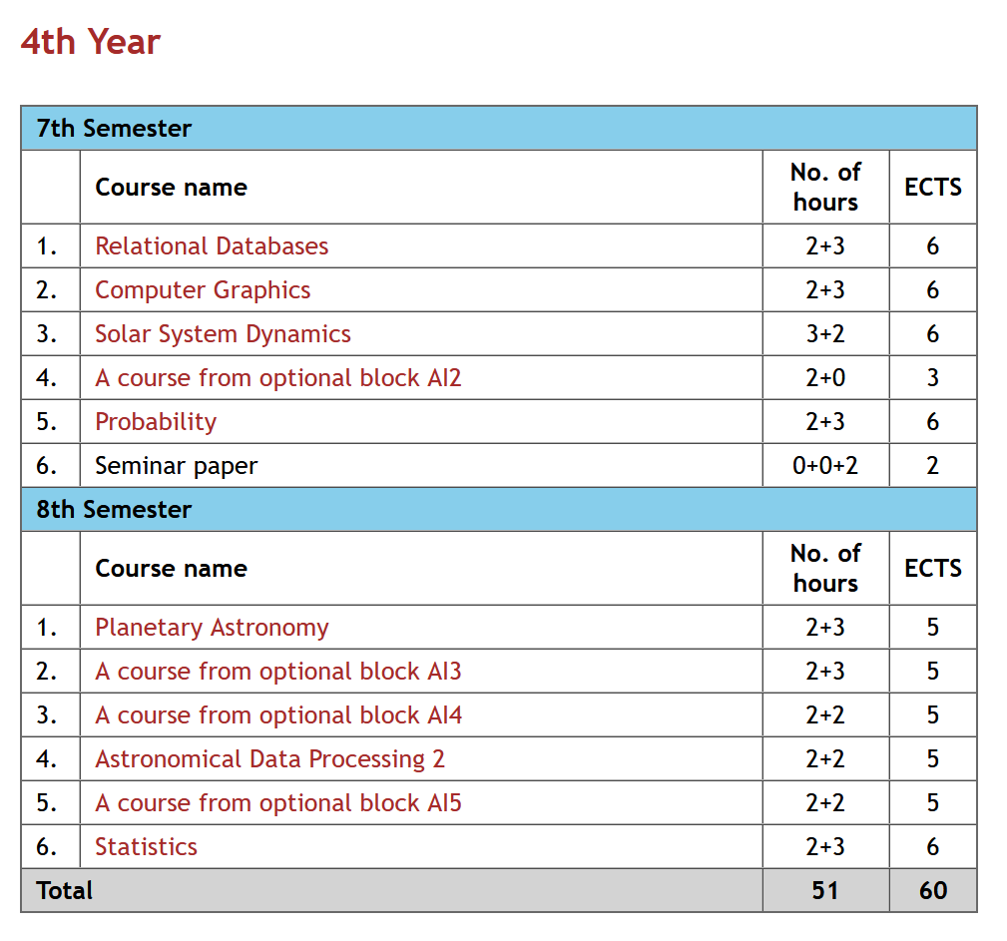
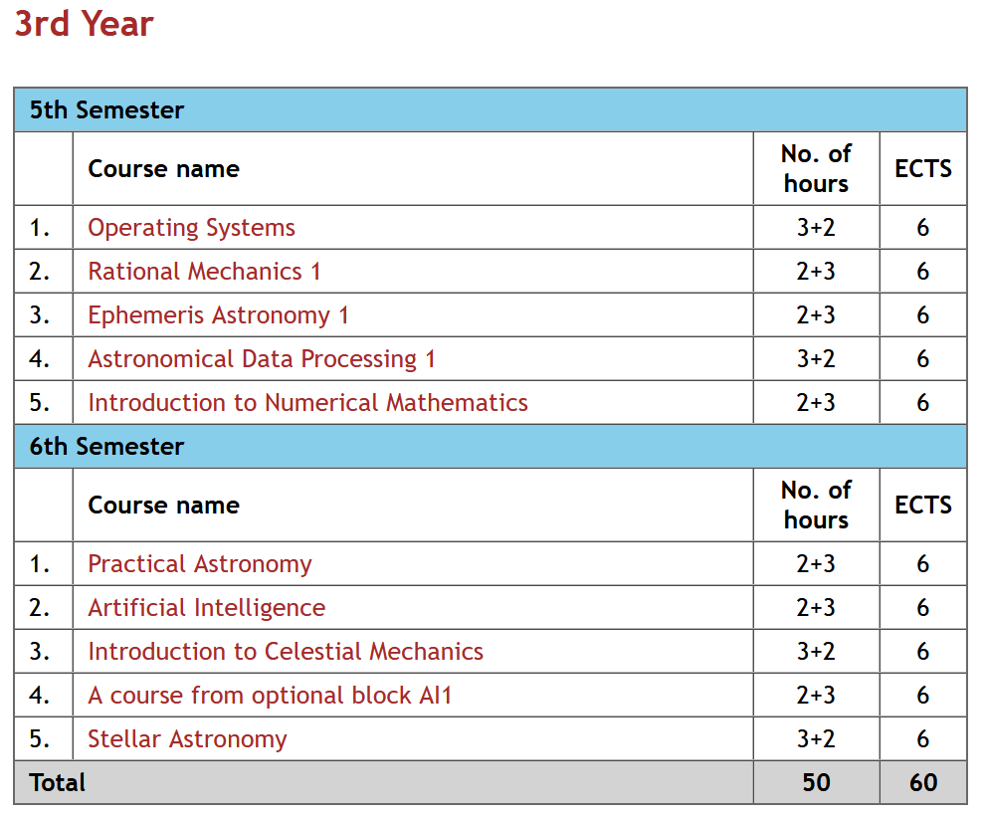
The studies last 4 years and have the extent of 240 ECTS
This Study Program became active since the 2015/16. school year
http://www.matf.bg.ac.rs/eng/cp/33/bachelor-studies---astronomy-and-astrophysics-p--module-astroinformatics--p-/

Slide 25
Tutors: Massimo Brescia and Stefano Cavuoti
The course of Astroinformatics of the Master's Degree in Physics of the University Federico II, is the first course of Astroinformatics in Europe and will address the methodological and technological challenges posed by the scientific exploitation of massive data sets produced by the new generation of telescopes and observatories. Astronomy, which already was at the forefront of Big Data science with exponentially growing data volumes and data rates, is now entering the petascale regime at optical, infrared and radio wavelengths. Astronomy is truly becoming data-driven in the ways that are both quantitatively and qualitatively different from the past. The data structures are not simple, and the procedures to gain astrophysical insights are not obvious, but the informational content of the modern data sets is so high that archival research and data mining are not merely profitable, but practically obligatory, since researchers who obtain the data can only extract a small fraction of the science that is enabled by it.
The Course gives 8 credits but is also included into the PhD curriculum in Physics of the University Federico II.
http://dame.oacn.inaf.it/astroinformatics.html

Slide 26
https://github.com/phuijse/courses_notebooks

Slide 27
XXX Canary Islands Winter School of Astrophysics
The primary aim of this XXX Winter School is to educate the next generation of astronomers in analysis techniques that can be used to digest the gigantic amounts of data that will be produced by the next generation of telescopes and surveys.
The eBook contains a summary with the contents given by each one of the lectures (named as Lectures notes), followed by the recorded talks (Lecture #) and the slides used for them (Lecture slides). References, tutorials, and suggestions for additional reading are also included.
http://research.iac.es/winterschool/2018/pages/book-ws2018.php

Slide 28
A brief summary before the Special Epilogue
Virtual Observatory (VO) and IVOA
Resources for VO
IVOA website and wiki pages
Curriculums and Tutorials
Schools, Meetings and Workshops
Resources for Astroinformatics

Slide 29
Collaboration between IVOA and IAU OAD
Both the OAD and IVOA have ongoing projects of astronomical education and public outreach and realize that astronomical data and technology have the potential to be applied in various fields to benefit society.
Purpose of the collaboration
Both the OAD and IVOA are motivated to use astronomical data for education, development and public outreach. The purpose of this collaboration is to bring together the complementary resources and expertise of IVOA and of the OAD to advance the application of astronomical data and technology use in different areas of society.
Initial pilot activities
The development of a blended-learning Masters course in Astrophysics for universities based in Southern Africa. This pilot initiative could later be expanded to other regions.
Astronomy for development and education activities, for example the Shristi Astronomy Project , run virtually from India, which trains students on using archival astronomy data for discoveries.
Data driven citizen science projects, for example Worldwide Telescope (WWT) guided tour contest.
Notes:
The purpose of this collaboration is to bring together the global resources and expertise to advance the application of astronomical data and technology use in different areas of society.

Slide 30
Worldwide Telescope Tour Contest
“A tool for showcasing astronomical data and knowledge.”
A public version of Virtual Observatory
A research data visualization tool
A 4D Solar System simulator
A data-driven educational environment
A reusable Web toolkit
A Windows application for high end work
WWT Tours, are scripted, multimedia experiences that guide the viewer through WWT’s simulated universe.
Creating and sharing tour is a typical STEM education process.
WWT tour creating contests
4 times in China
1 time in US
https://pretalx.adass2021.ac.za/adass-xxxi-2021/talk/9TTUAX/
2021-10-25, 21:00–21:30, Grand Ballroom
Interactively Visualizing Massive Images and Catalogs in Jupyter with AAS WorldWide Telescope (Peter K. G. Williams)

Slide 31
The 1st International WWT Tour Contest
https://contest.worldwidetelescope.org/
Looking forward to your contributions to the VO teaching resources and participation of the contest

