Slide 1
Euclid Big Data Challenges
J. Salgado**
on behalf of
B. Altieri*, S. Nieto**, P. de Teodoro**, E. Racero**, F. Giordano**, V. Navarro***, R. Alvarez***, B. Merín***, C. Arviset***, E. Valentjin****
*Euclid Archive Scientist **ESDC Team@ESAC ***ESA RuG, Groningen ****

Slide 2
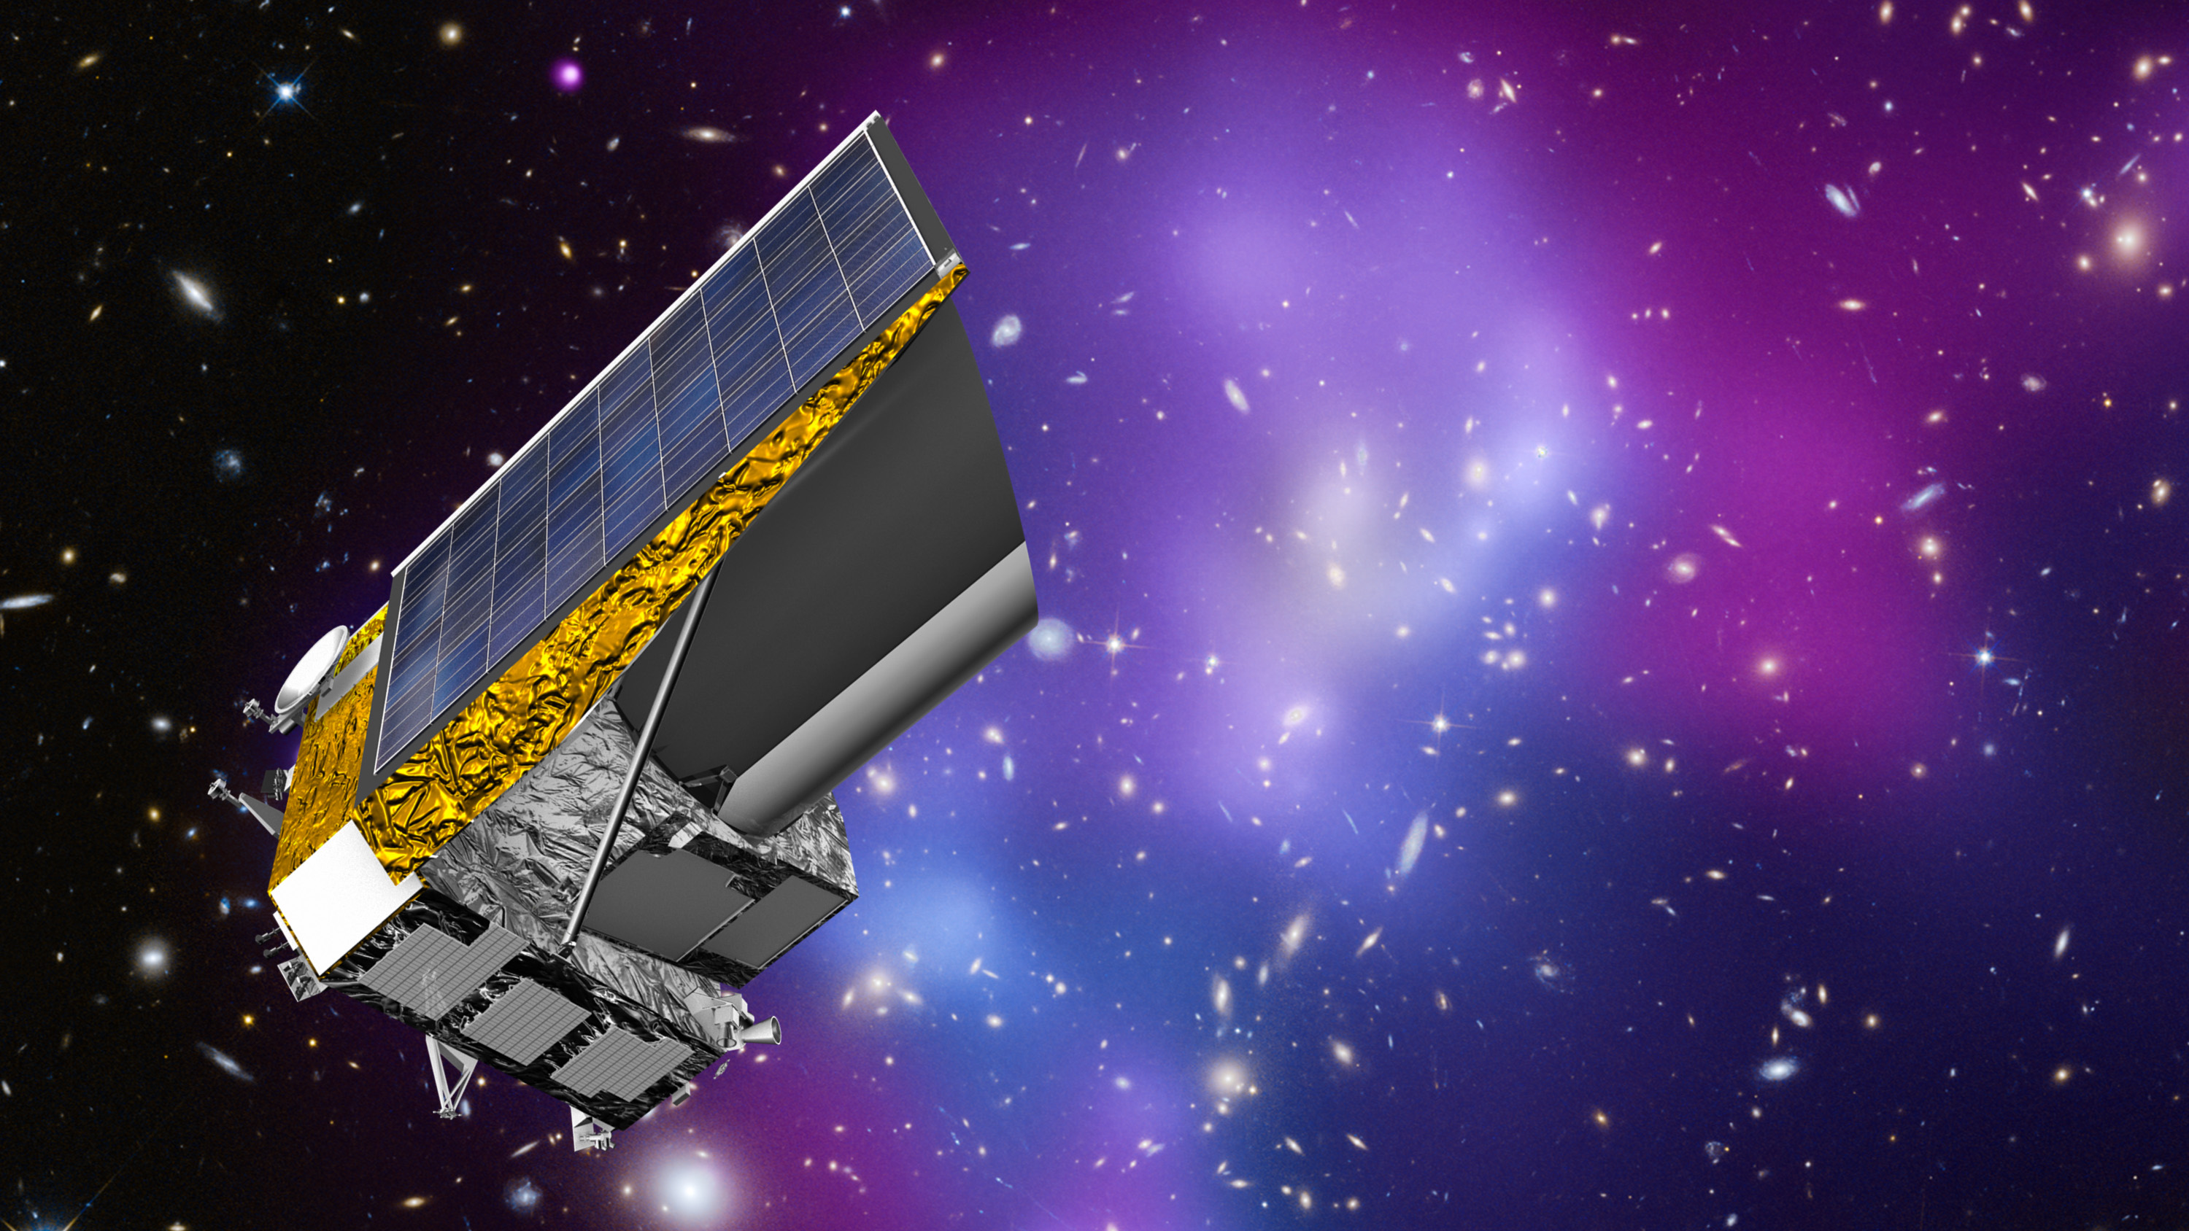
Euclid Mission
1.2m telescope, L2 orbit
5.5 years mission duration
Map the sky in 1 optical band, 3 NIR bands and NIR slit-less spectroscopy
Launch in Q4 2022
ESA is responsible for the mission.
The Euclid Consortium will supply ESA with the instruments and most of the SGS.
Euclid Consortium & Other teams
15 countries, 130 institutes,
1300 consortium members and
700 scientists
Ordinary Matter
5%
Dark Matter
26%
Dark Energy
69%

Slide 3
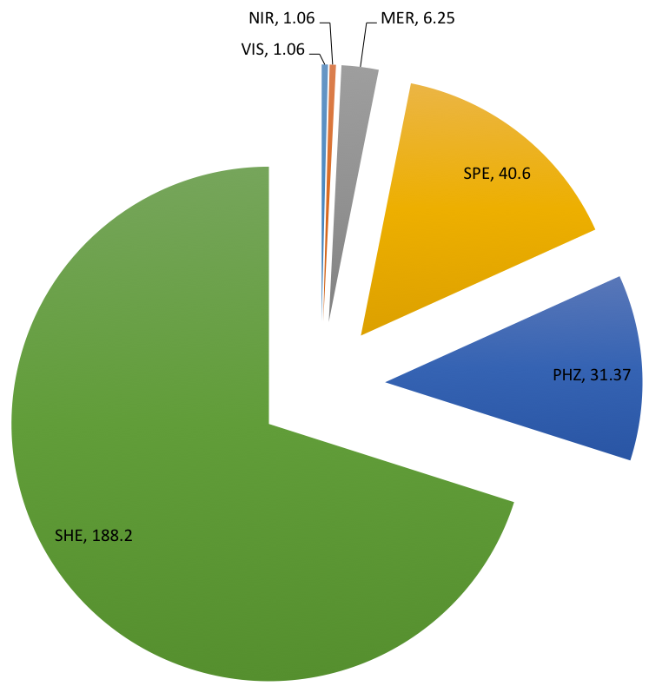
Euclid DR Estimations
~45000 observations in 6 years mission
Wide survey (15000 deg2)
Catalogue: ~268TB
VIS, NIR, MER (merging of all the level 2): 8.4TB
SPE (spectroscopic redshifts) columns: 40.6TB
PHZ (photometric redshifts) columns: 31.4TB
SHE (shape measurements) columns: 188TB
VIS and NIR imaging: ~3.5PB
VIS (visible imaging): 3PB (570TB per year)
NIR (near-infrared imaging) 0.5PB (90TB per year)
Spectra: 3.22PB (600TB per year)
Other archive products, HiPS maps: 0.5PB*
Excluded external catalogues: DES, KiDS, etc.
Deep survey (40 deg2 and 2 times deeper than WS)
External data: Pan-STARRS 1PB, LSST 2PB (France SPC)

Slide 4
EAS Metadata Centric Approach
EAS acts as interface between all ground system components
Metadata is centrally stored
EAS metadata contains all information except images/spectra
EAS data distributed across SDCs
EAS stores dependencies of data products
Avoid unnecessary reprocessing
Data provenance ensured
SOC will also host a DSS
Data Processing System
(EAS-DPS)
Science Archive System
(EAS-SAS)
Distributed Storage System at SDCs
(EAS-DSS)
Computing
facilities
SDC-US
Computing
facilities
SDC-FR
Computing
facilities
SDC-ES
Data files
storage
Data files
storage
Data files
storage
Computing
facilities
SDC-NL
Computing
facilities
SDC-DE
Computing
facilities
SDC-UK
Data files
storage
Data files
storage
Data files
storage
Computing
facilities
SDC-IT
Computing
facilities
SDC-CH
Computing
facilities
SDC-FI
Data files
storage
Data files
storage
Data files
storage
Notes:
File location in metadata provides a global “file system”
DSS server installed at each SDC provides data access to data at that SDC to other SDCs.
No constraint on storage or file system on storage nodes
DSS server supports the access of data in SDCs using different protocols
sftp, https, gridftp, Astro-Wise dataserver, IRods
Simple interface: store, retrieve, copy, delete, check
Extended interface: cut-out services
Adaptable to new or existing storage solutions at SDCs

Slide 5
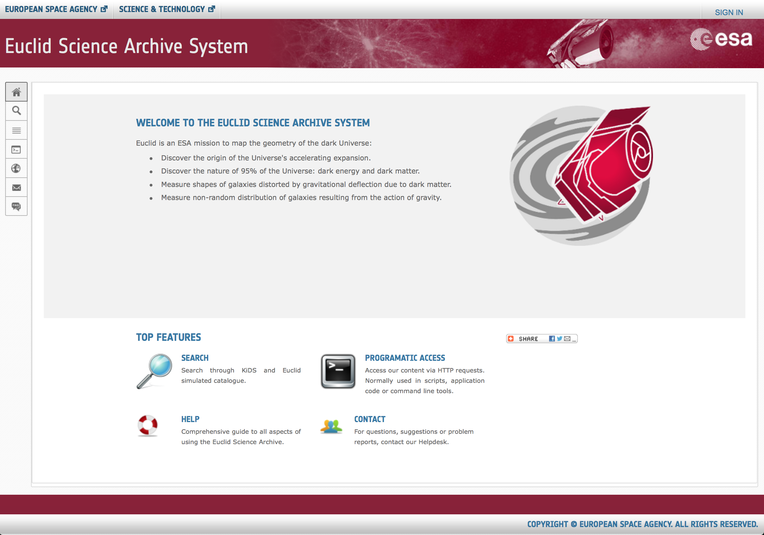
Euclid Scientific Archive System

Slide 6
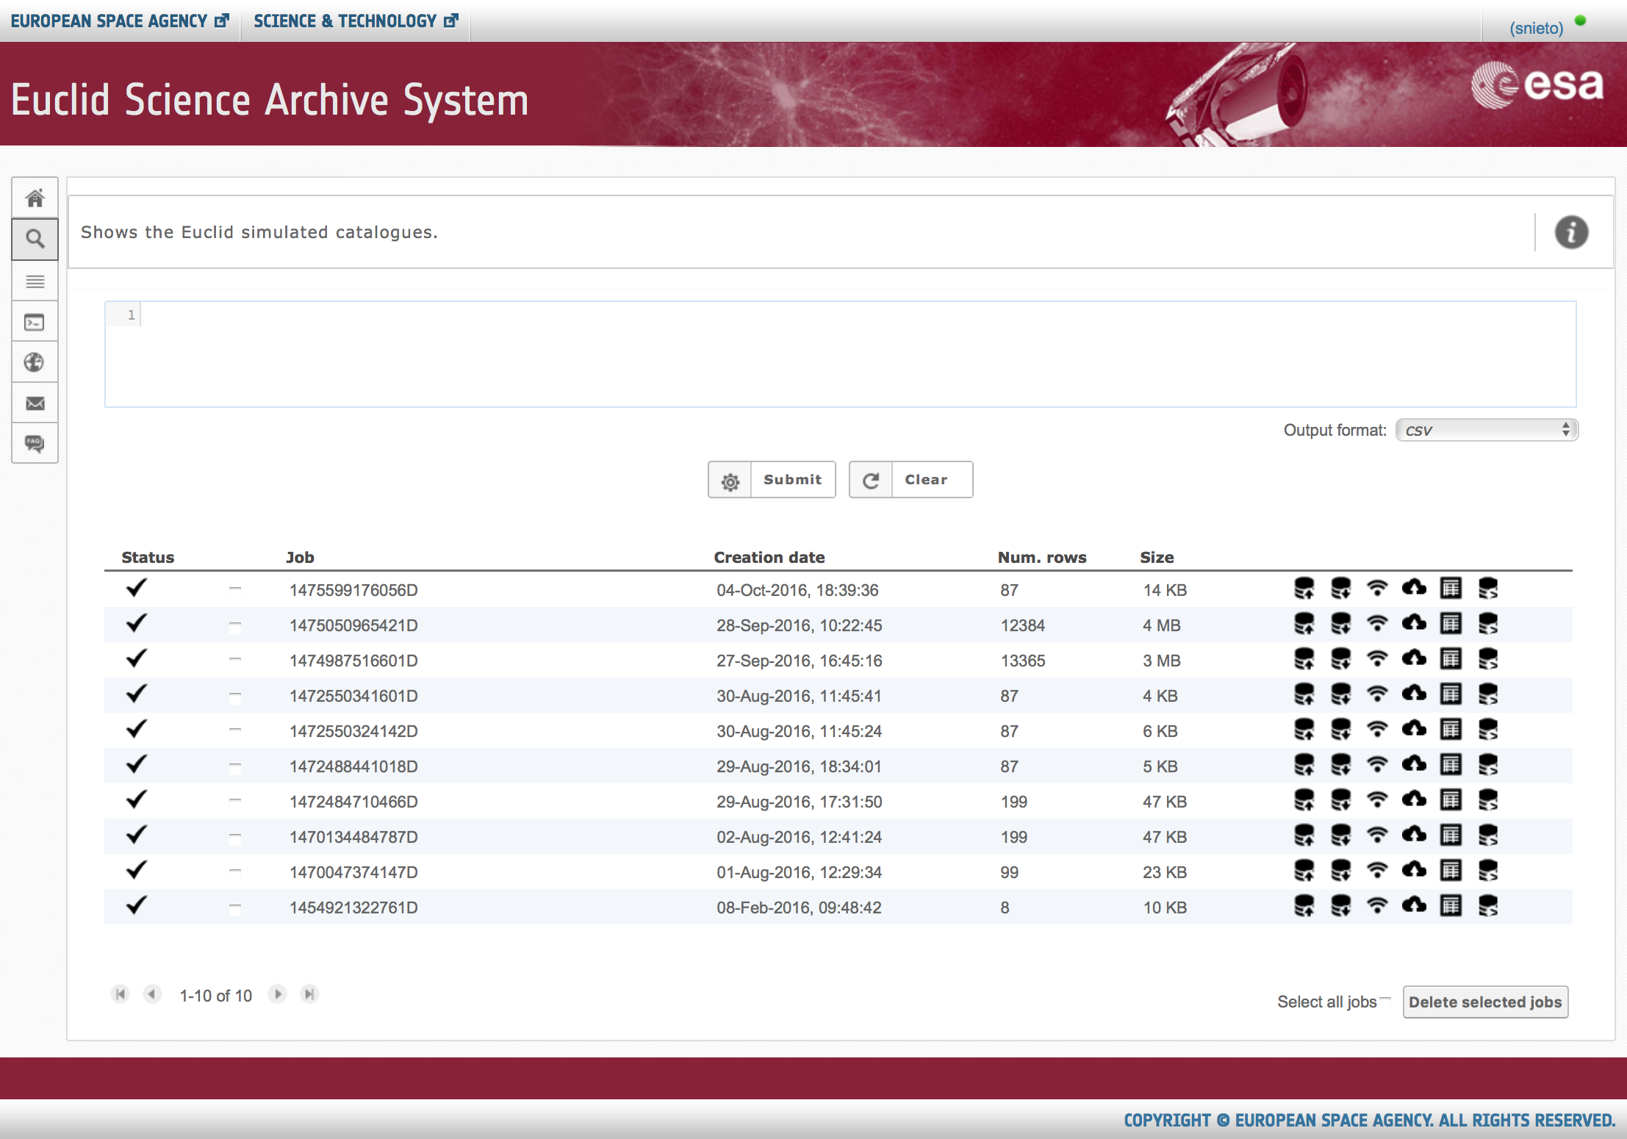
Euclid Scientific Archive System
Reuse of Gaia archive expertise
IVOA protocols: TAP+ Interface, UWS Job management
Main interface for protocols

Slide 7
Greenplum Architecture

Slide 8
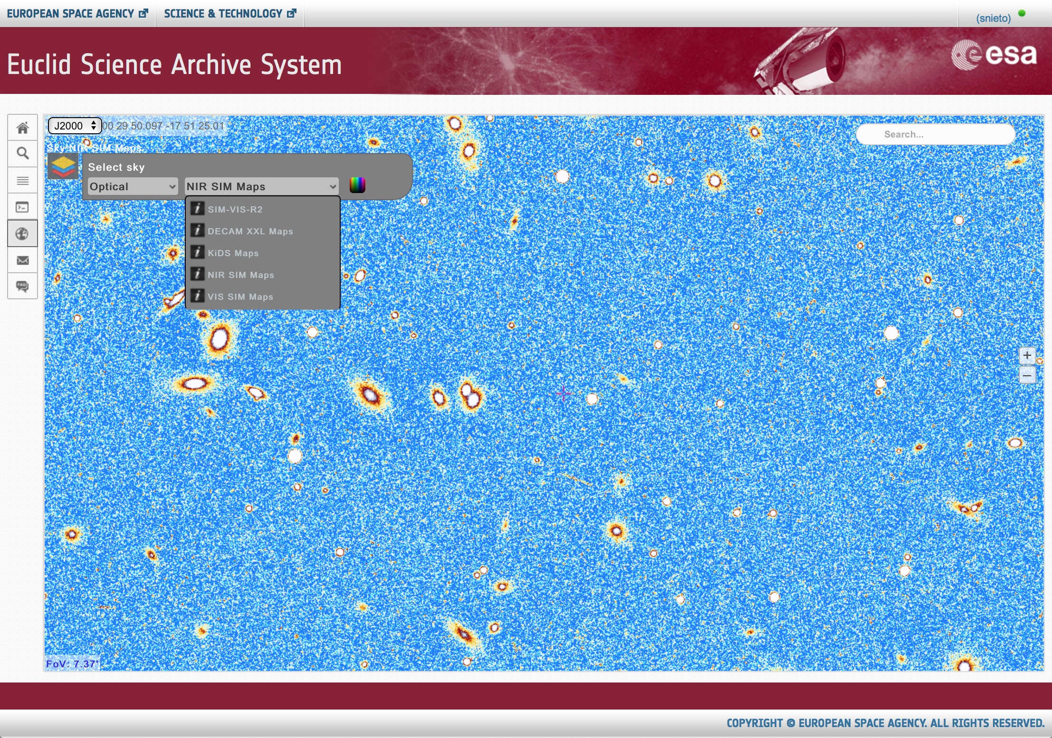
Euclid Scientific Archive System
Visual exploration capabilities for Euclid images
Based on ESASky technology (CDS Aladin Lite)
Map selector and search target capabilities
Future tools to work online: spectra tools, catalogues overlay, etc.

Slide 9
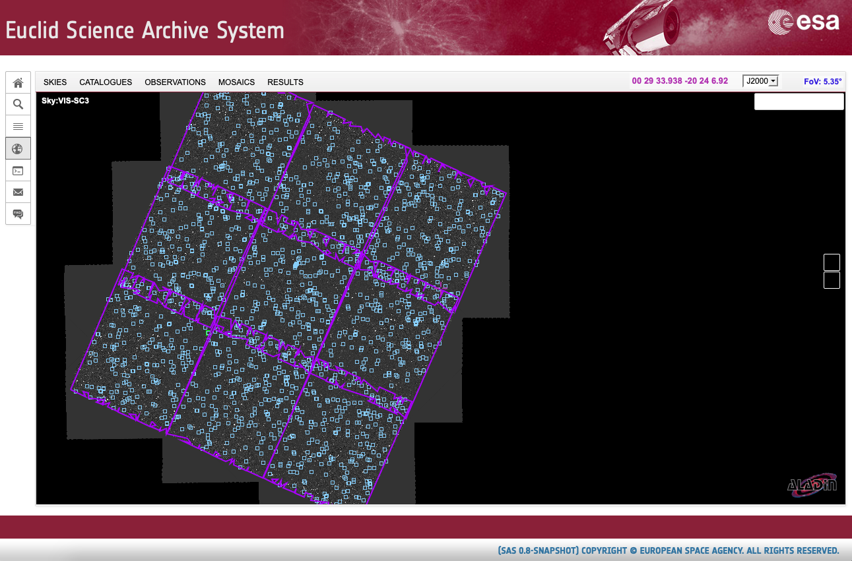
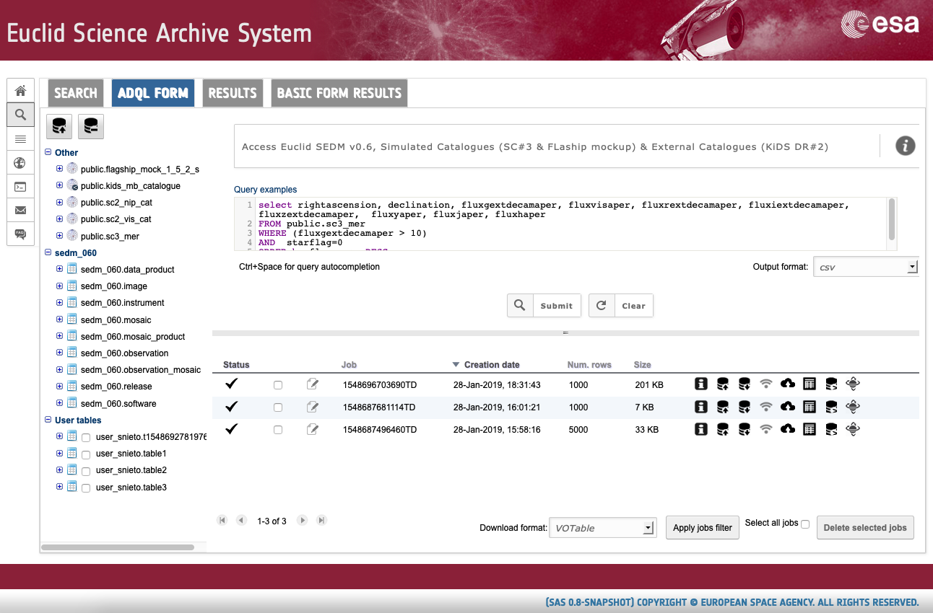
SAS v0.8.3

Slide 10
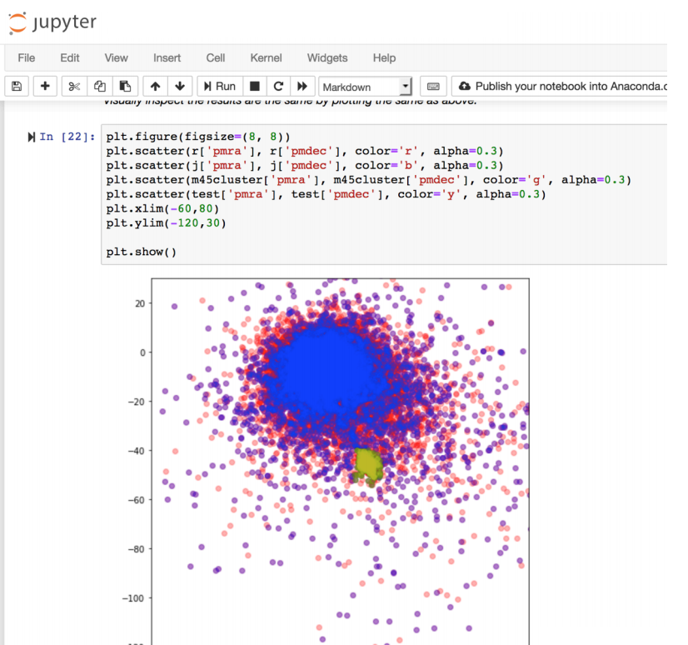
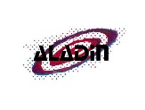
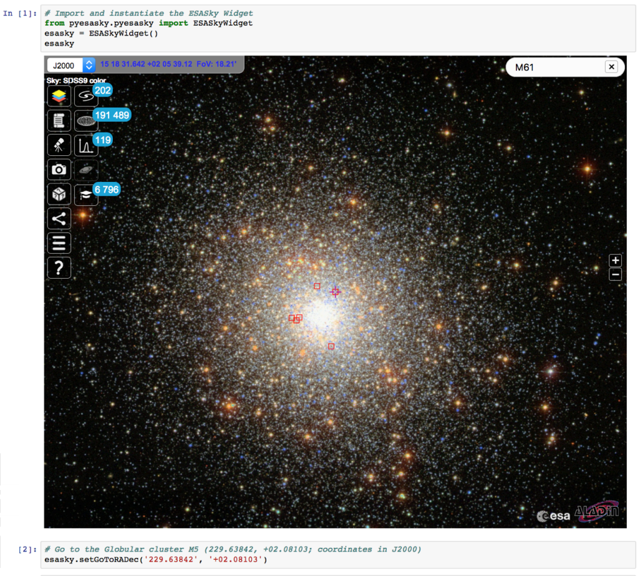
Move code to the data: SEPP (Science Exploitation and Preservation Platform)
Portal
Desktop
Apps
Discovery
Analysis
Workspace
Pipeline
Integration
Data
Application
Interoperability
Storage Infrastructure
Test
System Engineering
Computing Infrastructure
User Management
Logging & Monitoring
Registry
Resource Management

Slide 11
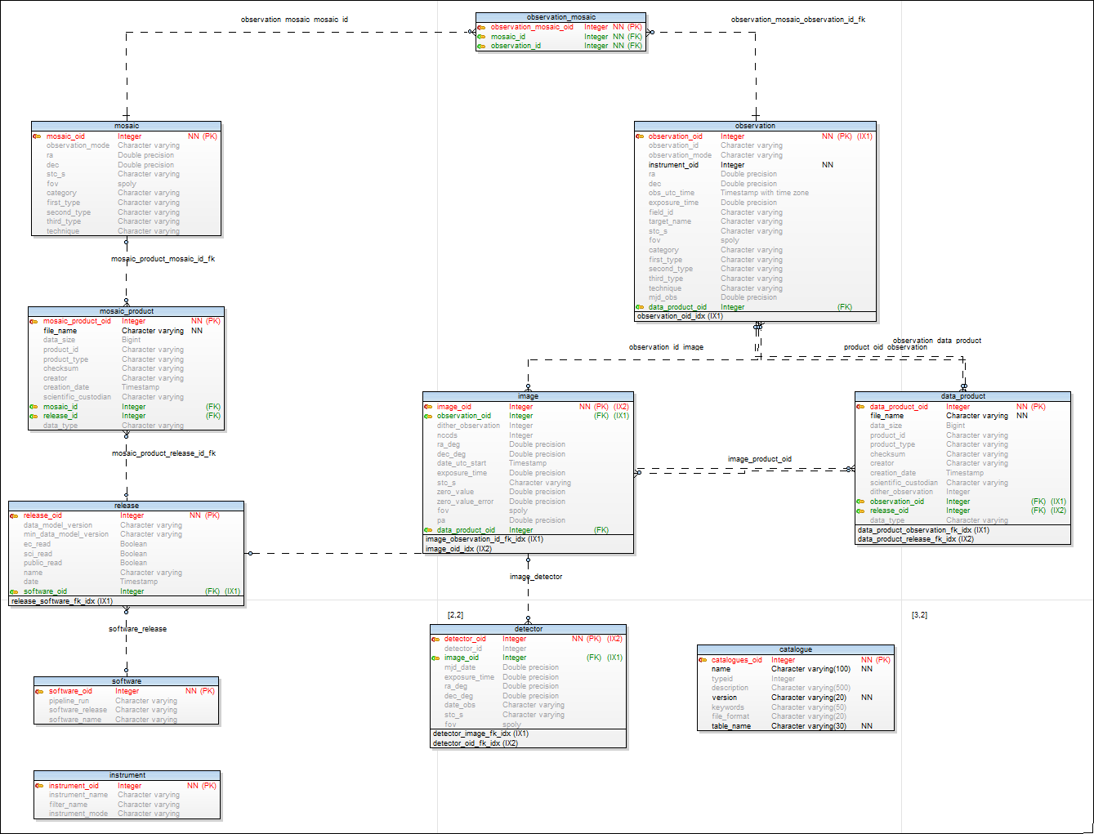
IVOA Standards in Euclid SAS
SEDM (Science Exploitation Data Model) based on VODM Standards:
ObsCore DM
Provenance DM
TAP+ (Table Access Protocol)
ADQL (Astronomical Data Query Lang.)
UWS (Universal Worker Service)
VOSpace (Virtual Observatory space)
HiPS (Hierarchical Progressive Survey)
SAMP (Simple Application Messaging Prot.)
SIAP (Simple Image Access Prot.)
DataLink
Source Data Model?

Slide 12
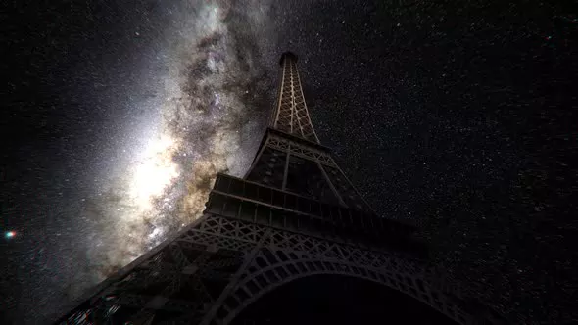
Questions
Thanks!

Slide 13
SAS DR#3 Estimations
VIS (65GB per field) x 109 fields = 7 TB
NIR 3 bands (22GB per field) x 109 fields = 2.34TB
MER Catalogue (300K sources in 9 fields) x 109 fields = 3.6M rows
MER tiles (358 tiles) for VIS and NIR = 5TB
SPE output is : 4,56 GB per Euclid Observation = 497GB
SHE output is : 26,4 GB per Euclid Observation = 2.8TB
EXT LSST is : 120 GB per Euclid Observation = 12.77TB
PHZ : 4,4 GB per Euclid Observation = 480GB
HiPSmaps for VIR and NIR: 2.5TB
Total ~35TB

Slide 14
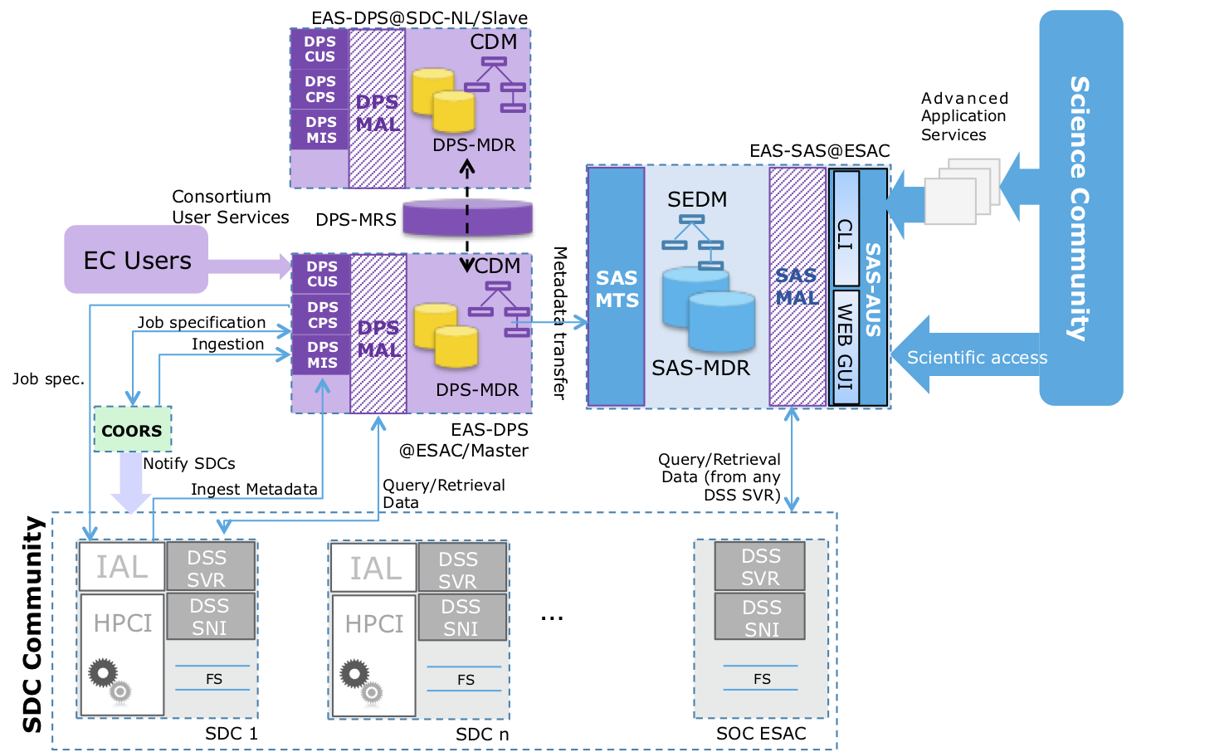
SGS and EAS Overall Architecture
SAS Components:
SAS-MAL: Metadata Access Service
SAS-MDR: Metadata Repository
SAS-MTS: Metadata Transfer Service
SAS-AUS: Archive User Services
SAS-CLI: Command Line Interface
SAS-GUI: Graphical User Interface
SEDM: Science Exploitation Data Model

Slide 15
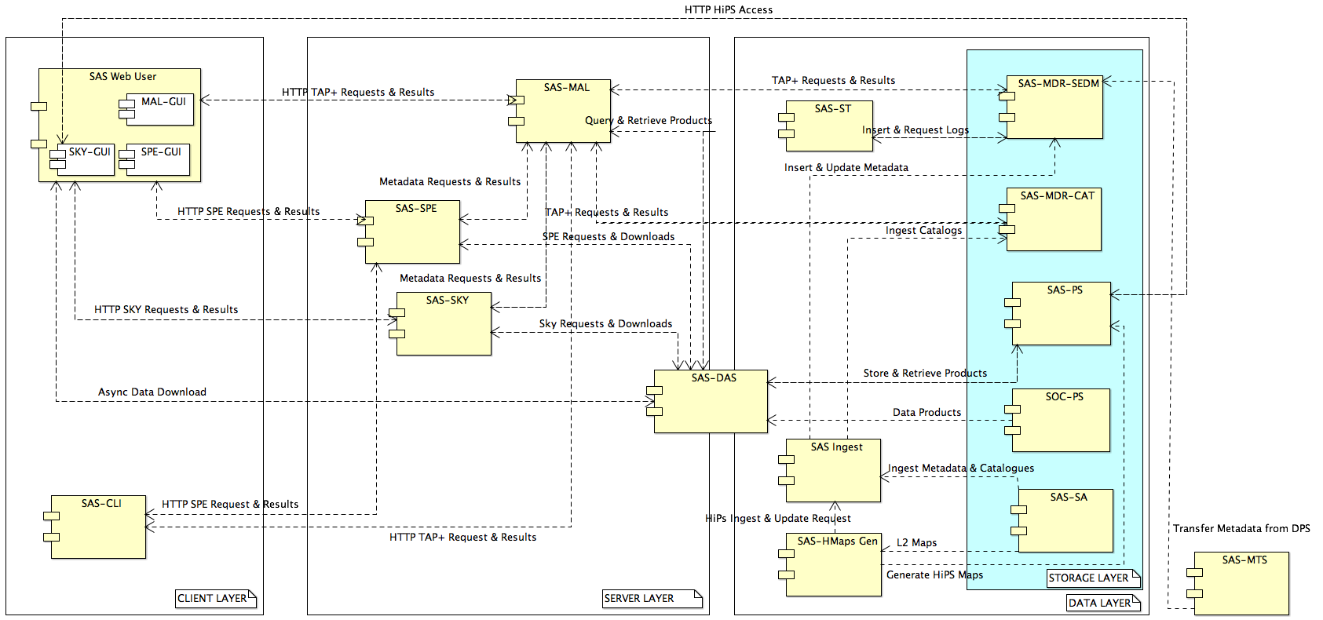
SAS Component Diagram
Notes:
CLIENT LAYER:
MAL-GUI: Metadata Access Layer Graphical User Interface
SKY-GUI: Sky Graphical User Interface
SPE-GUI: Spectra Graphical User Interface
SAS-CLI: Command Line Interface
SERVER LAYER:
SAS-MAL: SAS Metadata Access Layer
SAS-SPE: SAS Spectra
SAS-SKY: SAS Sky
SAS-DAS: Data Access Service
DATA LAYER:
SAS-ST: SAS Statistics
SAS-INGEST: SAS Ingest
SAS-Hmaps Gen: HiPS Maps Generator
SAS-MDR-SEDM: Metadata Access Layer for SEDM
SAS-MDR-CAT: Metadata Access Layer for Catalogues
SAS-PS: SAS Product Storage
SAS-SA: SAS Storage Area
SAS-MTS: SAS Metadata Transfer Layer

Slide 16
SAS Ingestion
R-EAS-M-032 : EAS-DPS and EAS-SAS shall interact via Metadata Transfer System between EAS-DPS and EAS-SAS to support production of public release of the data by the date specified in the Science Management Plan and derived documents from ESA Project Scientist.
Ingestion targets:
Ingestion of catalogues from FITS files
SEDM ingestion module from XML and FITS files
VIS, NIR and MER: Raw Frames, Calibrated Frames, Stacked Frames, MER Tiles
Spectra
Catalogues from MER on

Slide 17
Euclid SAS v0.8 (Feb. 2019)
Current version v0.8.2:
Ingestion of SC3 L2 data: Maps, Catalogue and Intermediate products
Simulated catalogue of 2.7 Billion sources (30% of the final catalogue)
KiDS DR#3 data of ~50M sources
Catalogue searches similar to Gaia archive (TAP+ with ADQL)
Products download
Sky exploration:
Maps visualization
Overlay of Catalogues and Query results
Footprints overlay for Observations and Mosaics
GreenPlum MPP database used as backend superseding Postgres-XL
On-going projects: Spark PoC for massive catalogue/images exploitation

Slide 18
SAS v0.9 (by May 2019)
Official participation in SC456 challenge; Ingestion of SC456 and EXT (DES and KiDS) products; new SEDM compliant with ECDM v1.8.3; Cut-out service on FITS MER tiles; Merge of Catalogue form and TAP form in GUI; A&A layer to all SAS interfaces.
Data Processing System (DPS) planned work: Maintenance of DPS services for ingestion, query, processing and data retrieval (DSS); Maintenance of Oracle databases and infrastructure; Support for testing; Participation in SC456 as Master@ESAC

