Slide 1

Square Kilometre Array Regional Centres
Séverin Gaudet
CADC
Canadian SKA Regional Centre
Rosie Bolton
SKAO
SKA Regional Centre Project Scientist
Exploring the Universe with the world’s largest radio telescope
Notes:
Slides from Michael Wise (formerly ASTRON PI of AENEAS) and Bryan Gaensler (former Science Director, SKA Canada)

Slide 2
The Square Kilometre Array
Vision: world’s most powerful radio telescope
2019: Final baseline design for SKA1 (first ∼10%)
2024: Start of commissioning
2028: Full operations
Members
Australia
Canada
China
France
Germany
India
Italy
Netherlands
New Zealand
South Africa
Spain
Sweden
United Kingdom
Potential members
Portugal
Switzerland

Slide 3
Distributed Operations
?
SDP Baseline Design:
Requirement to support IVOA protocols
Produce basic data products (calibrated images)
No user services at the SDP

Slide 4
Distributed Operations
SDP Baseline Design:
Requirement to support IVOA protocols
Produce basic data products (calibrated images)
No user services at the SDP

Slide 5
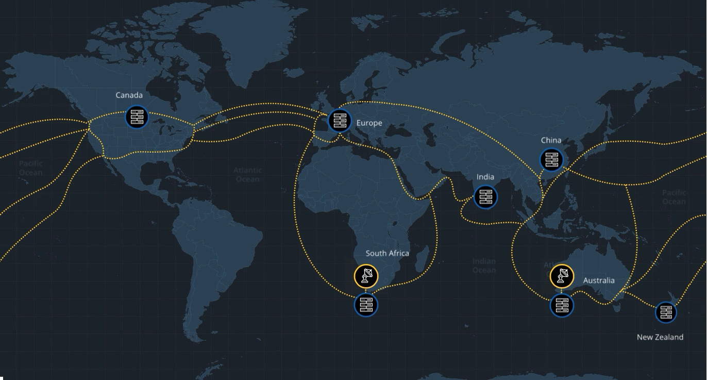
Network of Interoperating SRCs

Slide 6
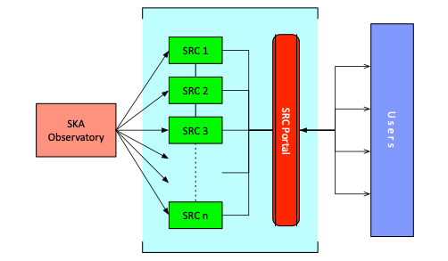
SKA Regional Centre (SRC)
Host the SKA science archive
Provide access to data products
Provide access to compute
and storage resources
Provide user support
Definition of scope, function resources required and organization recently initiated

Slide 7
SKA Regional Centre (SRC)
Host the SKA science archive
Provide access to data products
Provide access to compute
and storage resources
Provide user support
Definition of scope, function resources required and organization recently initiated
Primary interface for SKA data access and analysis
Required to be VO-compliant

Slide 8


