Slide 1
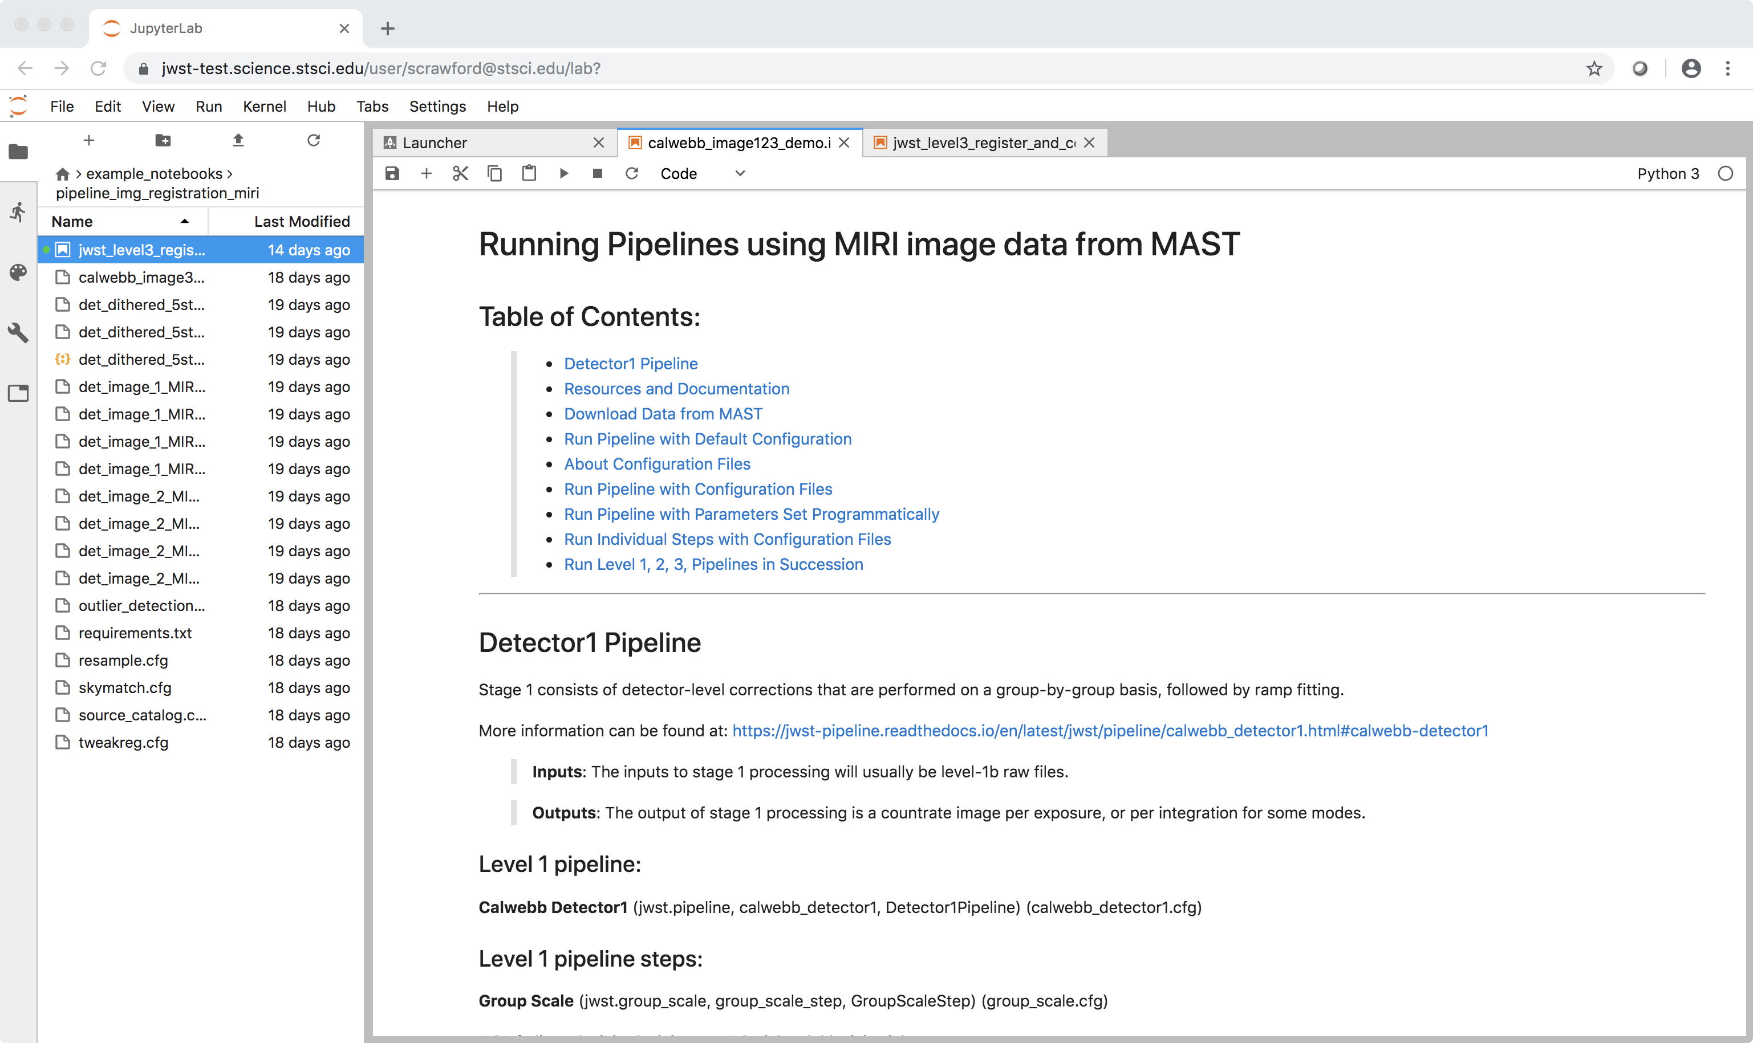
STScI Jupyterhub: a scalable science platform
https://github.com/spacetelescope
https://mast-labs.stsci.io/2019/02/zero-to-jupyterhub-with-ansible

Slide 2
Challenges in the Jupyterhub Environment
Security
How do we secure the environment from external and internal sources?
How do we control exclusive access data in the environment?
Collaboration
How do we provide an environment that enables collaboration while being secure?
Observability
What are the important metrics to monitor?
How do we have real time insight into the system?
Cost
How do we control costs for different users and different use cases?
How do we provide access for different users?
Adoption
As a new tool, how do we introduce it to the community?

