Slide 1
Overview of the CANFAR Science Platform
JJ Kavelaars on behalf of the CADC - CANFAR team

Slide 2
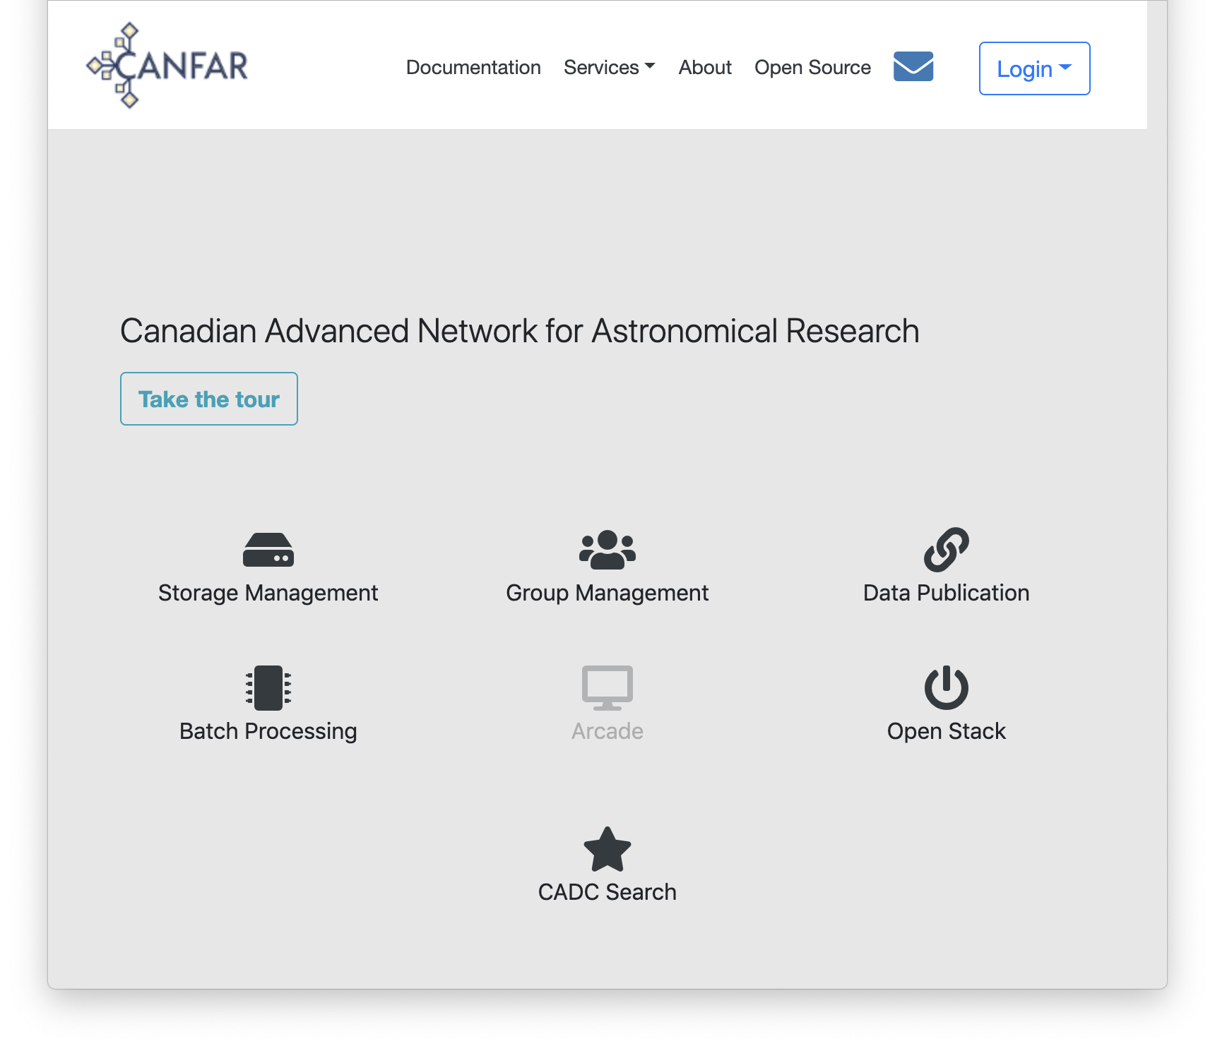
Canadian Advanced Network for Astronomical Research
A science platform:
Data intensive astronomy
Collaboration
Project agnostic
A collection of user services
Group management
User Storage
Interactive and persistent VMs
Batch processing with VMs
DOI service
User databases
Containers as a service
Using research cloud resources from Compute Canada
Operational since 2011!
Notes:
To be used for internal processing as well.
Eat your own dogfood!
Not as efficient
But one software stack
Closer to the user community
VO development driven this way

Slide 3
CANFAR in 2018
Number of user groups | 478
OpenStack users | 186
OpenStack projects | 53
Batch users | 75
Number of files ingested | 10,357,541
TiB ingested | 120
Number of retrievals | 47,559,651
TiB retrieved | 737
Jobs submitted | 6,118,009
Core years used | 1,154
DOIs issued | 16
Authenticated users retrieving | 236
Number of IPs with retrievals | 15,446
Peak retrievals/day | 2,457,618.0
Peak TiB retrievals/day | 60
Peak file ingestion/day | 378,074.0
Peak TiB ingestion/day | 9

Slide 4
CANFAR and IVOA
CANFAR infrastructure built with IVOA standards
Early implementers/adopters to verify standards meet needs
Advocating support for authorisation in all services
ADQL | SSO
CDP | TAP
DALI | TAPRegExt
DataLink | UWS
ObsCore | VODataService
RegistryInterfaces | VOResource
SIA | VOSI
SimpleDALRegExt | VOSpace
SODA | VOTable

Slide 5
Users: client applications, browser-based applications, scripts, tools, etc.
SIA
DOI
VOSpace
DataLink
GMS
CDP
data
SODA
TAP
CAOM Repo
Transfer
VOSpace
Metadata
DB
VOSpace
Metadata
DB
VOSpace
Metadata
DB
VOSpace
Metadata
DB
VOSpace
Metadata
DB
VOSpace
Metadata
DB
VOSpace
Metadata
DB
VOSpace
Metadata
DB
Monitoring (VOSI-1.1)
VOSpace
MD
Group/User
MD
Storage
MD
Catalogs
Observation
MD
CAOM-2.3
ObsCore-1.1
Obs Repo
MD
CAOM-2.3
Test Repo
MD
CAOM-2.3
ObsCore-1.1
Storage
Nagios
Sybase
LDAP389
Sybase
PostgreSQL
PostgreSQL
PostgreSQL
PostgreSQL
AD
Legend
Service API
IVOA Standard
Draft Standard
Private API
CADC
Future Standard
Internal
Off-the-shelf
Notes:
Using CADC == using VO services
TAP services deployed for many databases

Slide 6
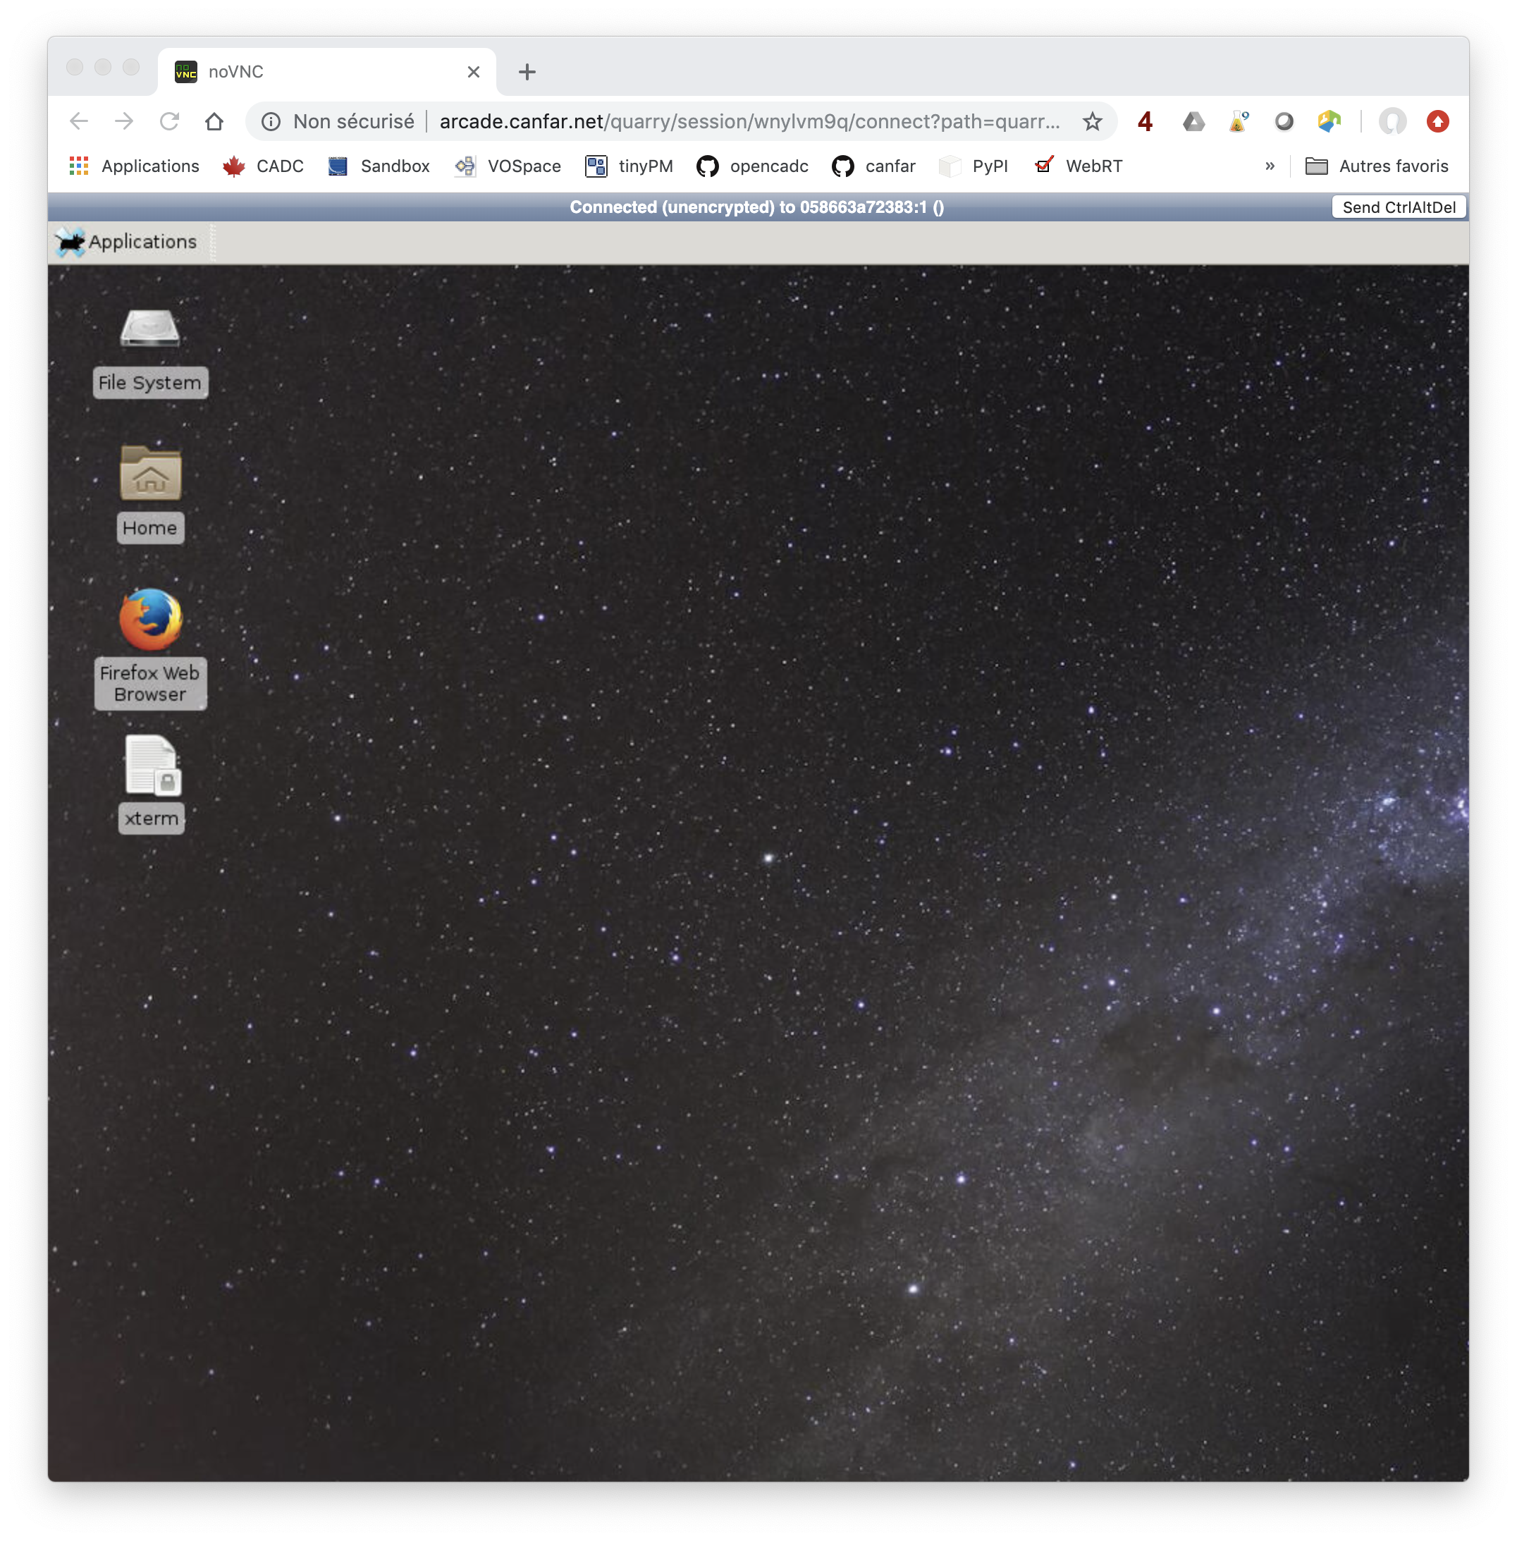
Arcade Prototype
Providing astronomy interactive data processing/analysis modules
Container-based, Kubernetes deployment targeted
Goal:
Inclusion of community curated contrainers
Integration with batch processing
Support for Jupyter notebooks

Slide 7
