Slide 1
SourceDM: Gaia and Euclid requirements
Jesús Salgado
ESAC Science Data Center (ESDC)

Slide 2
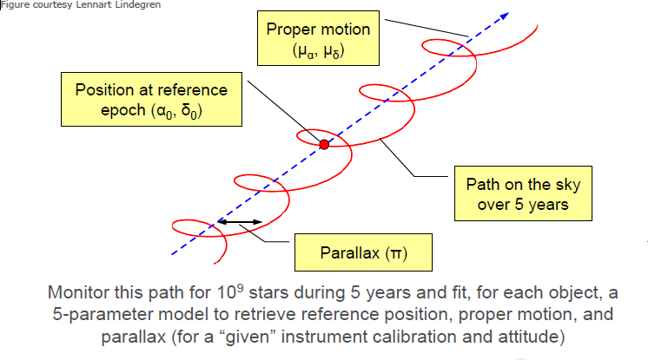
Gaia Catalogue
Jos de Bruijne, 2012

Slide 3
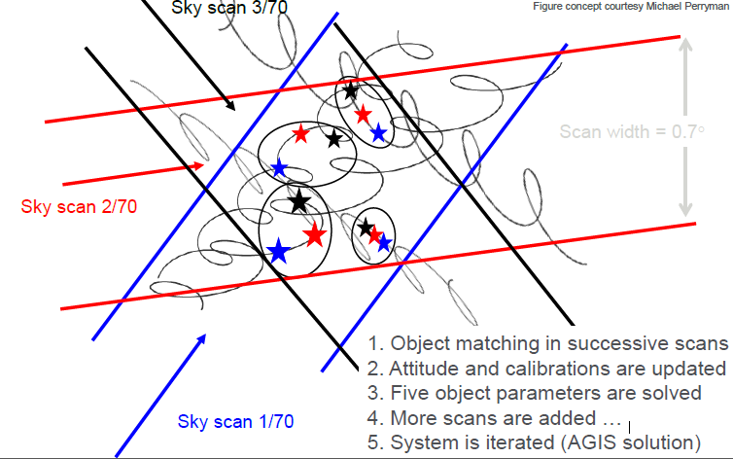
Scans
Jos de Bruijne, 2012

Slide 4
Source DM geometrical Support
STC-2
Attributes for:
Position
Errors
Epoch/Reference frames
Velocities/proper motion
Extended sources (?)
Redshift
Other attributes identified that could be needed
Parallaxes
Correlations

Slide 5
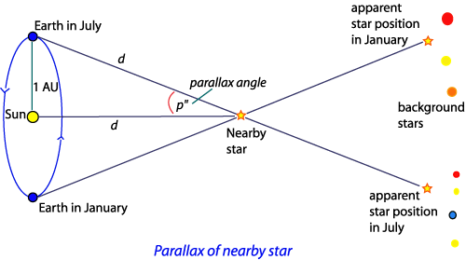
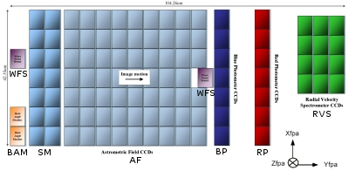
Distances, parallaxes and radial velocity
Distance is a derived quantity. Conversion from parallaxes to distance requires certain assumptions
Parallaxes are preferred as a closer concept to a measurement quantity
Both added to the DM
Radial velocity usually measured due to spectroscopic analysis
Combination of the object radial velocity and cosmological redshifts
Probably, radial velocity (in units of redshift) is better

Slide 6
Positions and proper motion
Positions:
(ra, dec) equatorial coordinates
Different coordinates systems could be (should be?) covered so we should need just to reuse the STC definitions but this produces certain complexities for the velocities
Maybe, this could go as a compulsory/optional depending on the protocol
Support to other coordinates within DM
Epoch
(raError, decError)
Proper motion:
(muRa, muDec)
Proper motion on the two spherical coordinates
Discussions on the projection
(muRaError, muDecError)

Slide 7
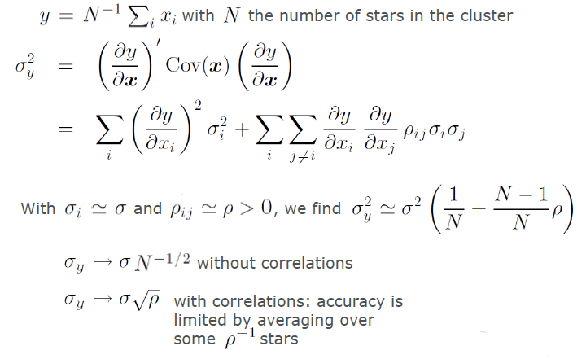
Correlations
Not only errors are needed to understand the accuracy of the astrometric solution. Correlations are also needed.
Holl et at, 2010

Slide 8
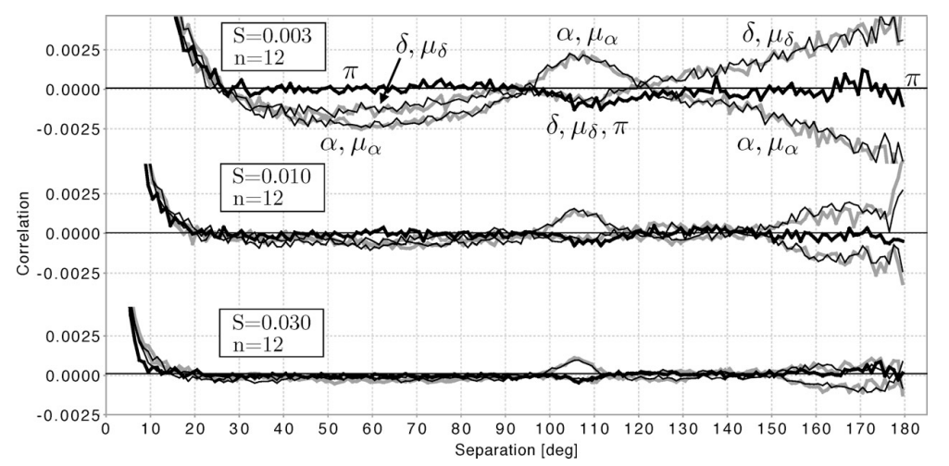
Correlations (III): Gaia simulations
Holl et at, 2010

Slide 9
Luminosities
Most of the catalogues are connected to luminosities through magnitudes/fluxes
Photometric values are usually represented by:
Magnitude value and error
Photometric system description
Zero point
Link to transmission curve
Colours?
Flux values are usually represented by:
Flux value and error
Spectral coverage
Include PhotometryPoint as direct element from PhotometryDM
Spectra and Time Series

Slide 10
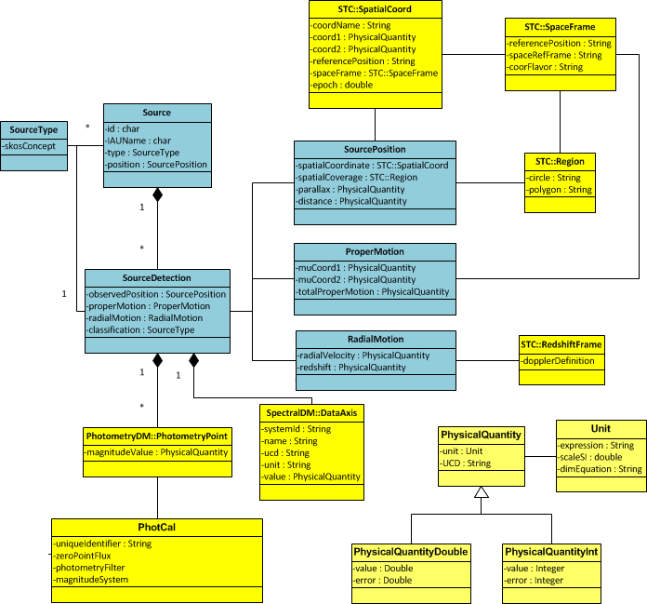

Slide 11
Euclid
Coordinates and errors needed
Epoch and Equinox
Errors in milliseconds
Combined information with Gaia in some cases so, probably, data model could define crossmatch information
No parallaxes or distances expected on Euclid catalogues
Radial velocity will not be provided but
Redshift will be provided for some Galaxies -> DM support needed
Photometry for some bands (Y,J,H) but, also, photometric information from ground based observatories (combination of Euclid and external photometric data)

Slide 12
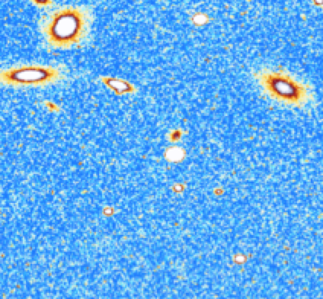
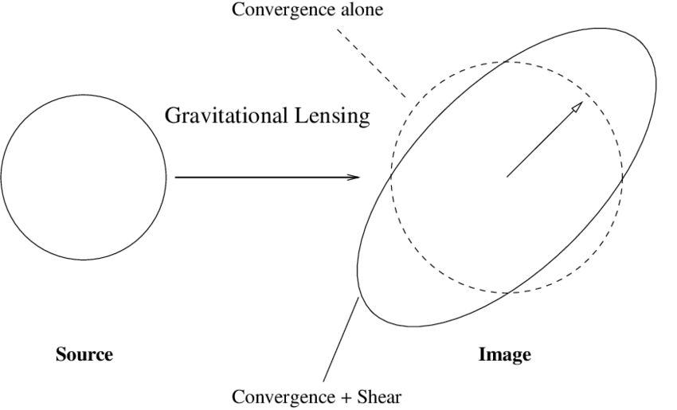
Euclid (II)
Difference on the data model between detection and source:
This is done by OU-MER, there will be one single ID per source/galaxy
Although there will be different detections per source, this is hidden into the Euclid catalogues
For Galaxies, there are going to be quite specific extra metadata
One very important requirements is the accurate description of shapes
Morphology
Photometric redshift

Slide 13
Thanks!

